Slide 1
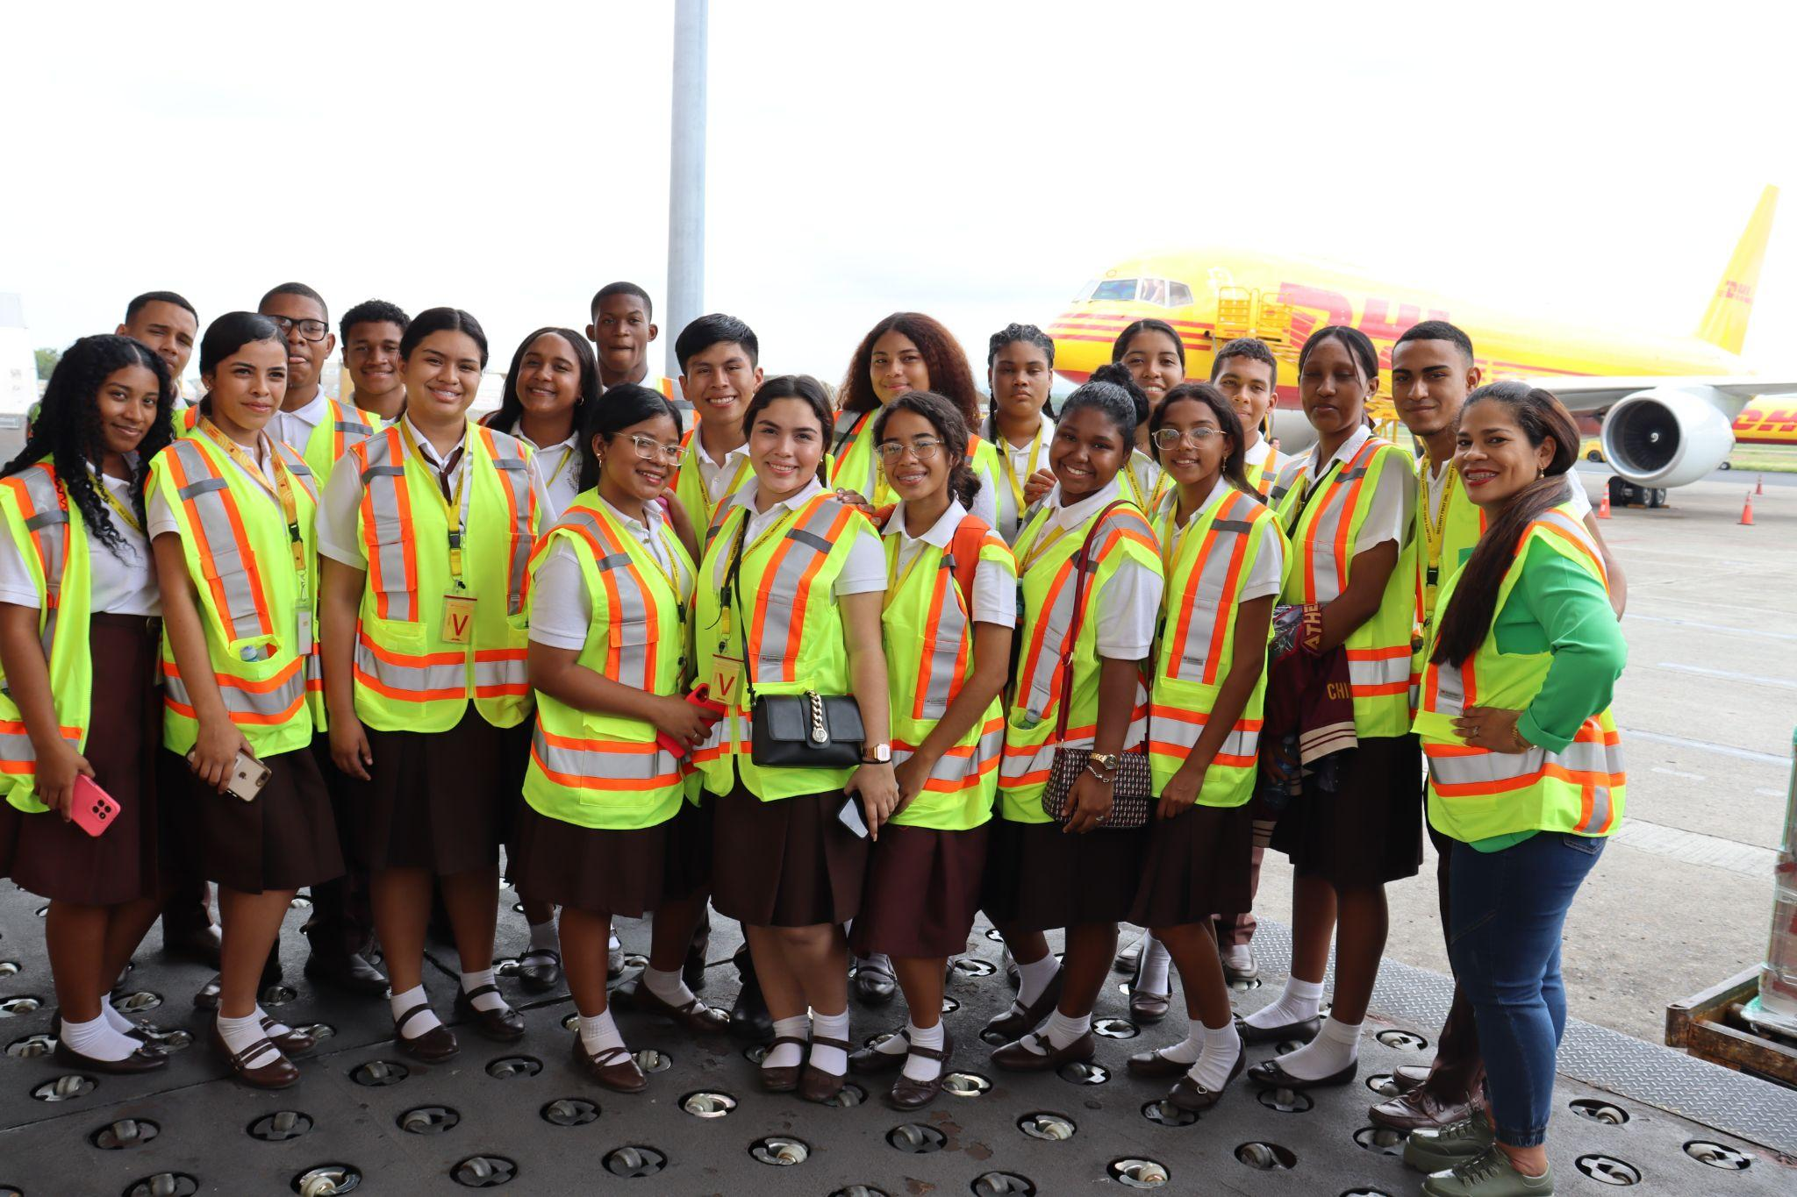

DHL Group & Teach For All
2024 Annual Partnership Report
Empowering all children and youth to thrive and lead in a changing world.

Slide 2
Global Impact

Slide 3
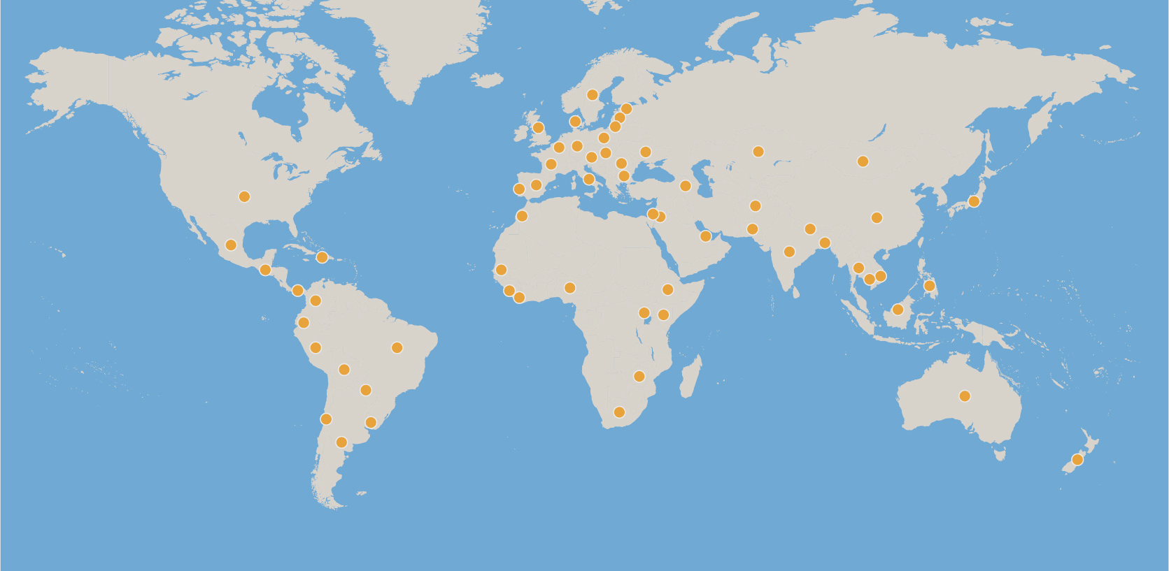
Global Impact
DHL Group’s long-standing partnership for 14 years with Teach For All is building collective leadership to ensure that all children can fulfill their potential
Last year, our network brought in over 7,300 new diverse teacher leaders who, together with their second-year counterparts, impacted more than 1 million children in 62 countries.
62 partners
13,000+
teachers
100,000
alumni
New partners: Enseña por Guatemala, Teach For Mongolia, Teach For Palestine, Teach For Qazaqstan

Slide 4
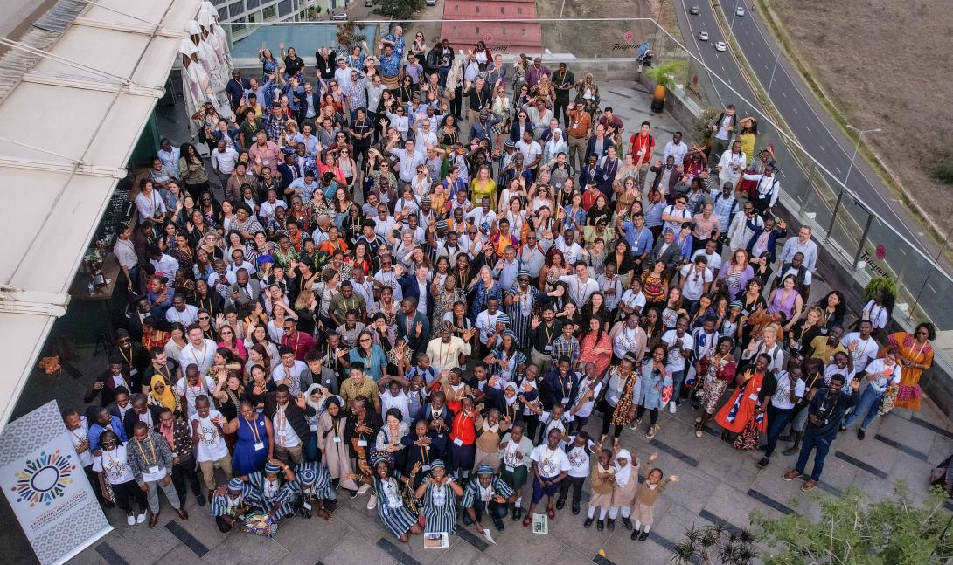


Global Impact
Teach For All Global Conference: Learning from Africa
DHL Group has enabled meaningful progress for Teach For All over the last decade—including our growth in sub-Saharan Africa, where we now have nine partners.
In October, we gathered alongside 600 members of Teach For All’s global community in Nairobi, Kenya, for our first Global Conference in Africa. Together, we learned from voices across Africa and our network about education innovations and developing student leadership.
Click the video above to watch highlights from Teach For All’s 2023 Global Conference in Nairobi, Kenya

Slide 5
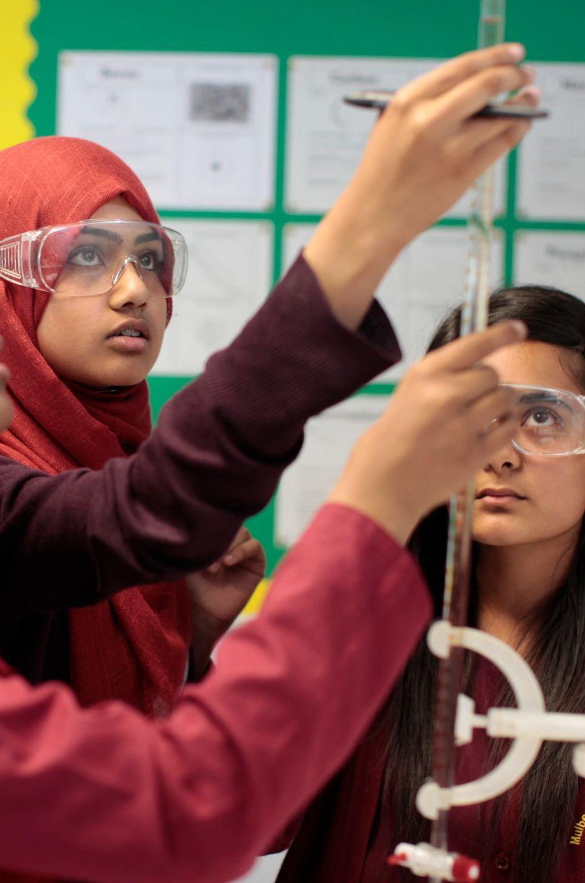
Global Impact
Preparing students to thrive and lead in the Future of Work
Our Future of Work Initiative seeks to bridge the gap between education and the world of work.
Over the last year, the initiative offered programming in four content areas—career education, digital literacy, financial education, and STEM.
Three global communities of practice and 21 learning calls helped teachers, alumni, and partner staff learn about impactful strategies for developing students’ leadership and future-ready skills.
Our new Career Readiness Framework helped educators design activities to help students explore and practice new skills for the world of work.
37 countries | 2,760 teachers | 166,000 students

Slide 6
Local Impact

Slide 7
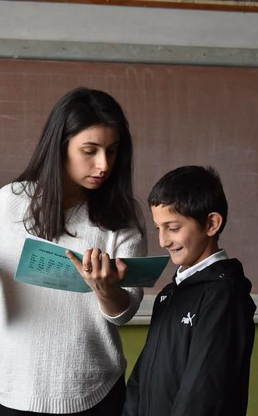
Local Impact
Education in Emergencies: Responding to critical needs in Armenia and Ukraine
Armenia
Teach For Armenia led an emergency response initiative to support forcibly displaced students, following armed conflict and displacement in the region. Their efforts mobilized a coalition of organizations to provide coordinated education, nutrition, housing, and healthcare services to students in schools across the country.
Teach For Armenia teachers received training in Education in Emergencies curriculum and strategies and then incorporated these approaches into their classrooms; a team of emergency responders implemented the program in afterschool settings. The program provided students with critical mental health and psychosocial support while also ensuring they received academic support to address schooling disruptions and learning loss.
Ukraine
In the midst of the ongoing war, Teach For Ukraine placed 33 teachers who are reaching over 4,000 children. Their impact extends to five de-occupied communities where 12 Teach For Ukraine teachers are actively contributing to recovery. Despite these challenges, Teach For Ukraine expanded its network of partnership schools to 19 across four regions of Ukraine (renewing 8 partnerships and adding 11 more).
The Teach For Ukraine team also successfully launched its Psych-emotional Support Program for 30 schools, reaching more than 600 teachers in rural areas. The initiative is addressing mental and emotional well-being among educators to help create classroom environments that positively impact students’ learning experience.

Slide 8


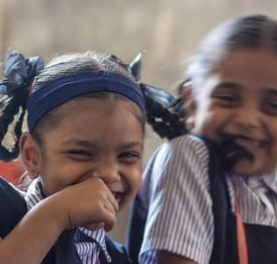
Local Impact
Designing innovative approaches to build student leadership
Teach For India reached beyond academics to build critical skills and leadership among students through creativity and a holistic approach.
Teach For India: 8 Cs Framework
Conference of the Birds
Teach For India works to deepen students’ understanding of key values through its 8 Cs framework, promoting self-reflection, personal development, and feedback culture.
This focus on the 8 Cs–consciousness, collaboration, communication, critical thinking, collaboration, curiosity, courage, and compassion–extends to classroom culture, academic content, and student activities.
Click here for a look at how the 8 Cs apply in sixth- through eighth-grade classrooms.
In June 2023, 24 talented Teach For India students from under-resourced schools in Pune took the stage in Mumbai, Delhi, and Bangalore, to present a remarkable Hamilton-inspired production.
Through this hip-hop Sufi musical, the young performers explored constitutional values of India such as liberty, fraternity, justice, and equality. The project took the students on a remarkable journey as they learned to sing, dance, act, and speak English and explored the messages in the music and storyline.
Click here to watch the journey of creating The Conference of the Birds.
Click here to watch the official video for the original song “I and I.”
Conference of the Bird musical (top). Teach For India student (bottom).

Slide 9
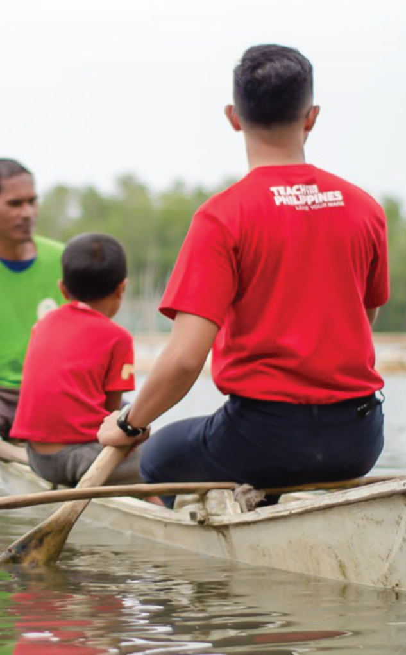
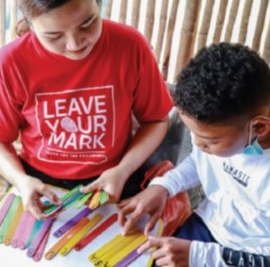
Local Impact
Reversing pandemic learning loss and improving student outcomes
The Philippines
In the country’s first year of full face-to-face classes, Teach For the Philippines aimed to address the most urgent issues in the country’s public school system. This meant helping students to recover from significant losses in reading, numeracy, and life skills, and providing support for educators at home and in school.
Teach For the Philippines achieved learning gains and holistic student development through its Functional Literacy and Batang Bayani Life Skills Programs. After completing one cycle of the FLP literacy sub-program, students’ literacy improved by 40% on average. One cycle of the numeracy sub-program, students’ numeracy improved by an incredible 70% on average.
Students also improved across all socioemotional competencies, particularly social awareness (practicing empathy and being more understanding of others) as most observed by their teachers. They also showed eagerness to practice responsible decision making, which led to showing initiative at school, planning projects that could help their
communities, and demonstrating critical thinking in solving problems.
Functional Literacy Program: Student improvement after one cycle
Literacy
🠅40%
Numeracy
🠅70%

Slide 10
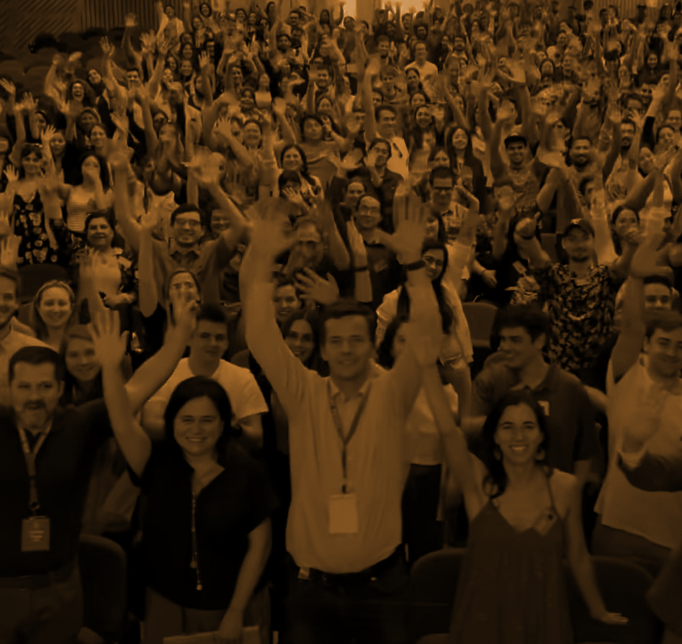
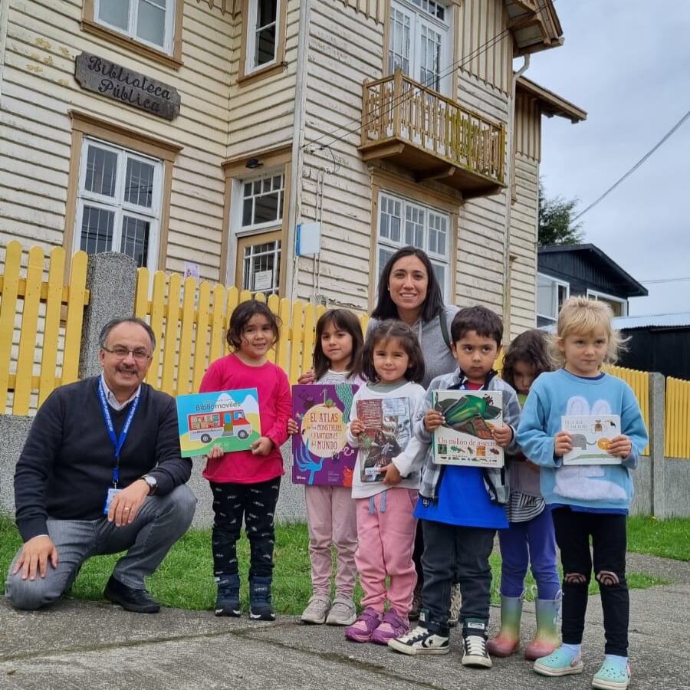

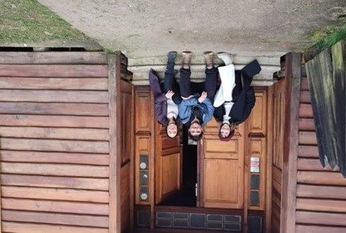
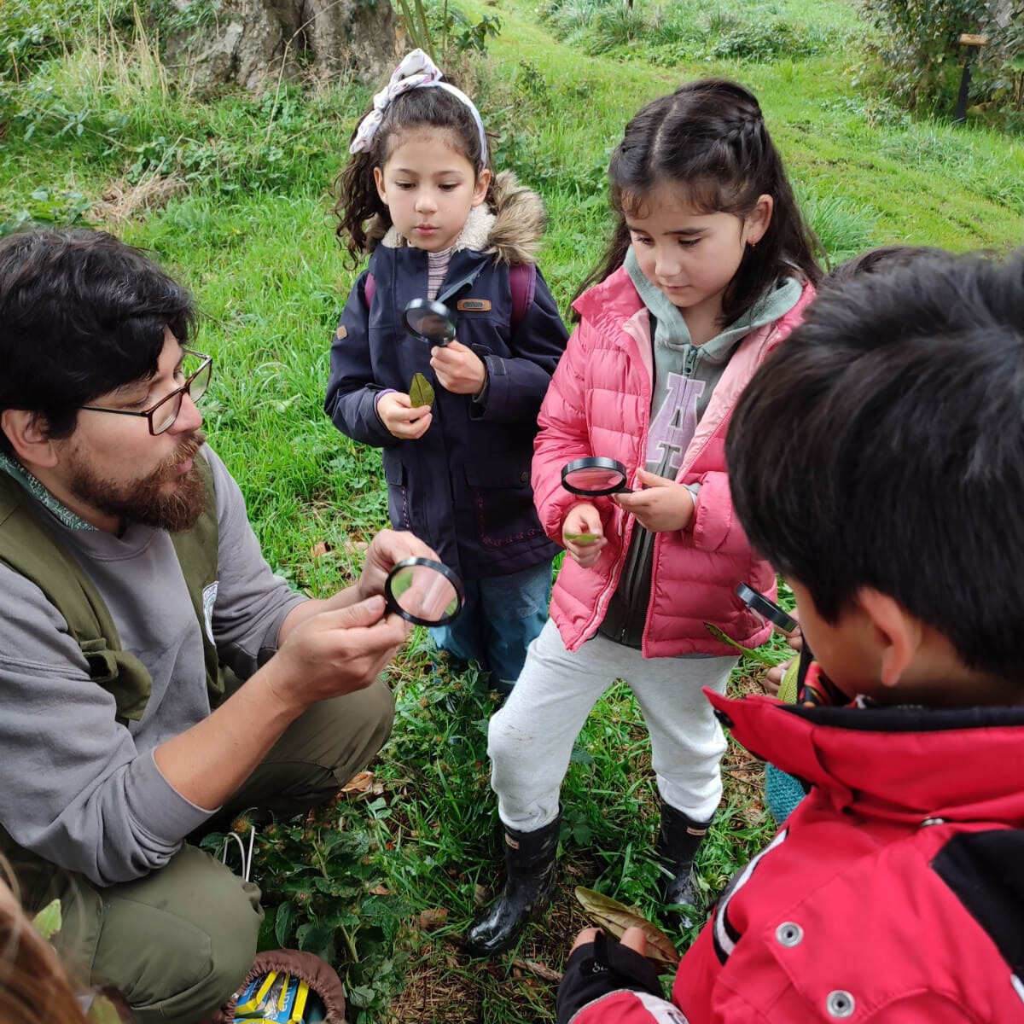
Local Impact
Alumni pursuing community-level change in their countries and creating new opportunities for students
Chile
In March 2023, a new school, La Redonda, opened in Puerto Octay, Chile.
The three founders—Magdalena Ibañez, Natalia Casas, and Pablo Salinas—first met as teachers and staff of Enseña Chile.
Founding the school was the result of their desire to see a paradigm shift in education, a journey that has its roots in their time as part of Enseña Chile, as well as their growth and development as alumni in the years since then.
The founders view La Redonda as more than just a school. It is a learning community, inspired by the Montessori philosophy, that is dedicated to helping uncover each student’s vocations and talents with confidence and enthusiasm at every stage of life.
Enseña Chile celebrated its 15th anniversary in December 2023.
Click here for a look at Enseña Chile’s celebration alongside long-term supporters like DHL Group.
“We know how essential collaboration is . . . because we believe that growth is only possible with others. Therefore, being part of the Enseña Chile alumni flows naturally in us.”
—Pablo Salinas, Co-Founder, La Redonda
The three founders of La Redonda. La Redonda teachers and students.

Slide 11
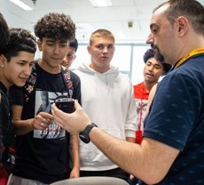
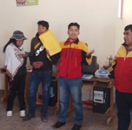
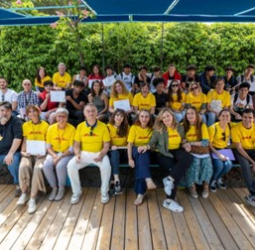
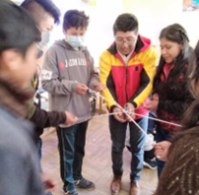
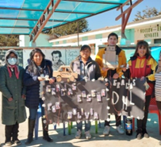
Local Impact
Shaping career trajectories through mentoring and career development
DHL Group employees worked with students to build key skills and career readiness.
Bolivia
For five Saturdays, DHL Group volunteers led job skills workshops for 17 students in Senkata Alta. The DHL employees shared practical tools and reflections that strengthened work and personal skills and fostered leadership development and personal growth. Through these workshops, students learned about concrete skills like writing resumes, as well as more complex topics including teamwork, conflict resolution, adaptation to change, and leadership.
Spain
DHL Group employees in Spain welcomed students from IES Villaverde to DHL facilities for an in-depth mentoring program. Seventeen DHL volunteers and 17 students met over the course of six sessions, engaging in activities and reflections designed to help guide mentees’ career paths. In workshops, students explored SMART objectives, planning, communication, IT skills, and other topics. DHL mentors guided students in crafting strong CVs and developing action plans for achieving their goals.
During a weeklong Day in the Classroom event at Centro Padre Piquer in Northern Madrid, 6 DHL volunteers spoke with 120 students, highlighting the value of education and offering inspiration about career opportunities for the future.
DHL Group volunteers and Empieza Por Educar students in Spain.
DHL Group volunteers interact with Teach For Bolivia mentees.

Slide 12
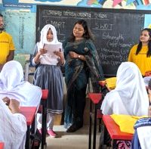
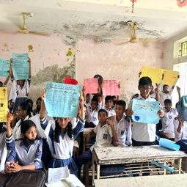
Local Impact
Career Talks: DHL Group volunteers help students imagine a new future
Volunteers engaged in dialogue with students and sparked new ways of thinking about the paths that lie ahead of them.
Bangladesh
“After our career mapping project, this program worked as magic. We experienced the diversity of the future. I learned how DHL works and operates . . . [and] how we can enhance our learning towards our dream.”
—Student, Teach For Bangladesh
Career Talks with DHL Group volunteers developed students’ confidence and gave them better insight into the diverse
career paths available to them.
Not only did these sessions contribute to their self-assurance, they also encouraged them to consider career paths beyond traditionally embraced roles in Bangladesh–doctors, engineers, and teachers–which are widely accepted by parents and society.
Through dialogue between the volunteers and students, and between students and their peers, the children became leaders of their own thoughts, feeling more empowered and confident to engage in difficult career-related conversations with their parents when they went back home.
Students ended the sessions feeling enthusiastic about sharing what they had learned, discussing the evolving needs of the country, and expressing their aspirations to pursue diverse career goals "
“I didn't have any ideas about what I could be in the future. But now, after the session with Mohsina Ma'am, I learned about different career pathways that I can aim for, and she also taught us about SMART goals and SWOT analysis, how we can systematically pursue our goals. I talked with my parents about what I learned from the DHL session and that there are so many career opportunities for me out there apart from just being a doctor or engineer. I feel confident in myself now."
—Jahin, seventh-grade Teach For Bangladesh student

Slide 13
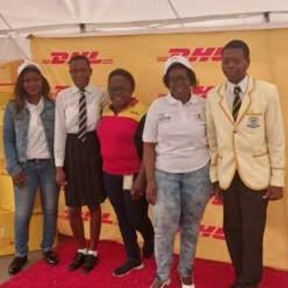
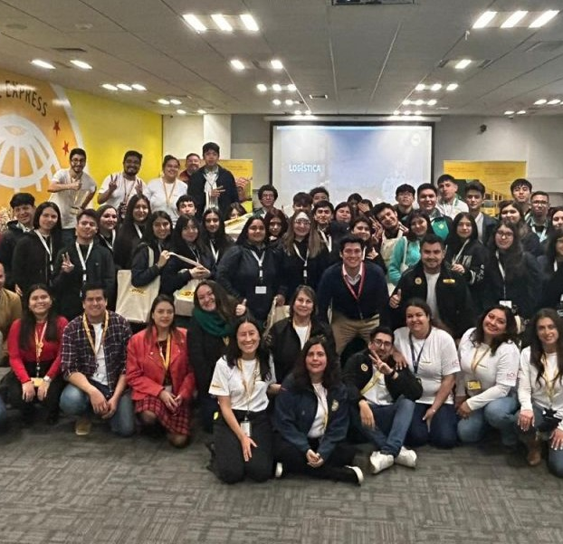
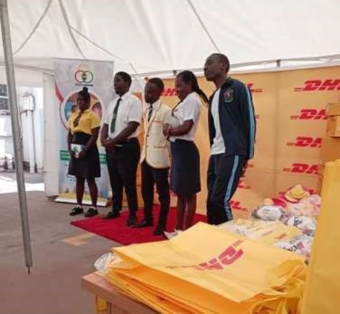
Local Impact
Career Fairs: exploring and preparing for the world of work
DHL volunteers exposed students to the variety of opportunities that lie ahead of them and helped them begin preparing for success in their future careers.
Chile
Zimbabwe
On August 9, 39 high school students from King's School in La Pintana participated in a career fair held by DHL Express, DHL Global Forwarding, and DHL Supply Chain. Twenty-three volunteers gathered to showcase their work with interactive videos, conversation, and even a virtual reality visit to international distribution centers.
More than 280 high school students from Mutoko participated in a career fair at Mutoko Government High School on June 23. Students explored career options, gained insights into the job market, and connected with DHL volunteers.
The career fair was an excellent opportunity for students to learn about different job roles, industries, and university requirements for the careers they might pursue. Students also had the opportunity to learn about the skills and qualifications needed to succeed , and they began to build important job- seeking skills. Including how to interview well and create strong CVs and cover letters.
A few weeks later, the students’ teacher, Matias, noticed a positive change in the attitude of his students. He began to see how the lesson of perseverance and effort shown by DHL workers at the fair had impacted this group of young people. In his words: “They now have a more positive outlook about their future”
“They now have a more positive outlook about their future.”
—Matias, Enseña Chile teacher
DHL Group volunteers and students fromEnsena Chile and Teach For Zimbabwe connected at career fairs in La Pintana, Chile, and Mutoko, Zimbabwe.

Slide 14
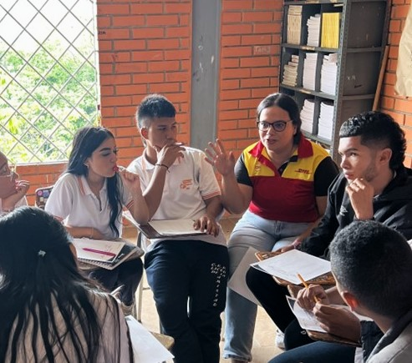
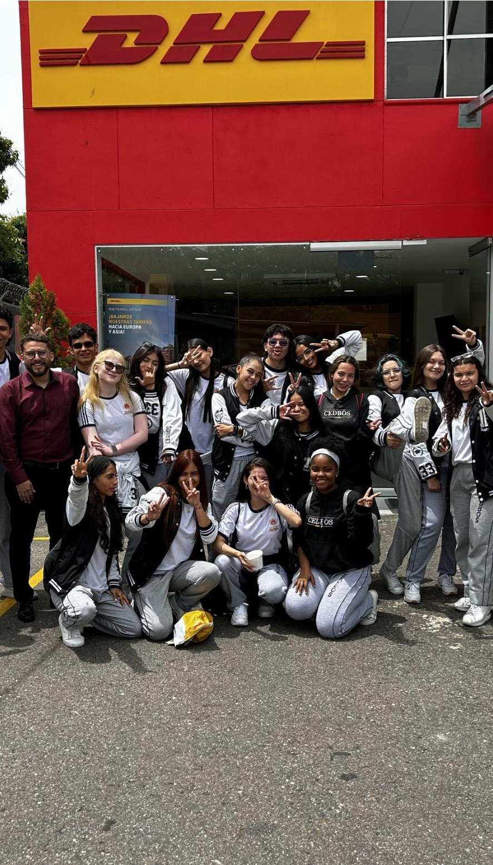
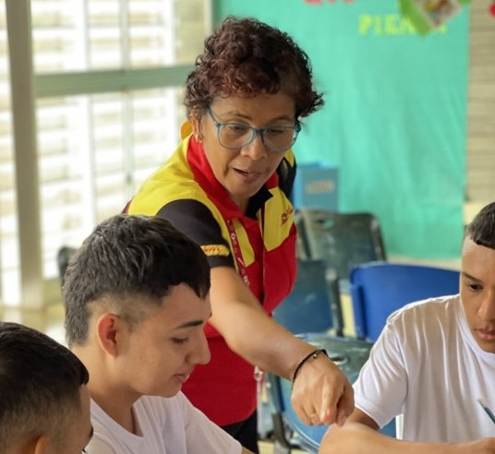
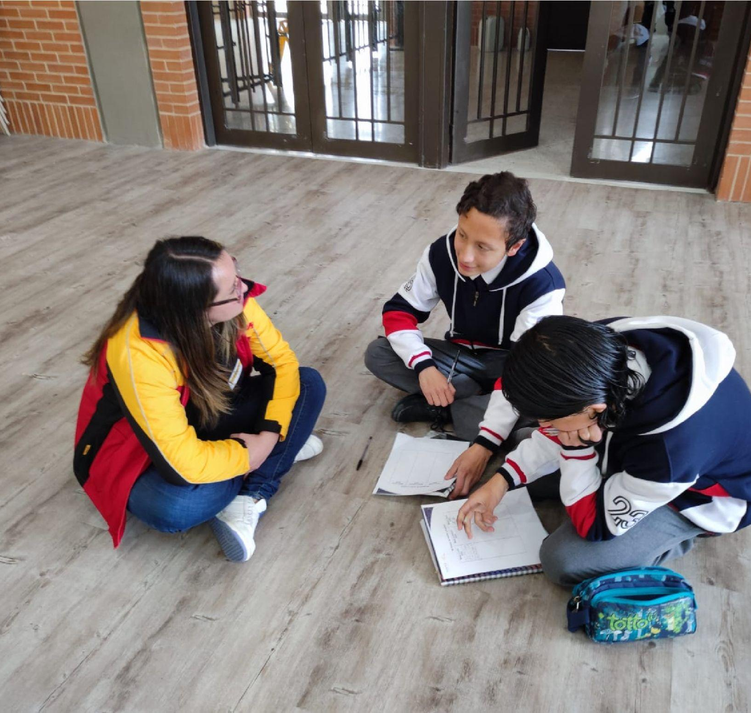
Local Impact
Engaging volunteers in office and school visits for students
Colombia
In four cities across Colombia, 68 DHL volunteers conducted office and school visits with 199 10th- and 11th-grade students. Over the course of 10 engagements, volunteers helped to strengthen student’s employability skills and highlight the possibility of future careers in logistics.
Panama
Twenty-five DHL volunteers in Panama welcomed students to DHL Aviation, DHL Express, and DHL Global for a variety of activities. These included a mentoring program, a day of job shadowing, and three workshops covering resumes, job interviews, finding one’s passion, and using Excel.
Malaysia
Uruguay
On a visit to DHL’s ITS office, 26 students from SMK Shah Alam, a local high school, learned about the role of IT solutions in tracking the supply chain, the facilities in the office, and the experience of employees. Students also explored what their own futures might look like by interviewing their mentors about their own career journeys.
Enseña Uruguay students visited DHL’s central offices where they met team members across the organization and learned about DHL’s different departments and processes over the course of the day.
DHL volunteers engaged with students in cities across Colombia: Medellín, Barranquilla, Cali, and Bogotá.

Slide 15

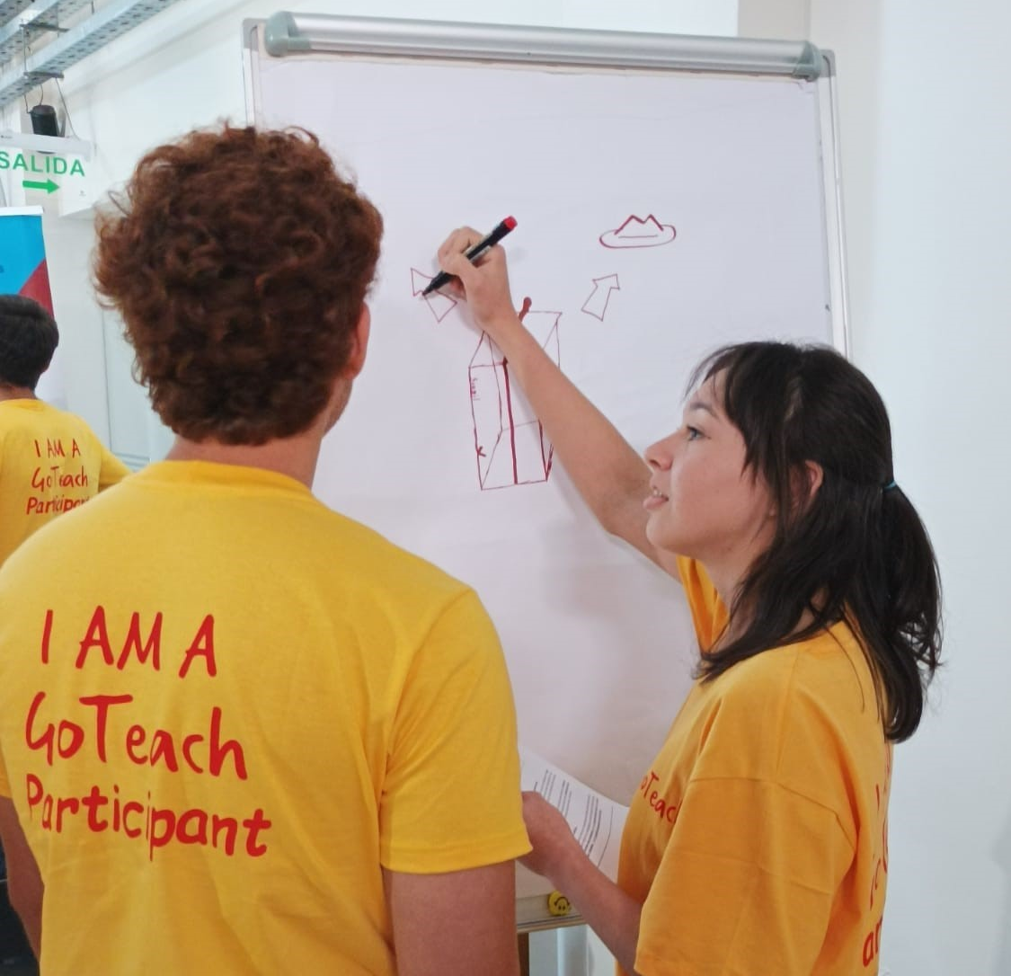
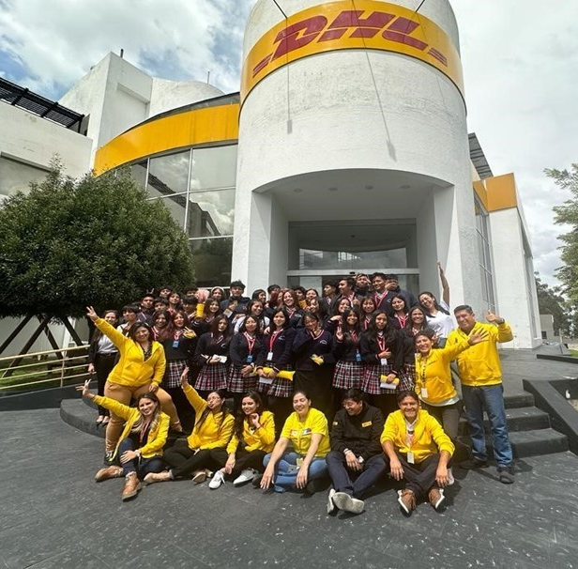
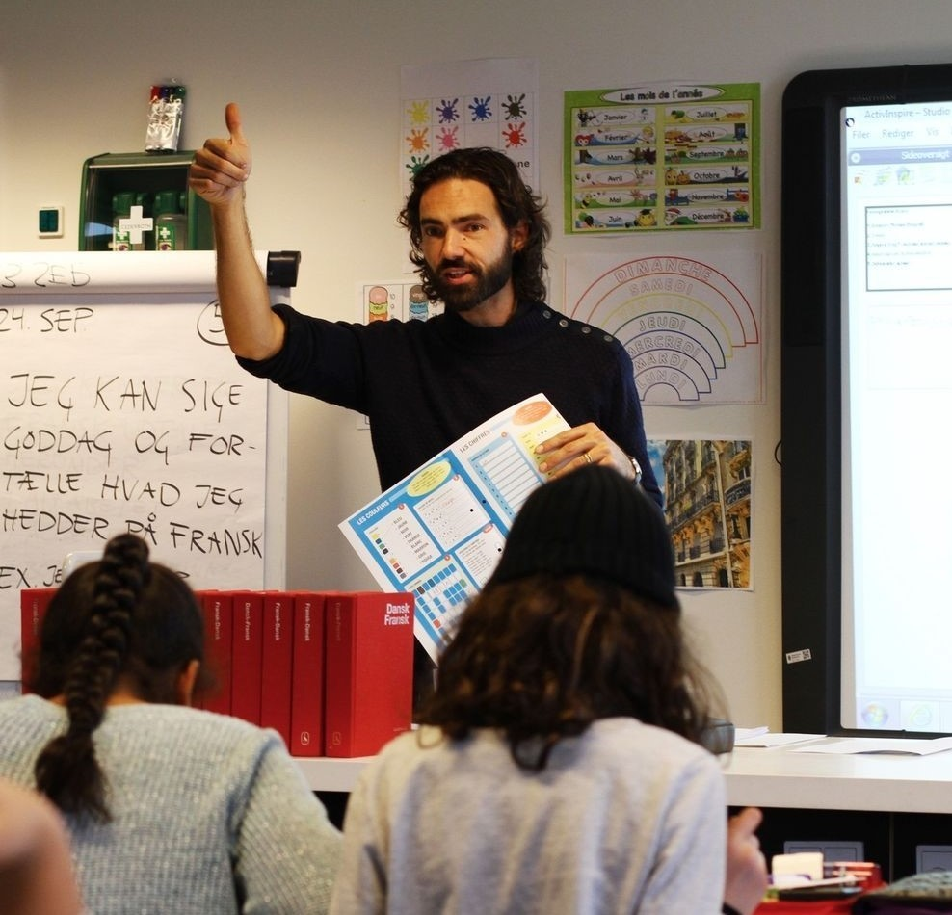
Local Impact
Cultivating students’ self-awareness, leadership development, and professional skills
Through their guidance and instruction, DHL volunteers helped students engage in self-reflection and grow their aspirations for what their futures may hold—from university to the workplace.
Denmark
Paraguay
Ecuador
DHL volunteers helped students increase their self-awareness, improve their collaboration skills, adapt to different social contexts.
Through activities like mind mapping, volunteers guided students in writing CVs and interviewing, and helped them to explore various topics related to success in the workplace.
An enriching, experiential workshop with DHL volunteers helped students in their last two years of high school reflect on their student
Fifteen DHL volunteers offered 65 students insight into the variety of career opportunities available at DHL facilities. Volunteers drew connections between students’ schooling and their future careers, discussing what they might need to study, what soft and hard skills are needed, and the complexities that arise within different kinds of work.
careers and connect them with their aspirations for their professional careers. This was especially fitting for students at this stage as they consider their transition beyond high school.
The workshop underscored the importance of continuing their education—at an age when school dropout rates are highest—in order to have greater future opportunities. DHL volunteers led activities to help the young people explore their career ambitions, begin developing necessary job-seeking skills, and experience a bit of the world of work.
“The workshops given by DHL volunteers allowed me to have more clarity about what I want to do when I finish school. The session on university scholarships and defining our possible career helped me a lot to solve several doubts I had about the university. I was inspired by visiting the DHL facilities.”
—Student, Enseña Ecuador
Left to right:
Teach First Danmark teacher. GoTeach activity in Paraguay. DHL office visit in Quito, Ecuador.

Slide 16
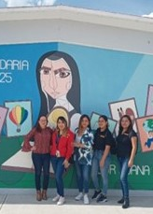
Local Impact
Supporting teacher and alumni development through DHL-led employability workshops
Support from DHL volunteers helped to equip Enseña por México teachers and alumni with important skills and enhance their personal and professional development.
Mexico
Four volunteers from DHL Express worked with Enseña por México to plan and implement a series of workshops for 74 teachers and alumni.
DHL volunteers covered these topics over the course of four sessions:
Defining my life plan and my alumni experience.
Preparing CVs and applying and interviewing for jobs
Positioning my professional profile in the labor market.
Using my networks to search for a job or generate professional relationships
These skills will play an important role in contributing toward Enseña por México’s vision—by equipping teachers and alumni to find and take on roles through which they can hep generate the systemic change that will enable all children in Mexico to achieve their potential.
These workshops are a key part of Enseña por México’s EmploLabs program, which aims to develop new capabilities and tools in students, teacher, and alumni that will support them beyond the classroom and in any workplace in the future.
DHL volunteers at an event for students at an Enseña por México partner school.

Slide 17
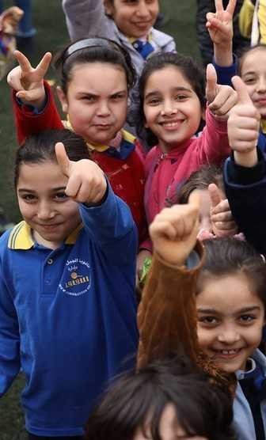
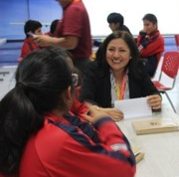
Local Impact
Creating opportunities to promote and reflect on gender equality with students
Lebanon
Teach For Lebanon teachers Jihan Iskandarani and Abir El Ashkar led a five-week program with their third- and fourth-grade students at Rafik Hariri Public School to highlight issues of gender equality and the importance of women and men’s rights in the community where they live.
After noticing some misconceptions among their students about what women and men can do, the teachers aimed to raise awareness of the various roles men and women play. They prompted conversation and debate among their students, encouraged them to share their questions, and offered photos (of, for example, a policewoman, a woman bodybuilder, a man working in a kitchen, and a man caring for his child) as points of discussion. Some of the boys spoke out strongly for women's rights, and girls noted the problems that men face in their daily lives. Over time, the teachers began to notice a change in the beliefs and misconceptions of their students.
Peru
DHL volunteers conducted four sessions for students to address gender gaps in the workplace. This included in-person sessions at DHL Global Forwarding and DHL Express, and a virtual session with DHL Supply Chain collaborators. DHL volunteers helped students cultivate a critical understanding of gender inequalities through real-life cases and workplace data and encouraged their reflection about gender-related issues.

Slide 18
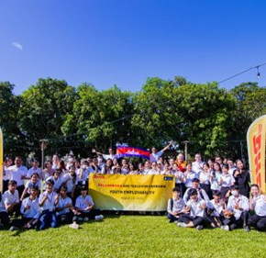
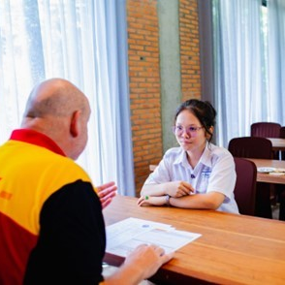
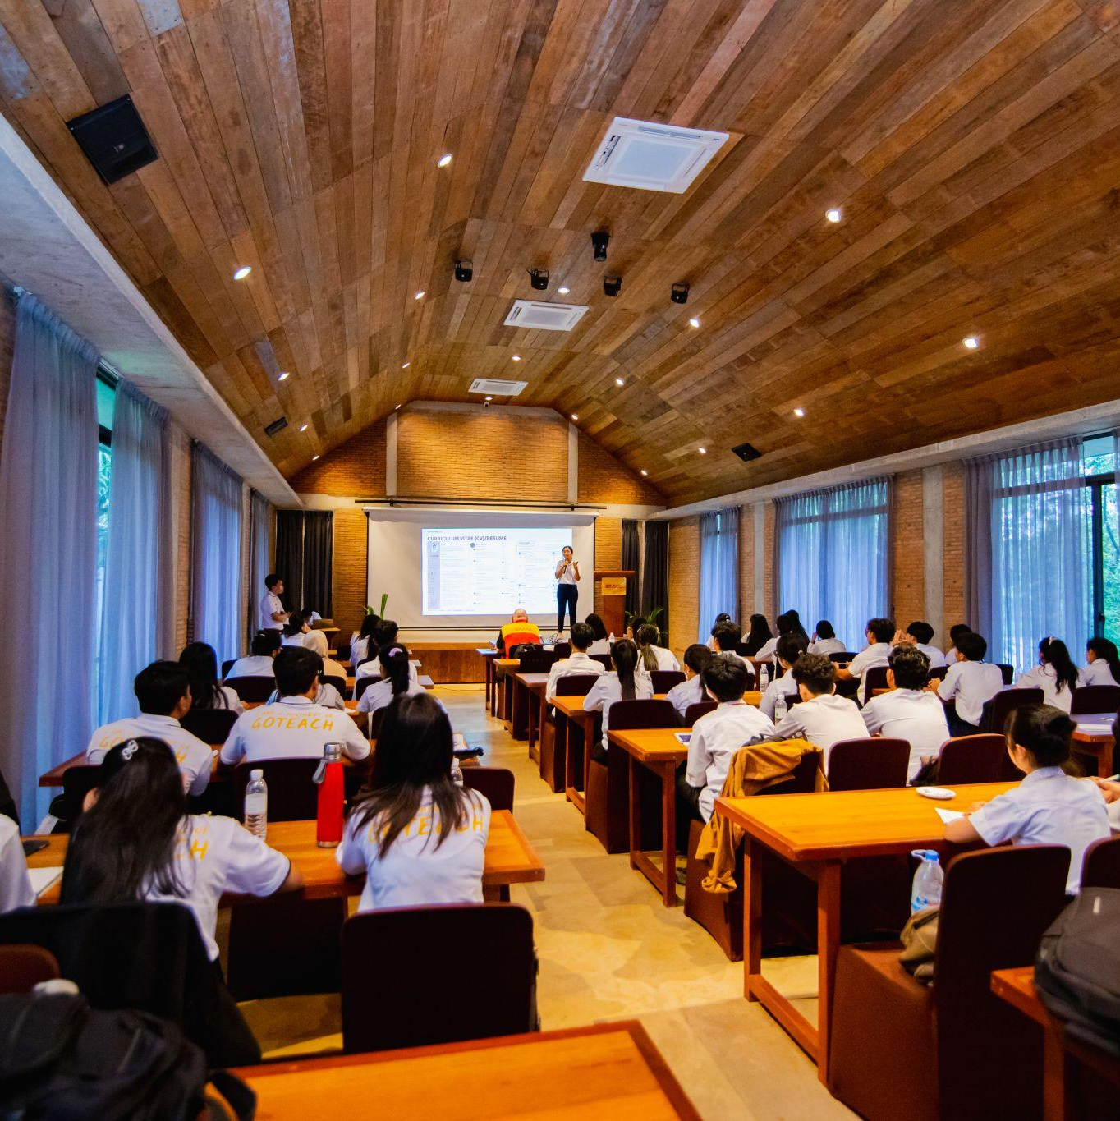
Local Impact
Student Spotlight: career planning and skill development with DHL volunteers
DHL volunteers mentored and encouraged 35 students at Teach For Cambodia’s Youth Employability day, helping to set students on new paths.
Phy Sokunchakrya
2021 Go Teach student & Current DHL employee
Yung Sreyneang
Teach For Cambodia student
Phy Sokunchakrya was a student in a rural community near the Cambodia-Vietnam border when she participated in the 2021 GoTeach program. In her community, most girls were expected to get married or start working before
Yung Sreyneang a Teach For Cambodia student at Russey Keo High School, shared that, through workplace visits to the DHL Express Cambodia Office, she gained a better understanding of how
employees perform their roles and deliver tasks at work and in professional settings. She learned valuable skills such as CV writing, cover letter preparation, and job interview techniques. Participating in mock interview exercises improved Sreyneang’s confidence in her communication and interview skills. She could actively engage with the Country Manager of DHL Express and DHL Global Forwarding and the COO of Teach For Cambodia, despite being unfamiliar with them. And the the feedback she received after a mock interview helped her identify improvement areas that could help her to successfully land her ideal job.
finishing high school.
Sokunchakrya explained that participating in the GoTeach program helped her understand the different stages that might establish her in a career, from choosing the right university degree to preparing for a job search, and, ultimately, securing a full-time job. Through the program, she learned how to write a CV and successfully interview.
Sokunchakrya gives the GoTeach program a lot of credit, saying it changed her life. She went from being a high school student who did not expect to attend university to interning with DHL Cambodia and then securing a full-time job with the company—a testament to the lasting impact of DHL volunteers.
Teach For Cambodia Youth Employability Day. Yung Sreyneang participates in a mock interview with DHL volunteer.

Slide 19
Building a Stronger Partnership

Slide 20

Building a Stronger Partnership
During 2023, our partnership
continued to foster the necessary skills for young people to be ready to shape their future.
We are deeply grateful to DHL volunteers who supported students with their time, skills, and knowledge!
803students impacted
1,348students reached
1038volunteers
25countries
Thank you for your ongoing support.

