Slide 1



Budget Process and requirements
Request
For SOS Children's Villages the regional team of GoTeach defines the amounts according to the number of historical activities, % accuracy in the use of the budget in the previous year and country size (number of business units in the country). Amounts are: 5000 Euros / 7000 Euros / 10000 Euros. In the case of Teach for all the budget is always 7000 Euros per country. We present this information in our first regional call in January for both partnerships.
Approval
Verification that the entire budget has the program focus, we answer at least one week after the country sent.
Feedback is given country by country
Countries present their estimated plans and budgets according to the maximum granted that they can request; until the end of March.
Excel file sent for approval to the Manager and Coordinator of GoTeach.
The final plan and budget, it is approved by official mail country by country.
In the approval we make explicit the exact amount approved, to have a backup in case it is needed by audit or compliance policies

Slide 2
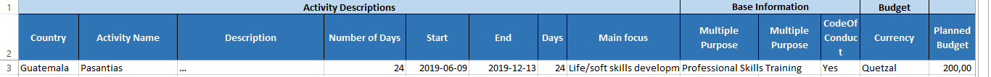
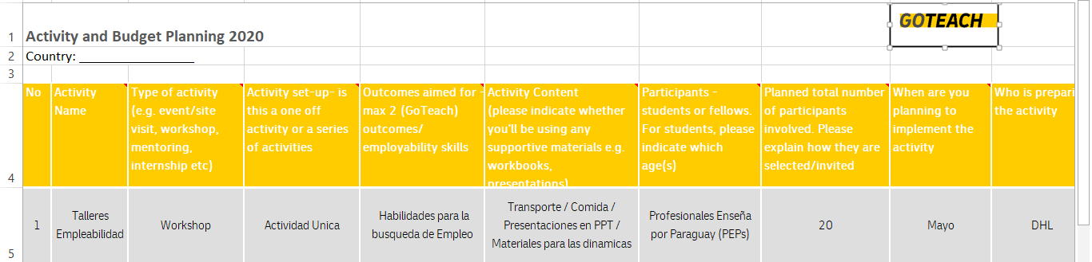
Budget Process and requirements - Templetes
Excel File for Plan & Budget ( is provided by GHO for both Partnerships)
Tracking Tool : Reimbursement GoTeach; we have for both partnerships
Standard Email for approval

Slide 3
Go Teach Refund Request - General Information
In Americas, our GoTeach budget is located in the regional office of DHL Express CSA based in Costa Rica. From there we manage the budget for all countries in the different Business units.
The definition of the processes are prepared in conjunction with the regional Finance team.
All countries execute from their local budgets, and apply to refunds according to what they are spending. We do not give an advance budget.
Each country defines how the granted annual budget will be managed.
Some examples:
  Mexico develops the plan and budget together and each Business Unit applies to the reimbursement of what it spends in the program
  Panama defines every year which business unit will carry out the financial process.
In every approval we make explicit the exact amount approved, to have a backup in case it is needed by audit or compliance policies

Slide 4
Go Teach Refund Request
Request
Application: Maximum on the 23rd of each month and is done in local currency
Approval
Intercompany invoice prepared by the Finance Department to proceed with the corresponding payment and send it to Estefania (Regional Finance team) and in copy regional GoTeach team.
Payment
Copy the finance officer from the request
You must ensure that the expenses are preloaded in your local systems (SAP example).
Intercompany Invoice Data are provided by the regional GoTeach team.
Verify that all expenses have the corresponding backup invoice and that the invoice is fully legible.
Perform the breakdown of expenses in an Excel file provided, attaching the corresponding invoices.
They should pay attention to the local guidelines for generating IC invoices
Invoices are received with a maximum of 2 months old. And they must be invoices related to the GoTeach program.
Excel file sent with all the support invoices to the Regional GoTeach team for approval.

Slide 5
Go Teach Refund Request - Templates
Excel File: Expenses MACMAO Invoice; the same for both partnerships

Slide 6
Financial Statement Process
Process
The regional GoTeach team requests from the regional Finance team the account statement of both partnerships according to need.
The financial statements are sent to the global office in January or according to request.

Slide 7
Financial Statement Process - Templates
File Excel: Budget Goteach 2019, for both partnerships

