Slide 1

GoTeach Framework 2023
CREATING GREATER IMPACT WITH your GoTeach Partnership
January 2023
Global GoTeach Team

Slide 2
GOTEACH: WHAT WE DO
  Vision:
  By 2030, we aim to empower all young people in the GoTeach program to attain the employability skills necessary to live an independent life
  MiSSION:
  Improving employability by equipping young people with the skills and professional interactions needed to prepare them for the world of work

Slide 3
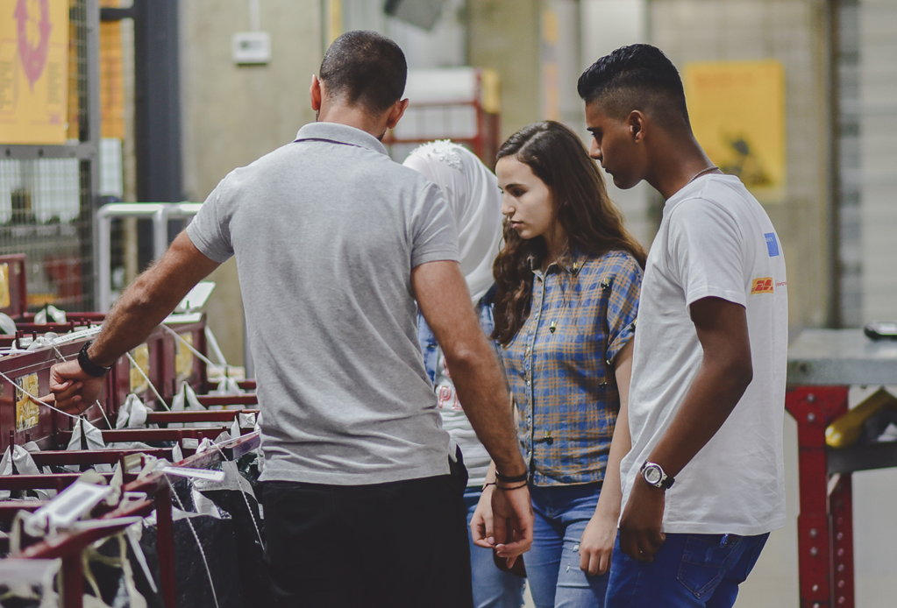


2023 strategic GoTeach targets
        In 2023, the focus of GoTeach is increasing the impact by ensuring a minimum of 3 GoTeach activities for each young person.
Increasing the impact
Professionalize GoTeach activities and ensuring participation in three GoTeach activities for each GoTeach participant in the same year
Enabling job opportunities
Provide GoTeach young participants with networks and support to find employment opportunities
Driving gender equality
Take action to empower girls and young women to make the best use of their abilities and skills

Slide 4


Why should students engage with DHL and workplaces?
For internal use
          To enhance the understanding of jobs and careers
          e.g. through job shadowing, workplace visits, career talks about jobs and the value people in work find in them, job fairs, discussions of the gendered character of work
          To provide them with knowledge and skills demanded by the labor market
          e.g. through internships, work shadowing, skills training
          To provide them with knowledge and skills demanded for successful school-to-work transitions
          e.g. development of CV writing and interview skills, career talks about the jobs and how to access them, discussions with people in work about the future of work
          To enrich education
          e.g. through work-related learning where employers enrich classroom teaching
Research shows these measures have a central role to play in enabling better employment outcomes for youth
Source: Study on CAREER READINESS, OECD, 2021

Slide 5
In 2023, the focus is on implementing 3 interventions for the same group of participants for creating more impact and better employment outcomes for youth
Guiding principles
Examples
Additional activities in local ownership
Internship
My 1st Job program
…
OPTIONAL
Three interventions from different areas for the same group of people in the same year
Minimum requirement for all GoTeach partnerships
MANDATORY

Slide 6
The GoTeach pool of interventions is clustered in 3 areas
MANDATORY: 3 INTERVENTIONS
OPTIONAL
1
Expose
Activities that present ideas, information and concepts about the world of work and career development.
2
Explore
Activities in which young people actively explore and investigate the world of work and develop specific skills
3
Practice
Activities that offer young people close and more sustained opportunities for observation and participation in one or more workplaces.
  Workplace visit
  Career fair
  Career talk
  Employability skills training
  CV writing and interview skills training
  Logistics-related training
  Job shadowing
  Mentoring
  Internship
  Apprenticeship*
* e.g. My 1st Job program, Americas

Slide 7
Employability Readiness Journey: interventions and intended outcomes
MANDATORY: 3 INTERVENTIONS PER YOUNG PERSON
OPTIONAL
1. Expose
Intended outcome: Allow children and youth to obtain information about the professional work environment and provide an insight into career opportunities and apprenticeships.
2. Explore
Intended outcome: Young people actively explore the world of work, think about their future plans, learn specific skills to make important decisions about the future.
3. Practice
Intended outcome: Provide youth with the opportunity to experience the working world in a real business environment and to do a job that puts into practice the employability skills they have already developed.
Workplace visit
Visit of a local site or office (a few hours) to experience different places of employment where employees perform tasks, jobs and projects, including a career Q&A with DPDHL employees
Employability skills training
Train program participants in life skills and professional skills that prepare them for their first job or start their own business
Internship
Short-term working experience (up to six months) that integrates theory and skills learned in the classroom with practical application and skills development in a professional setting
Career fair
Stands are set up and each department inform about the variety of professional opportunities, as well as employees share their own work experience
CV writing & interview skills training
Help young people to create an impactful CV and learn how to prepare for an interview
Apprenticeship*
Provide temporary work experience including supervised on-the-job training, along with job-related skills training, all while earning a wage. Apprenticeship programs are full time positions within DPDHL
Career talk
Employees talk about their occupations and how to access them including session on gender stereotypes or future of work
Logistics-related training
Train program participants about the world of logistics, including logistics-themed problem solving and teamwork activities
Job shadowing
On-the-job training (up to one week) that allows them to observe an employee performing a job role, incl. the opportunity to ask questions throughout the day or at the end of the experience
Mentoring
Support program participant to develop skills and attitudes needed to progress into employment, training or further education
* e.g. My 1st Job program, Americas

Slide 8

2023 GoTeach Framework: How to reach the minimum requirements for GoTeach?
What is in scope ...
What is out of scope ...
  Three interventions conducted during a multi-day camp activity
  Three interventions conducted during a one-day activity
  All activities that are not listed under 1. Expose or 2. Explore do not count for fulfilling the minimum requirements but can be conducted additionally, e.g. all hands-on activities, like renovations, fundraising, sports, road safety workshops, talent shows
  Picking up three activities from area 1. Expose and/or 2. Explore, ideally different formats
  Activities could be either virtual, face-to-face or blended (no need to be delivered in person only)
  Activities for other target groups, e.g. Fellows, alumni of TFALL partners, staff of SOS or TFALL do not count for fulfilling the minimum requirements but can be conducted additionally
  Activities that are conducted by external organizations and not by DHL volunteers (e.g. entrepreneurship training)

Slide 9
Communicating the new framework
SOS and TFA (staff):
PPT
Video
Infographic: visual checklist
Posters (to disseminate to youths)
Youths/students:
Posters
Youth Ambassadors:
Cheat sheet of new framework (same as the infographic)
DHL GoTeach teams:
PPT
Video
Infographic (visual checklist)
DHL volunteers:
PPT
Video
Infographic (visual checklist)
DPDHL SMTs:
PPT
Video

Slide 10

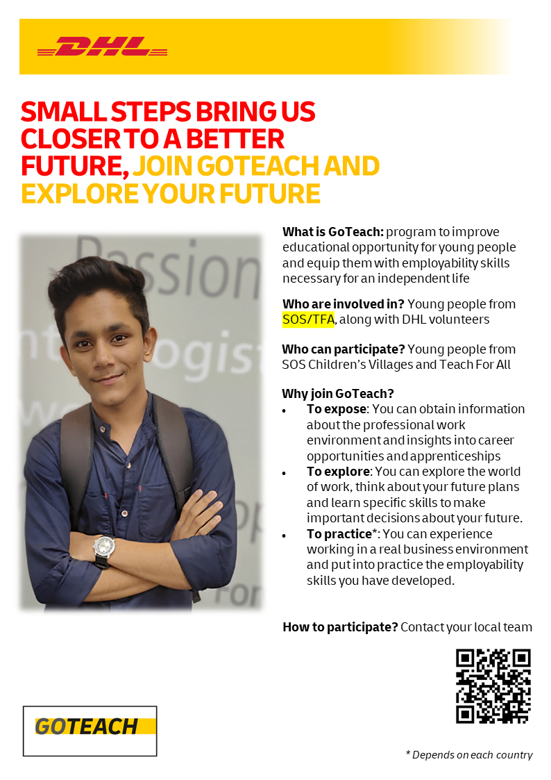
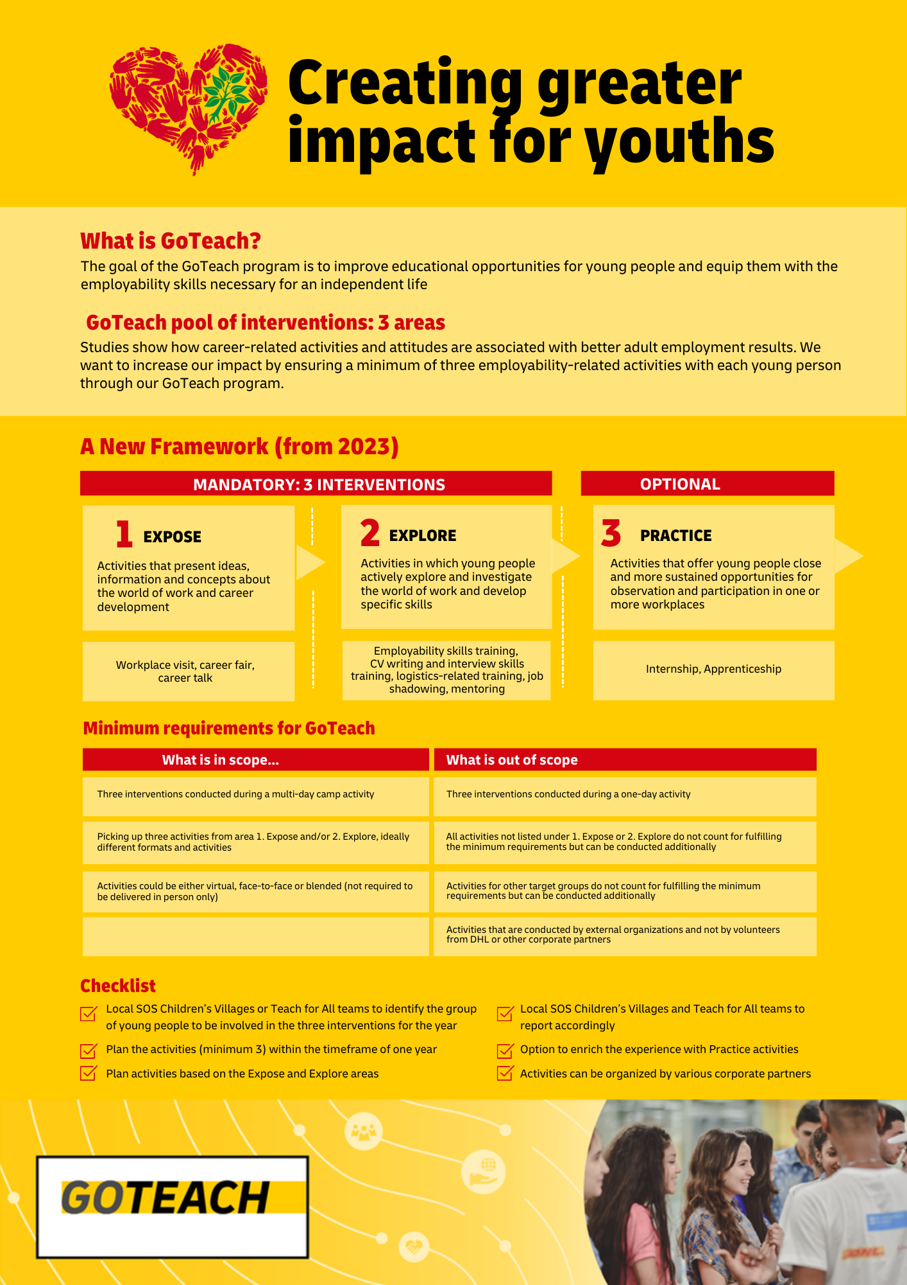
Communicating the new framework
        Video
        Poster
        Infographic

Slide 11
Questions?

Slide 12
Thank you

