Slide 1
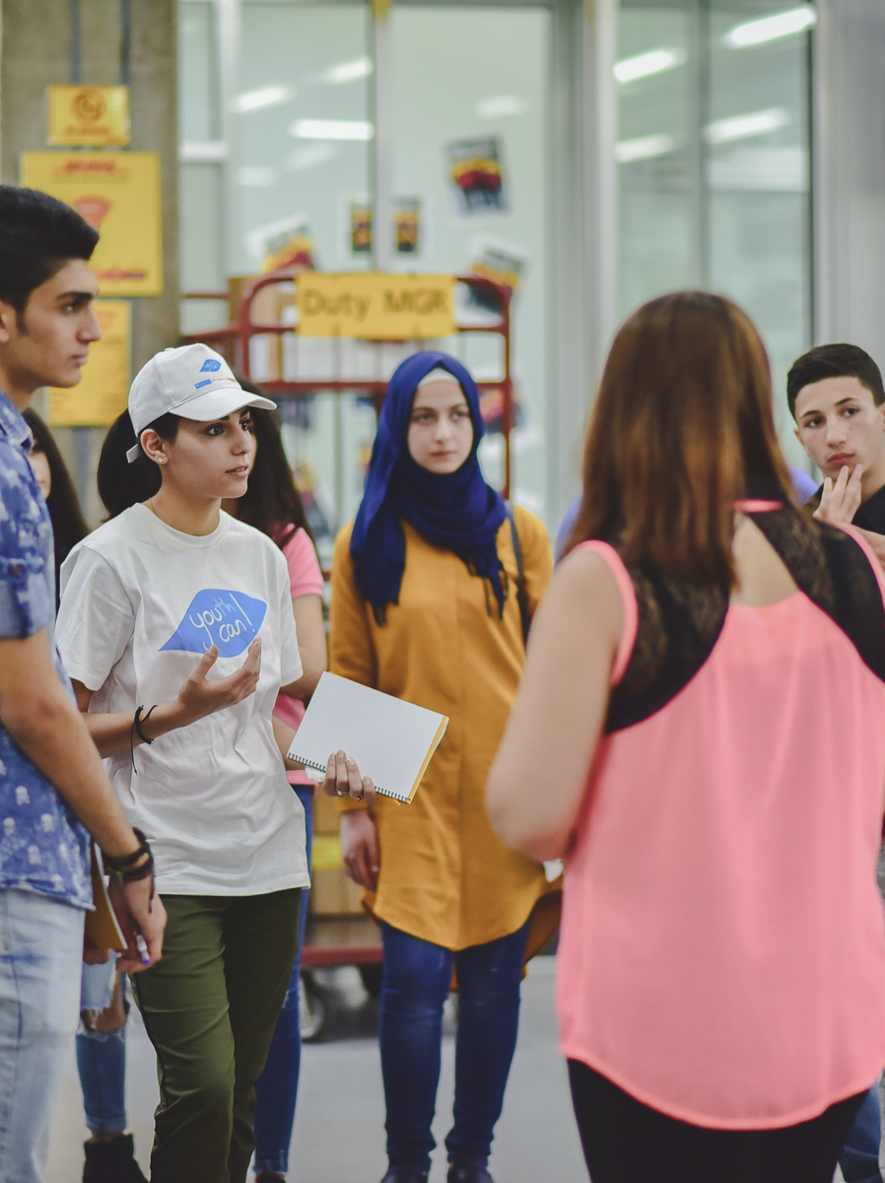
GoTeach
Menue of Activities
Bonn, July, 2020
Group Communications, Sustainability & Brand

Slide 2

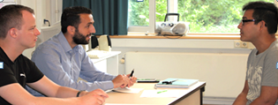
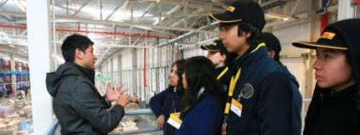


Menu of Activities (1/2)
Activity
Objective
1. Mentoring
Mentor a student, supporting them to develop the skills and attitudes needed to progress into employment, training or further education
2. CV & Interview
Session
Run a CV & Interview Skills workshop for young people – helping them to create an impactful CV and learn how to prepare for an interview
3. Site Visit
Provide an immersive and interactive site visit at a local site or office. This includes a site tour, career Q&A with DPDHL colleagues, and logistics-themed problem solving and teamwork activities.
4. Classroom
Session
Inspire students in the classroom by delivering a guest teacher lesson. As a role model, you will help the students think differently about the world of work and careers in the logistics industry.
5. Employability
Workshop
Run a workshop that supports young people to develop employability skills and helps attract more young people into Logistics.

Slide 3
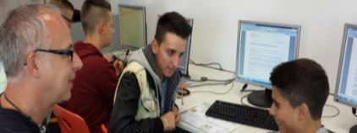

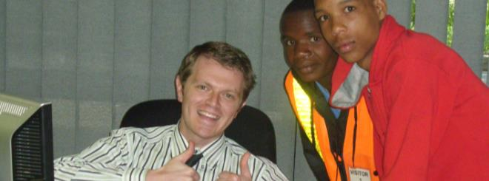
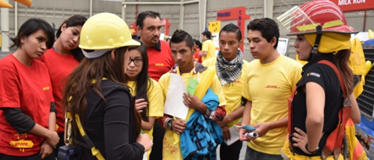

Menu of Activities (2/2)
Activity
Objective
6. Career Session
Help students develop their career plan and provide an insight into career opportunities and apprenticeships.
7. Internship
Provide a students with an opportunity to experience the working week in a real business environment, doing a job that benefits the employer and put into practice what employability skills they have already developed.
8. Job Shadowing
Young people accompany employees over a week or less to learn what it means to work in a certain area
9. Career Fair
Allow young people to obtain information about the professional work environment and provide an insight into career opportunities and apprenticeships. Stands are set up and each department the variety of professional opportunities, as well as their own work experience.
10. Entrepreneur-
ship Training
Train young people to start their own business covering areas like business plan writing, promoting their business, looking for funds etc.

