Slide 1
CAREER TALKS
YOUR TRAITS AND SKILLS FOR CAREER
DEVELOPMENT - CLASSROOM

Slide 2
Explain in a broader context, the key requirements and elements for successful career development
Explain the difference between Personality Traits and Transferable Skills and how these are important for specific job roles and career development
Reflect on future career opportunities and the areas that require focus for building a career in a specific direction

Slide 3

MY FUTURE CAREER SHOULD BRING ME ...
Other...
10
8
6
4
Growth opportunities
2
Happiness
Great
job content
Good money

Slide 4
MY FUTURE CAREER SHOULD BRING ME ...
Depending on the person and your personal reasons, all areas are very important. If the money is great but the job is horrible and offers no growth opportunities, how happy are you in the end?
Or if the job is great and makes you happy, but the money part is not up to standard? For how long will you remain happy and satisfied?
Nevertheless, some of us may choose for financial reward (so short term) and others more for job content (long term). That is all good and fine.

Slide 5
CAREER DEVELOPMENT – TOP TIPS
Identify your talents. We all have talents each of which can be useful in many situations. Explore what can you bring to the table. What are the things you are good at? What is the value that you can add?
Embrace your strengths and weaknesses. What is your kryptonite? Be proud of it. But also know the things that can limit you. These may be developed if possible but at least consider the fact there are some weaknesses so you know what is possible and what may be more challenging.
Turn around your 'Yeah ... But' thoughts. Don't limit your view but broaden in and think positively. See the opportunities and take them.
Know your skill and trait gaps. Remain open to feedback and change where necessary. Keep developing yourself and build your skillset until you achieve mastery.

Slide 6
CAREER DEVELOPMENT – TOP TIPS
Map out your career development plan. Think about the future. Where do you want to be in 5, 10, 15 years. Build a 5-year plan.
Own your career development. Don't sit and wait until good things happen. Be pro-active and take action.
Remain open to change. Change is the only constant so do not get stuck in one place. Embrace change as a good thing and find new opportunities.
Success is never guaranteed but if you sit back and relax, there is a guarantee for sure and that is that not much will happen, and you will not achieve your career goals.

Slide 7



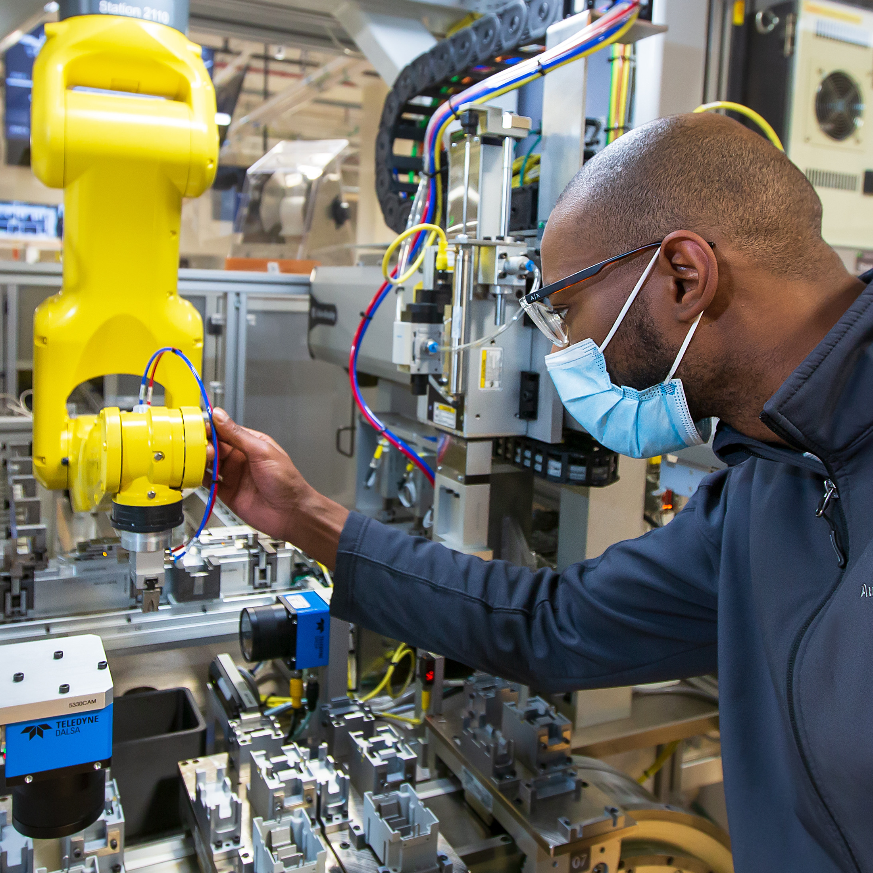





FOR INSPIRATION – INDUSTRIES TO PURSUE A CAREER
Logistics
Pharmaceutical
Agriculture
Manufacturing
Hospitality
Technology & IT
Education
Finance
Healthcare

Slide 8
PURSUEING YOUR CAREER
If you are not yet sure about the Industry of your interest (and that is very common) you may want engage in a workplace visit and get to know some of the job profiles in such industry.
This will help you to assess what would be thing that you want to go for and even then … it is not set in stone! Because seeing the opportunities and being open to change, you might not want to pursue a career in one single direction. One thing might lead to the next.
Keep in mind that the job market is volatile and ever changing. Check the World Economic Forum web pages:
https://www.weforum.org/reports/
https://www.weforum.org/reports/the-future-of-jobs-report-2023/infographics

Slide 9


PERSONALITY TRAITS & TRANSFERABLE SKILLS
Personality traits relate to your character as a person: how you are, and the attitude related to it.
Transferable skills are learnt abilities that can help you at work or in life, so in a variety of situations.

Slide 10
PERSONALITY TRAITS & TRANSFERABLE SKILLS
A personality trait is quite similar to a transferable skill, but there is a slight difference.
A personality trait relates to your character as a person: how you are, and the attitude related to it. A personality trait is something that we developed in life, through our upbringing and our experiences. It can be changed but that takes quite some time and effort.
A transferable (or soft) skill on the other hand is very much learnt behavior and therefore can be improved and developed. It can help you at work or in life in a variety of situations. You can improve your communication skills and team-work skills.
Your personality may indicate what job you may like to do but your “Soft Skills” define how good you may be at it.

Slide 11
PERSONALITY TRAITS
There are both positive and negative personality traits.
Positive personality traits can be things like helpfulness, optimism, honesty, friendliness, and responsibility.
Negative personality traits can be potentially career limiting. Things like laziness, arrogance, recklessness, disrespect, and impatience.
Nevertheless, these can very well be part of us, so we must be aware of those negative personality traits. We must recognize them and make sure that they don’t get in the way of our goals.

Slide 12

POSITIVE PERSONALITY TRAITS
HELPFUL
OPTIMISTIC
HONEST
FRIENDLY
RESPONSIBLE
SELF CONFIDENCE
ENTHUSIASM
HUMOR
AMBITION
CURIOSITY
COURAGE
CONSIDERATE
GENEROSITY
OPENNESS
LOYALTY

Slide 13

NEGATIVE PERSONALITY TRAITS
LAZYNESS
ARROGANCE
RECKLESSNESS
IMPATIENCE
DISRESPECT
JEALOUSY
GREED
MANIPULATION
STUBBORNESS
DISHONESTY
CYNISISM
RUDENESS
SELFISHNESS
APATHY
PESSIMISM

Slide 14
TRANSFERABLE SKILLS
Teamwork, flexibility, problem solving, critical thinking, adaptability, communication and attention to detail are good examples of transferable skills.
An example:
If you are a caring and friendly person you might like to work in jobs that involve people, for example Health Care. Your communication and problem-solving skills may define how good you are at it.
If these skills are not up to standard, you may not succeed and you may even develop anxiety and stress. The good news is that you can develop your transferable skills which means you can improve and with that be increasingly successful at what you love to do.
This means that finding a job role that matches your personality is only part of the equation. You also need to find a role that matches your skillset.

Slide 15
TRANSFERABLE SKILLS
LEADERSHIP
COMMUNICATION
TEAMWORK
ORGANISATION
PROBLEM SOLVING
TIME MANAGEMENT
CREATIVITY
DATA ANALYSIS
ATTENTION TO DETAIL
COMPUTER SKILLS
WRITING
ADAPTABILITY
DEALING WITH CONFLICT
PUBLIC SPEAKING
CRITICAL THINKING

Slide 16
WHY IS THIS IMPORTANT?
When you apply for a job, it is the Personality Traits and Transferable Skills your employer will be interested in. What do you bring to the business? What are your strengths and weaknesses? How do you add value to the employer?
So, reflecting on and knowing about your strengths and weaknesses will help you understand your development needs, but it will surely help you with your CV writing, your applications and job interviews, selecting the right employer and job role and with all that ... your career development.

Slide 17

LOGISTICS AS AN EXAMPLE – BUZZ WORDS
PLAINS, TRAINS AND AUTOMOBILES
SEA TRANSPORT
AIR TRANSPORT
DPDHL
CARGO
FROM HERE TO THERE (A TO B)
TRANSPORT
ROAD TRANSPORT
DRIVERS

Slide 18
A CAREER IN LOGISTICS
Working in groups of 4
In your group, for your assigned job role, define:
What transferable skills and personality traits would be required? (TOP 3 of each)
How do you think these add to success?
10 to 15 minutes

Slide 19
JOB TITLE – HEAVY GOODS VEHICLE DRIVER
JOB DESCRIPTION:
To deliver products to different locations throughout the COUNTRY in a safe and efficient manner, whilst observing all legal regulations.
WHAT PERSONALITY TRAITS AND TRANSFERABLE SKILLS ARE NEEDED? TOP 3 OF EACH
PERSONALITY TRAITS
TRANSFERABLE SKILLS
1
1
2
2
3
3

Slide 20
JOB TITLE – HEAVY GOODS VEHICLE DRIVER
HOW DO YOU THINK THESE CAN ADD TO SUCCESS?

Slide 21
JOB TITLE – TRANSPORT PLANNER
JOB DESCRIPTION:
TO PLAN THE DAILY ROUTES FOR ALL DRIVERS, CONSIDERING VARIABLES LIKE LEAVE DAYS, SPECIFIC DELIVERY TIMES AND TRAFFIC SITUATIONS.
WHAT PERSONALITY TRAITS AND TRANSFERABLE SKILLS ARE NEEDED? TOP 3 OF EACH
PERSONALITY TRAITS
TRANSFERABLE SKILLS
1
1
2
2
3
3

Slide 22
JOB TITLE – TRANSPORT PLANNER
HOW DO YOU THINK THESE CAN ADD TO SUCCESS?

Slide 23
JOB TITLE – WAREHOUSE SUPERVISOR
JOB DESCRIPTION:
TO SUPERVISE THE WAREHOUSE CREW AND MAKE SURE DEADLINES ARE ACHIEVED WITHOUT ERRORS WHILST KEEPING STAFF MOTIVATION AND MORALE AT A HIGH.
WHAT PERSONALITY TRAITS AND TRANSFERABLE SKILLS ARE NEEDED? TOP 3 OF EACH
PERSONALITY TRAITS
TRANSFERABLE SKILLS
1
1
2
2
3
3

Slide 24
JOB TITLE – WAREHOUSE SUPERVISOR
HOW DO YOU THINK THESE CAN ADD TO SUCCESS?

Slide 25
YOUR ADDITIONAL NOTES

Slide 26
YOUR ADDITIONAL NOTES

Slide 27
ONE WORD ... ONE SENTENCE
MY WORD THAT DESCRIBES TODAY’S WORKSHOP IS ...
I CHOSE THAT WORD BECAUSE ...

Slide 28
Disclaimer:
The material contains images from Shutterstock. These images cannot be used in any other materials by anyone without applicable Shutterstock licensing.
Some of the icons used in this material originate from Flaticon.

