Slide 1
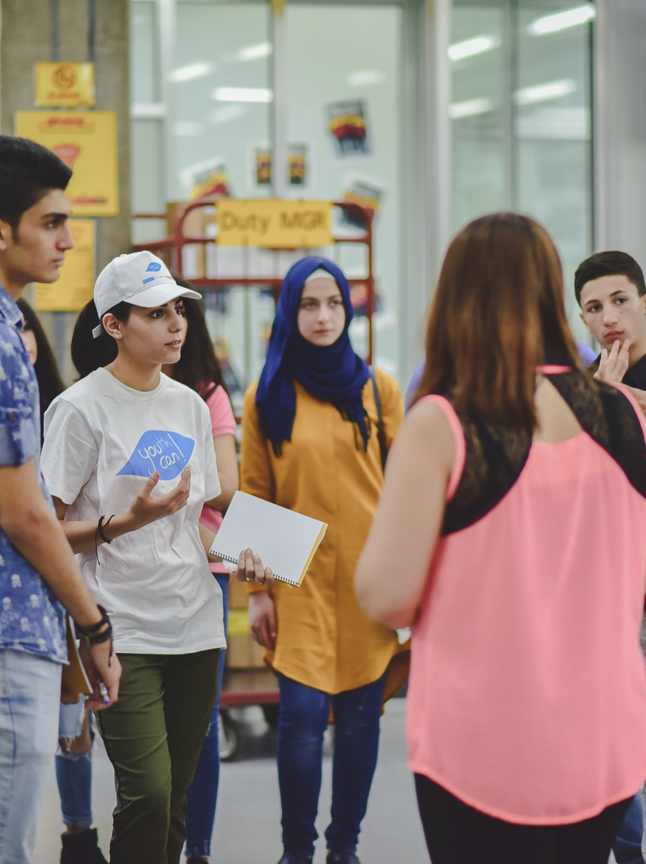
GoTeach
CREATING Value for Society and Business
Name of presenter
Bonn, July, 2020
Group Communications, Sustainability & Brand

Slide 2

More than 267 million young people worldwide are neither in employment, education or training
For internal use
The challenge
Risk of marginalization and social exclusion
Without education, work experience and income, especially disadvantaged young people are vulnerable to a lifetime of continued poverty

Slide 3

I want to become an independent woman
Sonali, Mumbai, India

Slide 4
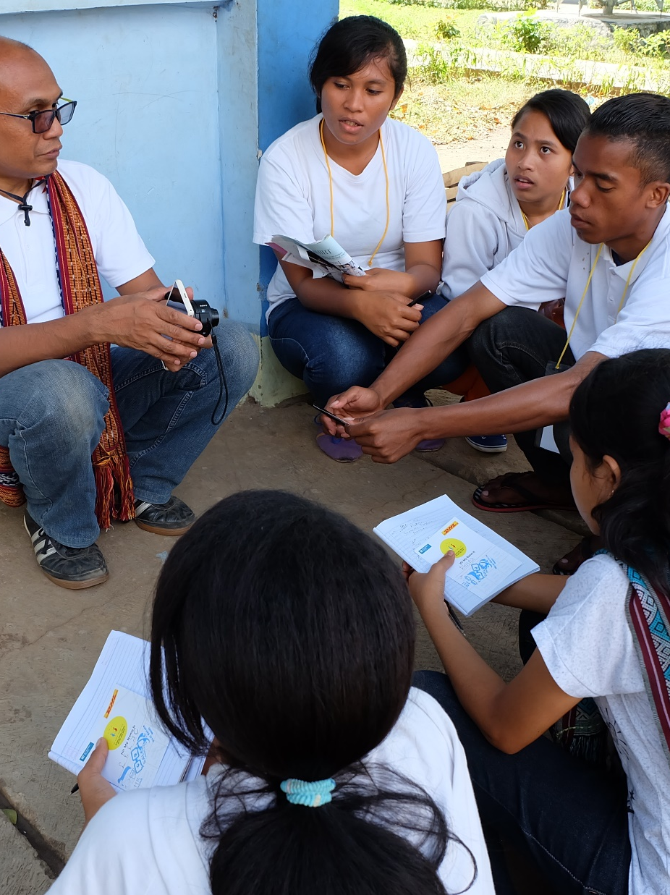
Empowering young people to attain employability skills to live an independent life
Mission
Improving employability by equipping young people with the skills and encounters needed to be prepared for the world of work
Target Group
Children (7+) and young people (15+) in need as a result of poverty, loss of family or being forced to flee their country
Lead partners
SOS Children‘s Villages & Teach For All network
Main lever
Local employees interact with children and young people to bring the world of work to life by sharing their know-how and experience
Goals
SDG 4 & 8: Empower children and young people to fulfill their potential by developing their mindsets, life skills, and capacity to reach their aspirations and connecting them to the world of work
SDG 17: Demonstrate best practices and drive multi-stakeholder partnerships to scale solutions

Slide 5



With Teach For All and SOS Children’s Villages we are delivering on shared missions
For internal use
In 2040, communities in every part of the world are enabling all their children to have the education, support and opportunity to shape a better future for themselves and all of us.
Every child belongs to a family and grows with love, respect and security.

Slide 6






GoTeach goes beyond giving money
Time
contributions
Cash
contributions
CONTRIBUTIONS FOR PARTNER ORGANISATIONS
Management
costs
Social
innovations
& networks

Slide 7

Leveraging our unique strenghts and assets
Logistics competencies
Experience, knowledge & time of employees
Global reach and local presence
*) in 2018

Slide 8
The global GoTeach program for employability was launched in 2009 and has by now established 68 national partnerships in 58 countries worldwide
20 Teach For All partners
48 SOS Children’s Villages
EUROPE Armenia – Germany – Denmark – Spain – UK* – Lithuania – Serbia – Sweden
MENA Jordan – Lebanon – Syria
ASIA PACIFIC Indonesia – Sri Lanka – Thailand – Vietnam – Bangladesh – Cambodia – India – Malaysia - Philippines
AMERICAS Argentina – Bolivia – Brazil – Chile – Colombia – Costa Rica – Dominican Republic – Ecuador – El Salvador – Guatemala – Haiti – Honduras – Jamaica – Mexico – Nicaragua – Panama – Paraguay – Peru
AFRICA Benin – Burundi – Cape Verde – Ghana – Ethiopia – Ivory Coast – Kenya – Lesotho – Mali – Mauritius – Madagascar – Morocco – Nigeria – South Africa – Senegal – Swaziland – Tanzania – Togo – Uganda
*) in cooperation with the DHL UK Foundation

Slide 9
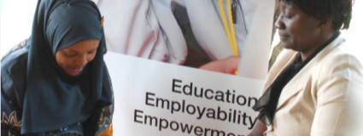
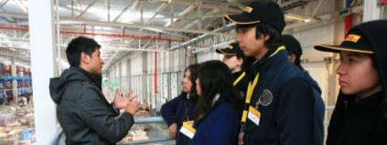
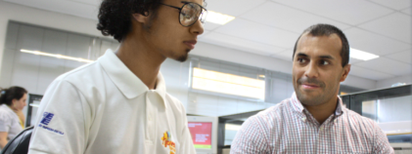
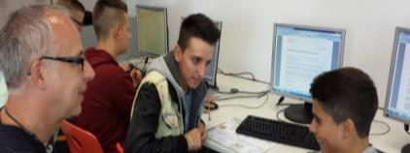
Our employees contribute their time and expertise through activities in cooperation with local partners
EXAMPLES
Kenya
Chile
1
2
Mentoring
Facility visits
Brazil
Germany
3
4
Work experience
Skills training

Slide 10

Research found that encounters with volunteers from the world of work make a real difference to young people
Young adults … who recalled four or more employer contacts such as career talks or work experience while at school were five times less likely to be NEET (not in education, employment or training) and earned, on average, 16% more than peers who recalled no such activities.
Source: Dr Dr Anthony Mann, Director of Research and Policy, Education and Employers Taskforce: It’s who you meet: why employer contacts at school make a difference to the employment prospects of young adults , 2012

Slide 11








2019, more than 2,000 employees contributed to our GoTeach partnerships – more than 11,000 beneficiaries benefitted from the program
58
2,040
20,700
Countries
Employee volunteers
Hours dedicated
69
11,670
1
National partner organizations
Lives directly impacted
Multi-stakeholder platform participation

Slide 12
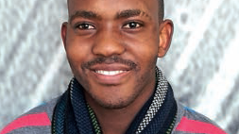
”I grew up in the SOS Children‘s Village in Cape Town. Nisa has been my mentor since 2012. The GoTeach program brought us together. In the meantime I have completed my apprenticeship and now have a permanent position at DHL in South Africa. Now I‘m supporting young people from the SOS Children‘s Village, where I come from.“
Keeper Bonase, former mentee, now DHL employee, SOS CV South Africa

Slide 13

Corporate Citizenship impacts employee engagement
59% of staff feel encouraged to participate in a CC program
78% of staff agree that our CC programs make them proud to work for this company
81% of staff believe that our CC programs have a positive impact on our company culture
86% of staff think that our CC programs support the goals of enhancing the company’s reputation
1
2
3
4
Source: MRSC Employee Shuttle Survey on Corporate Citizenship, November 2019

Slide 14
FURTHER MATERIAL

Slide 15


The global GoTeach program for employability was launched in 2009 and has by now established 68 national partnerships in 58 countries worldwide
LATIN AMERICA Argentina – Bolivia – Brazil –Chile – Colombia – Costa Rica – Dominican Republic – Ecuador – El Salvador – Guatemala – Haiti – Honduras – Jamaica – Mexico – Nicaragua – Panama – Paraguay – Peru – Uruguay
AFRICA Benin – Burundi – Cape Verde – Ghana – Ethiopia – Ivory Coast – Kenya – Lesotho – Mali – Mauritius – Madagascar – Morocco – Nigeria – South Africa – Senegal – Swaziland – Tanzania – Togo – Uganda
ASIA PACIFIC Indonesia – Sri Lanka – Thailand – Vietnam
EUROPE Lithuania – Serbia – Sweden
MENA Jordan – Lebanon – Syria
LATIN AMERICA Argentina–Chile – Colombia – Ecuador – Paraguay – Peru – Uruguay – Mexico
AFRICA Uganda
ASIA PACIFIC Bangladesh – Cambodia – India – Malaysia - Philippines
EUROPE Armenia – Germany – Denmark – Spain – UK*
MENA Lebanon
48
20
national SOS CV organizations
national Teach For All partners
*) in cooperation with the DHL UK Foundation

Slide 16




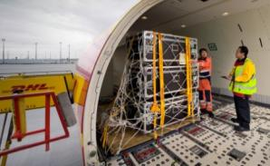
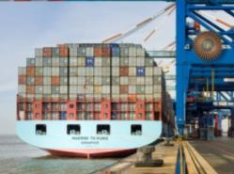



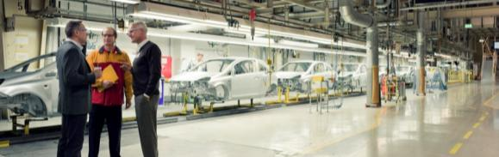
Who we are – a global company with a unique portfolio
As the world’s leading logistics company, we enable global trade in over 220 countries and territories
No. 1 in international express delivery
Europe’s largest postal service
Leader in the forwarding business
Partner for e-commerce and a pioneer in secure digital communications
No. 1 in contract logistics

Slide 17


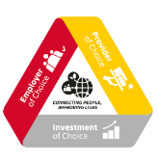


Our Strategy 2025 will focus on performing at best in class standards across the three bottom lines within the profitable core of each BU, in a sustainable way
For internal use
Our Purpose: Connecting People, improving lives
Our Vision: We are the logistics company for the world
Our Values: Respect and Results
OUR PURPOSE
CONNECTING PEOPLE, IMPROVING LIVES
Our Mission: Excellence. Simply delivered.
Along the three bottom-lines in a sustainable way
Enabled by Common DNA
We exist to connect people and improve their lives.
We enable trade and help businesses and people grow.
And we are taking responsibility for the world we live in.
Our Business Unit focus:
Strengthening the profitable core
Supported by Group functions
Profitable Core
Digitalization

Slide 18



Ensuring our contribution as a company and as a corporate citizen to the global sustainability agenda
UN Global Compact
SDG Commitment
10 principles of the UN Global Compact
signed in 2006
published in March 2017
Source: Deutsche Post DHL Group; https://www.unglobalcompact.org/what-is-gc/mission/principles; http://www.un.org/sustainabledevelopment/sustainable-development-goals/

Slide 19







DPDHL Group’s focus SDGs and related activities
We seek to make quality education and lifelong learning opportunities accessible for all
We support growth by facilitating global trade in a responsible manner
We minimize (transportation-induced) air pollution in cities and support disaster-affected communities
We seek to minimize our business’ impact on the environment with our environmental protection program
We collaborate with the UN and other partners to ensure the sustainable impact of our activities

Slide 20





Our four guiding principles position Corporate Citizenship as our way beyond charity
1
2
We create value for society…
We create value for business …
… by delivering to communities; making a lasting contribution to society and the environment in accordance with the SDGs
… by aligning our approach to support the company’s reputation and to attract, motivate and retain employees.
3
4
We leverage our unique strengths and assets…
We cooperate with
experienced partners…
… by utilizing our global reach and local presence, our logistics competencies and experience, knowledge and time of our employees. We encourage and support employee volunteering all year round to complement our financial support.
… by working closely together with leading partner organizations, we ensure a sustainable impact in our communities. We encourage multi-stakeholder partnerships with other companies that mobilize and share knowledge, expertise and technology.

Slide 21

We embrace our responsibilities as a corporate citizen with our vision to be the solution creator for global challenges in the societies we operate in
FOR INTERNAL USE
Mission:
We enable social innovation and programs in local communities by using our resources in collaboration with partners.
Vision:
To be the solution creator for global challenges in the societies we operate in.

Slide 22
Leveraging our unique strenghts and assets
Logistics competencies
Experience, knowledge & time of employees
Global reach and local presence
*) in 2018

Slide 23
















We work with partners to ensure a sustainable impact on the ground. In addition, we seek to facilitate large-scale change through networks and advocacy
Strategic Group-wide partners
Long-term partnerships with established partners on Group level
Strategic partners on regional/ country level
Examples:
Long-term partnerships with partners on regional or country level
Networks
Participation in multi-stakeholder platforms with other companies

Slide 24
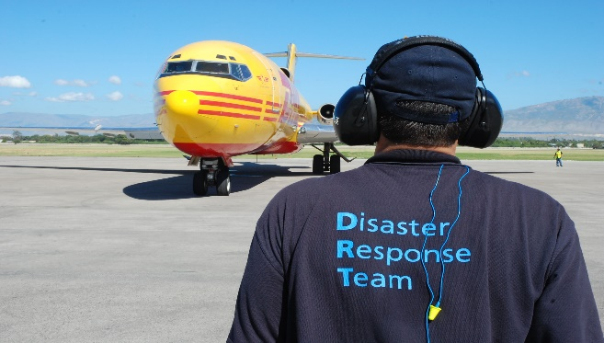
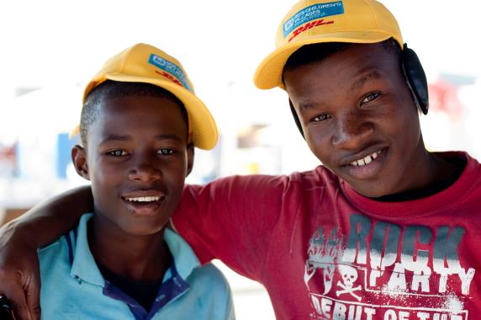
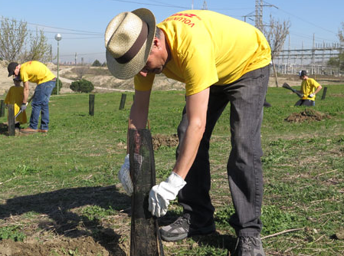














Corporate Citizenship focus
Group-wide initiatives as flagship programs show best practices whereas divisional, regional and individual initiatives with local partners aim at involving as many employees as possible
Disaster Management
Disaster Response Teams
Get Airports Ready for Disaster
Improving Employability
Partnerships with SOS Children’s Villages & Teach For All
Refugee Aid
Environmental protection
Tree planting campaign
Employee Volunteering

Slide 25

We and our partners contribute to the integration of refugees in Germany
Mission
Contribute to the integration of young refugees through vocational orientation and educational opportunities
Target Group
Refugees in Germany
Lead partner
Joblinge, Federal Employment Agency, Chambers of Industry and Commerce, Stiftung Lesen, Teach First Deutschland
Main levers
Expertise, commitment and time of our employees
Close cooperation with P&P and HR in Germany

Slide 26
Since the start of the refugee aid initiative, we were able to contribute to the integration of refugees in the German job market significantly
More than 11,000
… employment contracts with young-adult refugees signed
More than 1,200
… refugees completed internships
More than 240
… refugees in traineeships

Slide 27
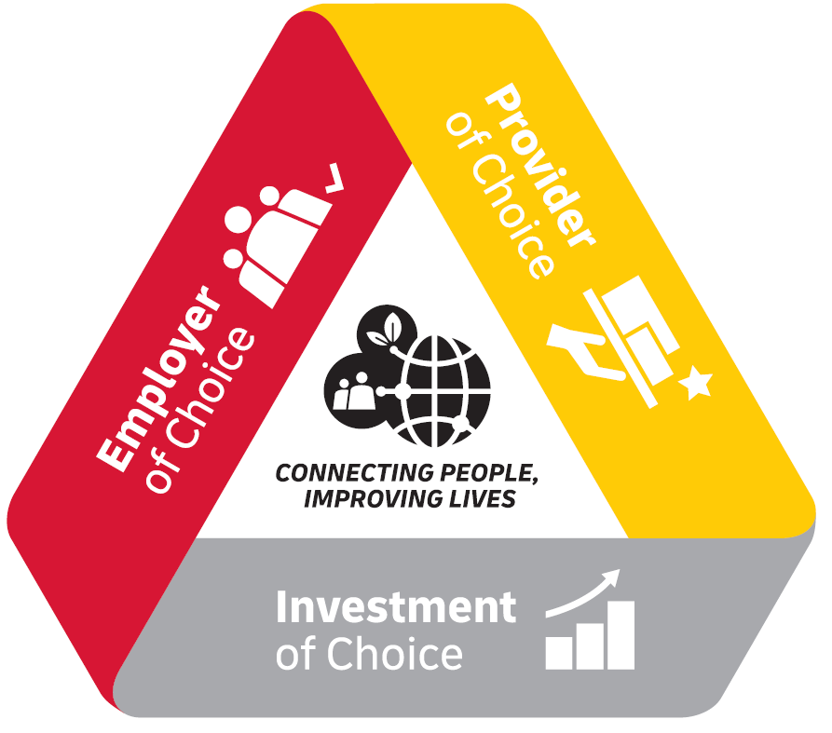
Corporate Citizenship is based on our corporate strategy and pursues business objectives to strengthen the company’s competitiveness
Employees’ functional and emotional commitment is considerably influenced by the company’s reputation for being a good corporate citizen.
Customers want to ensure environmental and ethical standards along their supply chains.
Increasingly, investors consider ESG* criteria in assessing long-term financial prospects of companies.
*) The Environmental, Social and Governance (ESG) criteria is a set of standards for a company’s operations that socially conscious investors use to screen investments.

Slide 28
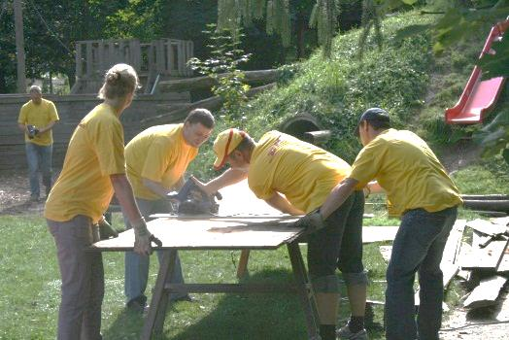
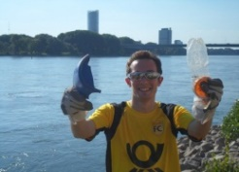
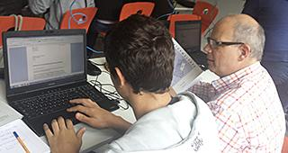
Corporate Citizenship is a strategic asset to drive employee engagement because our employees are those that ‘go the extra mile’ and help achieve business goals
CC activities at DPDHL ...
... change employees’ perception and behavior
... have impact on the company
... and influence financial KPIs
Increased profitability (revenue/profit)
Greater pride and loyalty to employer
Improved perception of the company and its products (bonding)
Increased Employee Engagement* (‘willingness to go the extra mile’)
Opportunity for personal development
Increased productivity
Increased retention
Increased customer loyalty
*) Employee engagement is the functional and emotional commitment the employee has to the organization and its goals

Slide 29
The EOS shows a solid CC performance which is among the Top10 drivers for Employee Engagement across the Group
Inspiration to act responsibly
Employee Engagement
Survey item: My company inspires me to act in a socially and environmentally responsible way.
Correlation analysis* Values of the Pearson Correlation: r = 0.69 with KPI Employee Engagement
2019 Group result:
78% favorable
*) Pearson's r can range from -1 to 1. An r of 0 indicates no linear relationship between variables, and an r of 1 indicates a perfect positive linear relationship between variables. If the coefficient value lies between ± 0.50 and ± 1, then it is said to be a strong correlation. Source: MRSC 2018

Slide 30
The amount of strongly bonded employees is extremely high among multiple CC participants
No Participation in Corporate Citizenship activities
n = 808
Participation in 1 Corporate Citizenship activity
n = 413
Participation in 2 or more CC activities
n = 170
58% of multiple volunteers are DPDHL advocates*
*) at least 2 of 3 advocate-items rated with 5 (Others would characterize me as being committed to DPDHL. In general, I speak very positively about DPDHL. I like recommending products and services of DPDHL to my friends.
“Residents”
“Committed employees”
“Advocates”

Slide 31
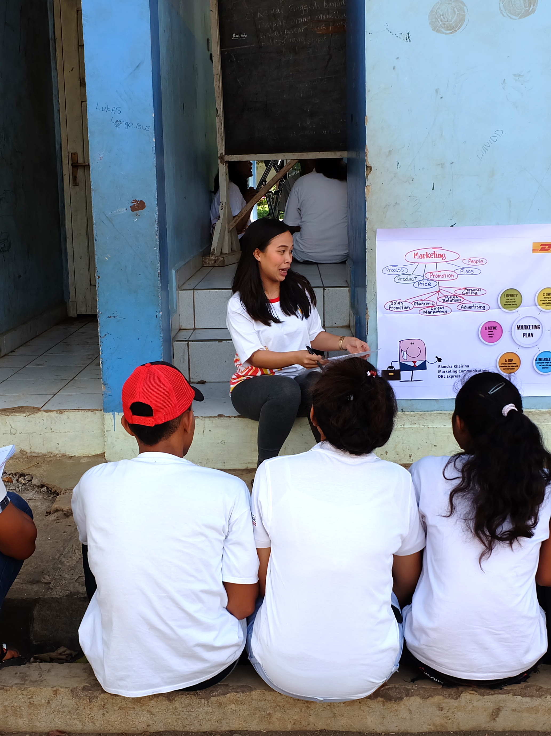

Opportunity to improve skills and knowledge of employees
59%
of employees agree that Corporate Citizenship programs give them skills and knowledge that they can also use in their daily job
Source: MRSC Employee Shuttle Survey on Corporate Citizenship, November 2019

Slide 32

Employees who volunteer in skill-based activities evaluate the positive effects of their participation in volunteering much better
… increase in
motivation
… increase in job
satisfaction
… increase in
problem solving skills
(in % favorable*)
*) Question: Thinking of your experiences with Deutsche Post DHL Group‘s Corporate Citizenship programs: To which extent do you agree with the following statements?
Source: MRSC Employee Shuttle Survey on Corporate Citizenship, November 2017

Slide 33
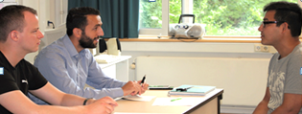

Menu of Activities (1/2)
Activity
Objective
1. Mentoring
Mentor a student, supporting them to develop the skills and attitudes needed to progress into employment, training or further education
2. CV & Interview
Session
Run a CV & Interview Skills workshop for young people – helping them to create an impactful CV and learn how to prepare for an interview
3. Site Visit
Provide an immersive and interactive site visit at a local site or office. This includes a site tour, career Q&A with DPDHL colleagues, and logistics-themed problem solving and teamwork activities.
4. Classroom
Session
Inspire students in the classroom by delivering a guest teacher lesson. As a role model, you will help the students think differently about the world of work and careers in the logistics industry.
5. Employability
Workshop
Run a workshop that supports young people to develop employability skills and helps attract more young people into Logistics.

Slide 34
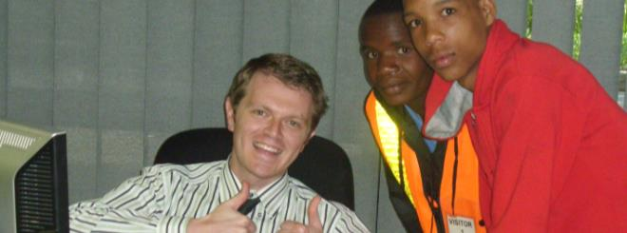
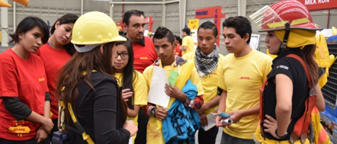

Menu of Activities (2/2)
Activity
Objective
6. Career Session
Help students develop their career plan and provide an insight into career opportunities and apprenticeships.
7. Internship
Provide a students with an opportunity to experience the working week in a real business environment, doing a job that benefits the employer and put into practice what employability skills they have already developed.
8. Job Shadowing
Young people accompany employees over a week or less to learn what it means to work in a certain area
9. Career Fair
Allow young people to obtain information about the professional work environment and provide an insight into career opportunities and apprenticeships. Stands are set up and each department the variety of professional opportunities, as well as their own work experience.
10. Entrepreneur-
ship Training
Train young people to start their own business covering areas like business plan writing, promoting their business, looking for funds etc.

