Slide 1
JOB SHADOWING
GUIDE FOR THE JOB SHADOWER

Slide 2

About job shadowing

Slide 3

ABOUT JOB SHADOWING
About this guide
Congratulations on your decision to participate in job shadowing!
Job shadowing is an excellent way to gain insight into a career field or specific job role and get hands-on experience in the workplace. The purpose of this guide is to help you prepare for your job shadowing session, so you can make the most of your experience.

Slide 4
ABOUT JOB SHADOWING
What is job shadowing?
Job shadowing is a process of following an experienced employee and observing their daily activities. It is a way of learning by doing and a valuable experience that helps you understand the ins and
Objective
Job shadowing as part of the GoTeach program at DPDHL is aimed at helping young adults who want to learn about doing a job that they don't have experience in. It gives a much deeper insight into what a job involves than just reading job descriptions or asking people questions.

Slide 5
ABOUT JOB SHADOWING
Location
The location where the job shadowing takes place is agreed upon between the job shadow (The employee who is observing the co-worker) and the host (The person who has agreed to be observed/shadowed). Ideally it should take place in the host’s workplace.
Method
Face to face is the most preferred way for job shadowing. Students typically job shadow individually, but on occasion small groups of up to two or three students might visit a workplace.

Slide 6
ABOUT JOB SHADOWING
Location
The location where the job shadowing takes place is agreed upon between the job shadow (The employee who is observing the co-worker) and the host (The person who has agreed to be observed/shadowed). Ideally it should take place in the host’s workplace.
Method
Face to face is the most preferred way for job shadowing. Students typically job shadow individually, but on occasion small groups of up to two or three students might visit a workplace.

Slide 7
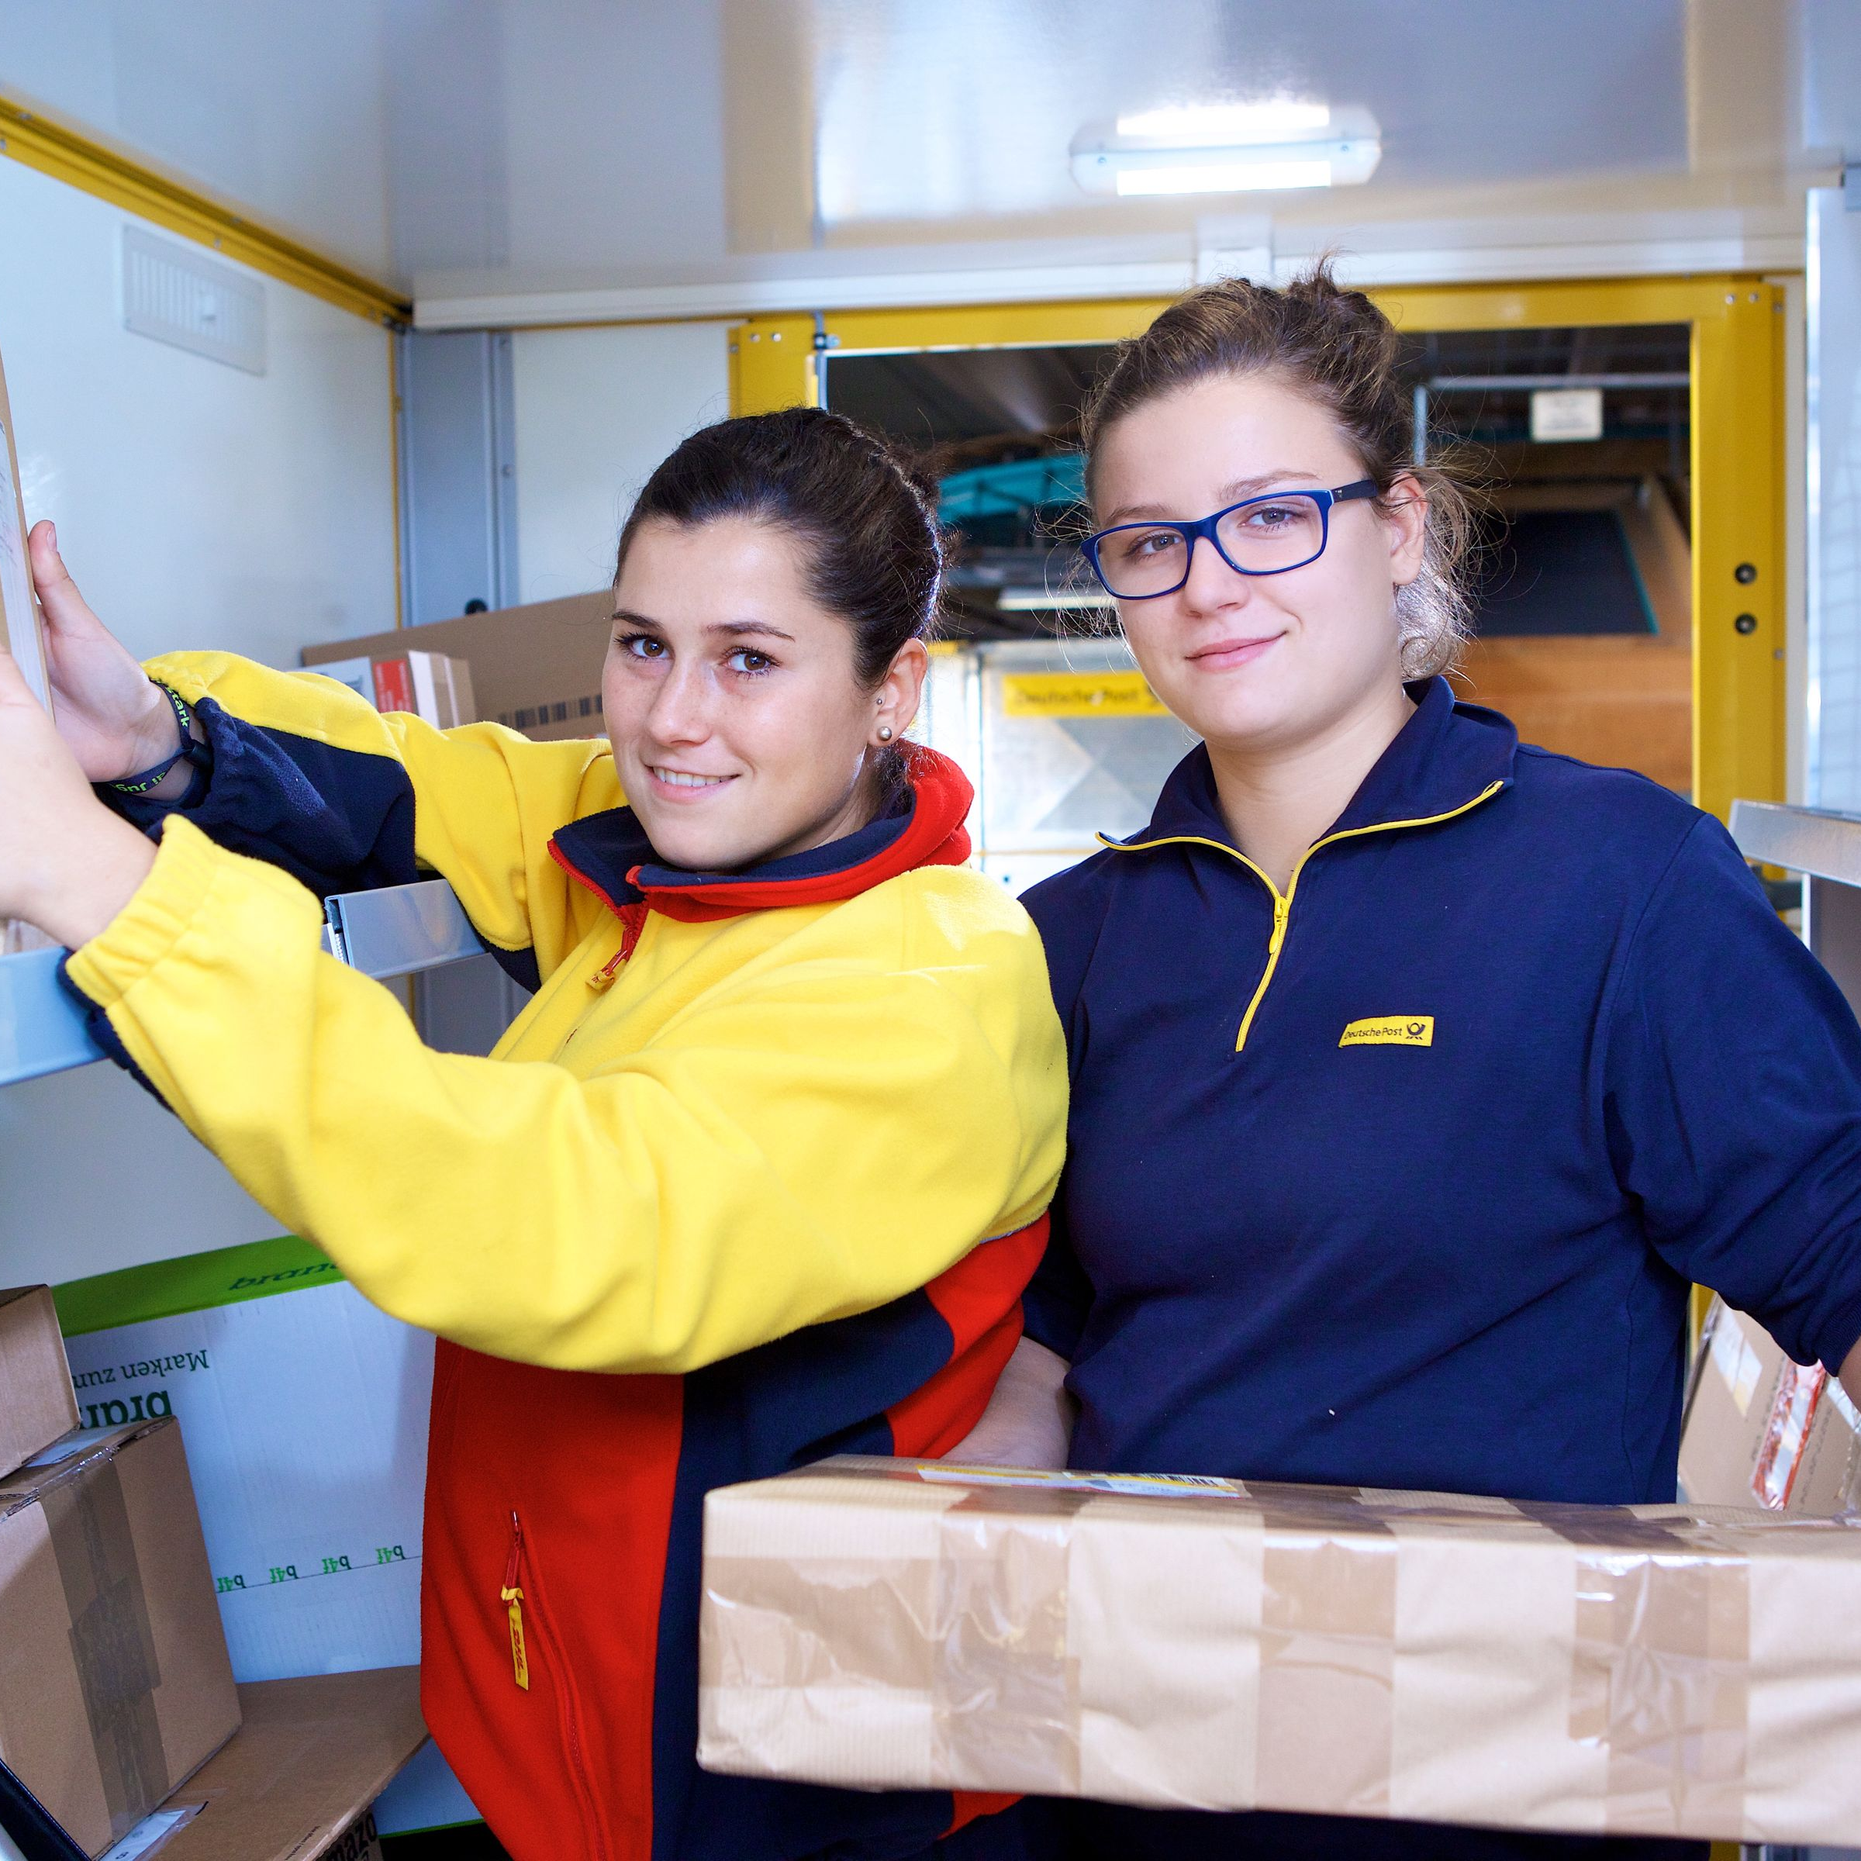
ABOUT JOB SHADOWING
Duration
A job shadow varies in length from a few hours to two workweeks. You may only want to spend one day, or you may want to shadow a few hours a week for several weeks or months. This should be agreed upon between the job shadow and the host.

Slide 8

Activities

Slide 9

ACTIVITIES
What activities can you expect?
Job shadowing activities can vary depending on the nature of the job and the goals of the shadowing program. On the next pages you will find a list of some typical job shadowing activities that could be included.
Observing the daily routine of the job:
This might include attending meetings, observing the work being done, and talking with employees.

Slide 10
ACTIVITIES
Meeting with different departments:
Depending on the job, it might be beneficial to meet with people from different departments to learn about their roles and how they interact with the job you're shadowing.
Hands-on experience:
In some cases, job shadowing might involve some hands-on experience, such as assisting with a task or project.
Networking:
Job shadowing can be a great way to make connections in the industry and build your professional network.

Slide 11

ACTIVITIES
Reviewing documentation:
Reviewing available documents about the company or the job can help you understand the job, the company, and the industry better.
Job shadowing report:
Some job shadowing programs require participants to write a report on their experience, including what they learned and any insights they gained.
Overall, job shadowing activities should be tailored to the specific job and your needs. It's important to have clear goals and expectations for the program to ensure that it is beneficial for everyone involved.

Slide 12

Preparation

Slide 13
PREPARATION - BEFORE THE SESSION
Confirm the date, time, and location of the job shadowing session
Set goals: What do you hope to learn from your job shadowing experience? What skills do you want to observe or practice? Set specific goals for your experience and communicate them to the host
Research the company and job role: Before your job shadowing session, research the company and the job role you will be shadowing. Look for information about the company's mission and values, the products, or services they offer, and any recent news or developments
Observe and take notes: Pay close attention to what your host is doing and how they are doing it. Take notes on the tasks they are performing, the tools they are using, and any other details that may be helpful

Slide 14

PREPARATION - BEFORE THE SESSION
Ask questions: Don't be afraid to ask questions. Your host is there to help you learn, so ask about anything you don't understand
Dress: Align with your host what is the appropriate dress at the location you are are visiting.
Bring: a notebook and pen to take notes
Lunch: Clarify with the host if lunch is provided or you should bring your own lunch
Transport: Find out how to get best to the location (public transport?)

Slide 15
PREPARATION - BEFORE THE SESSION
CLARIFY DATE AND TIME AND DEFINE YOUR GOALS
Job Role:
Date:
Time:
Goals:

Slide 16

PREPARATION - DURING THE SESSION
Arrive on time
Be respectful and professional
Observe and take notes
Ask questions
Be proactive and volunteer to help with tasks
Network with employees

Slide 17
QUESTIONS

Slide 18

PREPARATION - AFTER THE SESSION
Reflect on what you learned
Review your notes
Stay connected with the person you shadowed. Send a thank- you note and follow-up with any questions or insights you gained from the experience.
If you felt uncomfortable or noticed that any boundaries were crossed during the activities, report through the safeguarding channels.

Slide 19
YOUR REFLECTIONS – YOUR LEARNING
What are your main take aways from this job shadowing experience? Did you meet your goals?
2. Note any actions you want to take:

Slide 20

Some final tips

Slide 21
DOs
Be professional: be on time, friendly, approachable and polite.
Be attentive and engaged: Pay attention to what is happening around you, ask questions, and show interest in the job.
Take notes: Write down what you observe and learn during your job shadowing experience. This will help you remember key details later.
Respect company policies: Follow the company's policies and procedures, such as confidentiality agreements and safety regulations.
Build relationships: Take advantage of the opportunity to network and make connections with people in the industry.

Slide 22
DON’Ts
Interfere with the workplace: Be respectful of the working times and space of the people you are shadowing
Share confidential information: Respect the confidentiality of any information you learn during your job shadowing experience.
Overextend yourself: Don't take on tasks that are not directly approved by your host/supervisor. While it is important to learn by doing, do prioritize your host's tasks over other members of the team unless otherwise indicated.
Overstay your welcome: Stick to the schedule that has been arranged for your job shadowing experience, and don't overstay your welcome.
By following these dos and don'ts, you can make the most of your job shadowing experience and leave a positive impression with the host you are shadowing.

Slide 23

CONCLUSION
Job shadowing is an excellent way to gain insight into a career field or specific job role. By following the suggestions and checklist in this guide, you can prepare yourself for a successful job shadowing experience. Remember to be professional, ask questions, and make the most of your opportunity to learn.
Good luck!

Slide 24
Disclaimer:
The material contains images from Shutterstock. These images cannot be used in any other materials by anyone without applicable Shutterstock licensing.
Some of the icons used in this material originate from Flaticon.

