Slide 1
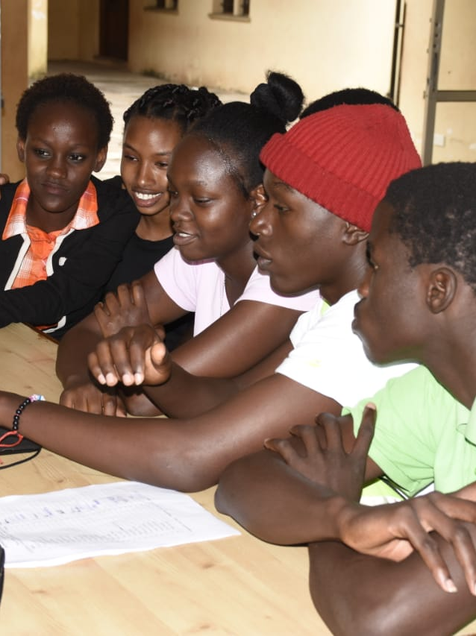


GoTEACH REPORTING
HANDBOOK

Slide 2
Agenda
1 | What is the MyVolunteering Platform?
2 | Reporting Requirements
3 | Activities
4 | Tutorial: Using the Microsite for Reporting
5

Slide 3


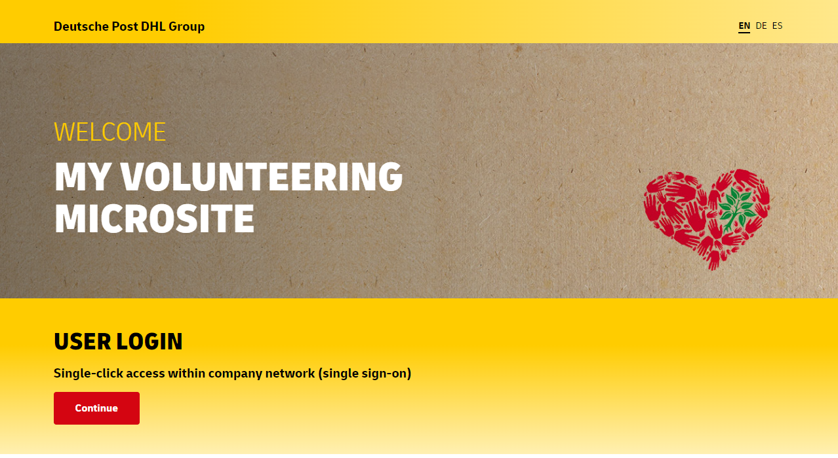
Let’s start with some theory
        We use the DPDHL MyVolunteering Microsite for Reporting our GoTeach activities.
          What is the DPDHL Microsite?
The MyVolunteering Microsite (www.volunteering-dpdhl.com) is a company-wide site giving our employees an overview over all Volunteering opportunities. You can use it to find volunteers for a project you organized or to find a project where you can contribute. Also, it is used for reporting, so we can monitor the results our volunteering activities have.
Sign in with single-click access within the company network.

Slide 4

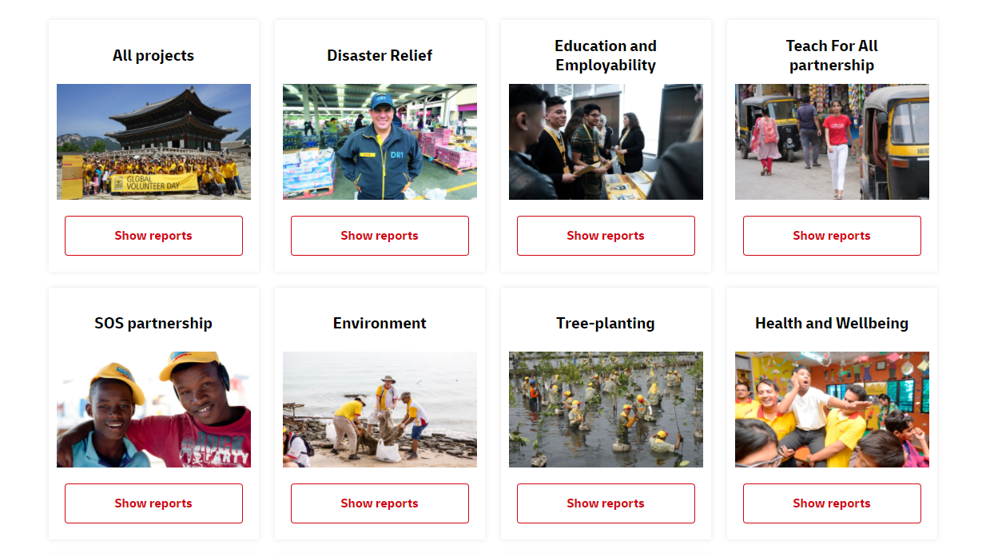
Let’s start with some theory
          You can find past volunteering projects from your colleagues on the front page, scrolling down.

Slide 5







Let’s start with some theory
          Why is Reporting important for GoTeach?
          Our goal is to contribute to the SDGs, most importantly to SDG 4 (Quality Education), SDG 5 (Gender Equality), SDG 8 (Decent Work and Economic Growth) and SDG 17 (Partnerships for the Goals). To measure how large our contributions is in numbers, i.e. how many young people we are reaching with our projects, we need reliable numbers by every single volunteer and contributor.
          Please note, that every Volunteering activity for SOS Children‘s Villages and Teach For All network partners has to be reported!
          On the next page you can find the Input and Output KPI’s we are measuring.

Slide 6

GoTeach reporting requirements to be collected by myVolunteering platform on activity level as of 2022
UNCLASSIFIED (PUBLIC)
          Inputs - Resources
  # of volunteers actively involved in the partnership
  Total # of volunteering hours
    thereof in working time
    thereof in own time
  Total # of partnership activities with a duration of…
    1 day
    2-3 days
    6-19 days
    >20 days
  Total amount of financial contribution in €
    thereof donations
    thereof project costs (e.g. material costs, …)
  Total amount of in-kind donations in €
          Outputs – Services and products
  Total # of partnership activities implemented
    thereof # of activities in a virtual format/mode
    thereof # of activities implemented face-to-face format
    thereof # of activities implemented in a blended format
  Total # of program participants who directly benefit from activity
  Thereof # of program participants who benefit from
    professional skills training
    life/soft skills development
    career guidance and orientation on job profile
    mentoring
    job shadowing
    internship/apprenticeship
    entrepreneurship activity
    an activity focused on gender equality
    classroom session (only for TFAll)
    other activities

Slide 7
Activities
Mentoring | Long-term relationship supporting the mentee to develop the skills and attitudes needed to progress into employment, training or further education
Professional skills training | Training or workshop on hard skills such as language skills, ICT skills, job hunting skills (CV and application letter writing and interview skills)
Life/Soft skills development | Training or workshop on personal-oriented interpersonal skills, such as effectively communicating, team work, collaboration skills, taking responsibility, problem solving
Career guidance and orientation on job profile | All activities to help young people to identify career options, such as career day/fair (to provide an insight into career opportunities and apprenticeships), company visit at a local site or office etc.
Classroom session | Delivering a guest teacher lesson to inspire students in the classroom as a role model (only applicable for Teach For All partnership)
Internship/apprenticeship | Young people get the opportunity to work in one or rotate through different departments in a company for a period of 1 week up to several months
Job shadowing | Young people accompany employees over a week or less to learn what it means to work in a certain area in a real business environment
Entrepreneurship | Training for young people on how to start and/or run their own business
Other activity | Other activities that do not fit into the above categories, e.g. renovation work

Slide 8



TUTORIAL
USING the VOLUNTEERING MICROSITE FOR GOTEACH REPORTING:
STEP BY STEP GUIDE THROUGH GOTEACH REPORTING

Slide 9
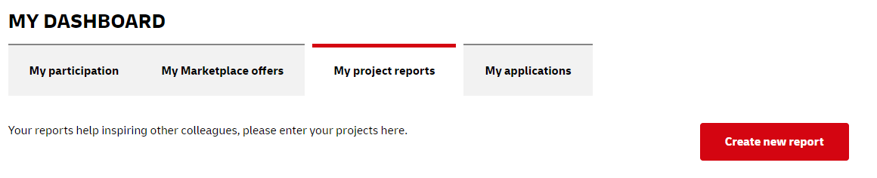
STEP 0: Open the Microsite and go to Reporting
        Open https://www.volunteering-dpdhl.com/ and sign in with your DPDHL-account.
        Scroll down to my dashboard and click on „My project reports“ and click „create new report“

Slide 10
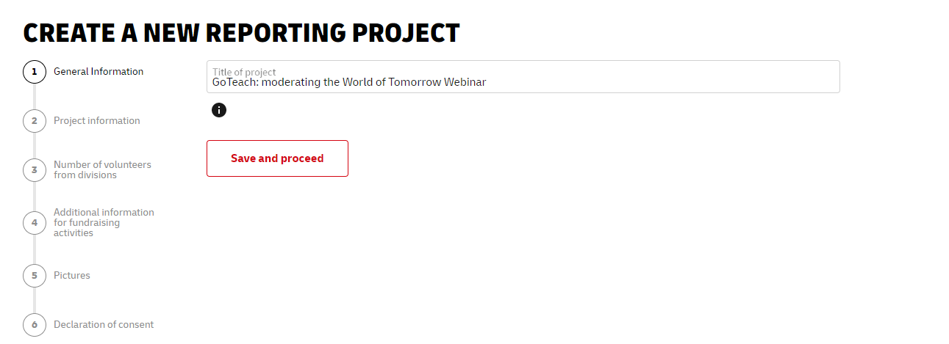
STEP 1: General Information

Slide 11
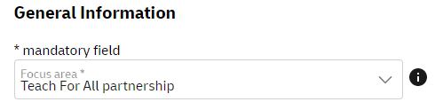

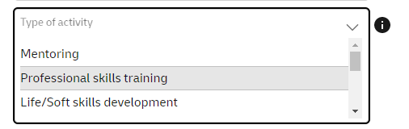
STEP 1: General Information
        Choose “Teach For All partnership” or “SOS partnership” for focus area
You can find additional information on the field by clicking on
        Select the Type of Activity based on the description in Slide 7

Slide 12
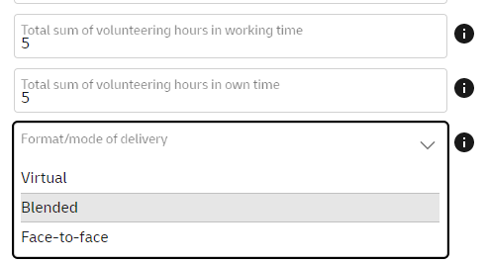

STEP 1: General Information – How to count volunteer hours
Please enter the total number of hours volunteered by employees for the project during working hours and own time separately. Please provide one figure for all employees who were involved, e.g. 3 employees worked for 5 hours = 15.
Please use the following calculation
Internship activities: Number of youths * number of internship days * 1 h volunteering time per intern per day
Job shadowing activities: Number of youths * number of internship days * 2 h volunteering time per intern per day

Slide 13

STEP 1: General Information – Format/mode of delivery
Blended formats generally apply to mentoring or training practices using both online and in-person approaches.

Slide 14
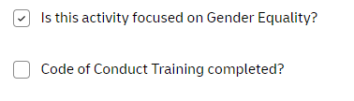
STEP 1: General Information: Gender Equality
Improving Gender Equality (SDG 5) is a new strategic GoTeach target. Please indicate if your Volunteering activity was focused on Gender Equality.
Take action to empower girls and young women to make the best use of their abilities and skills in line with closing the gender gap in youth employability

Slide 15
STEP 1: General Information: Code of Conduct
Relevant only for SOS activities:
Please make sure that you have completed the Code of Conduct Training.
The aim of a code of conduct is to ensure that all DHL colleagues involved in a GoTeach program or activity understand the importance of protecting the children and young people that we support through the GoTeach program, our colleagues and ourselves.

Slide 16
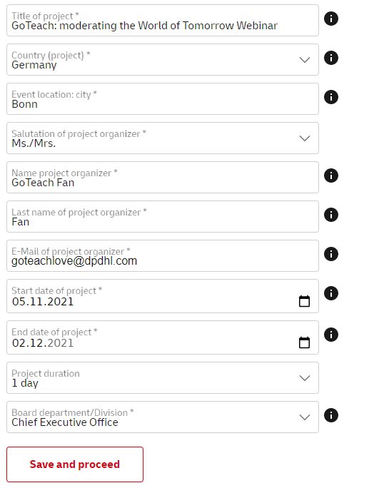
STEP 1: General information
Board department or division: please insert your (the volunteer filling out the project report) department
Please indicate the duration of your project: 1, 2-5 or 6-19 or >20 days.

Slide 17
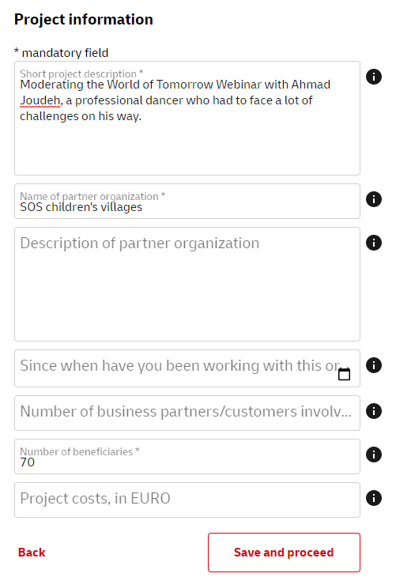

STEP 2: Project information
Give a short summary of the project. What is the aim of the project? What is the project's impact on society/environment? Which measures have been realized? What makes your project special? What are the tasks of the volunteers in the project? How do they provide concrete support? What skills and strengths do the volunteers bring to the project?
Please briefly describe your partner organization and their overall targets.
Notes:
Add explanations? Otherwise, think about redesigning this.

Slide 18
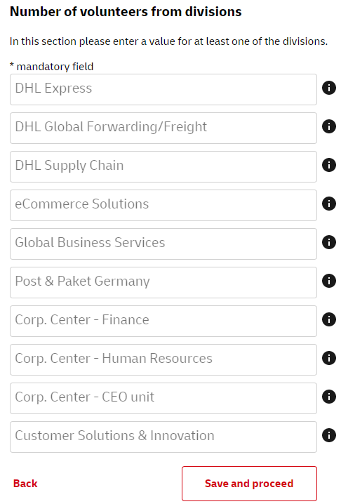
STEP 3: Number of volunteers from divisions
Please enter the number of volunteers from each organizational unit.

Slide 19
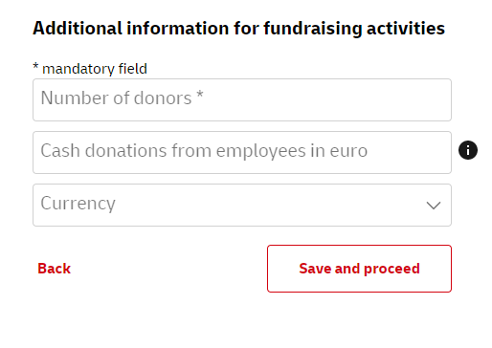

STEP 4: Additional information for fundraising activities
Financial donations to organizations in Euro.

Slide 20
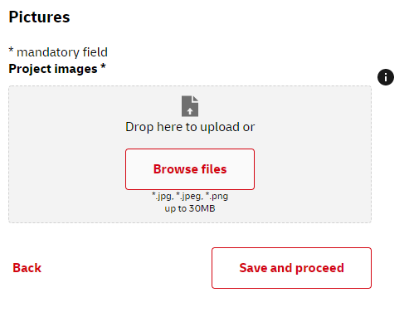
STEP 5: Upload any pictures you have
We are always looking for high-quality pictures of our GoTeach Activities.
On the next page you find some information on how to create the best pictures. Please make sure to name the files properly, e.g. Country_Activity_Year.

Slide 21
STEP 5: How to create amazing pictures
IMPORTANT:
Find out from your GoTeach Partner if you are allowed to publish photographs of the young people. Please also confirm if your partners have any guidelines for you to follow, e.g. close-ups of young people‘s faces may not be allowed. Others may allow any shots to be taken. It is always important to check!
          Photography guidelines
  Show your Volunteer activity in action
  Show interaction between DPDHL/DHL Volunteers and beneficiaries
  Make group shots of volunteers and/or beneficiaries
  If possible, make sure you can see the DPDHL/DHL logo on standees
  or banners
          Colors and Light
  We prefer pictures with natural light, taken outside or during daytime
  We want people to see how colorfoul GoTeach is – try to make it colorful but not exxagerated
  Don‘t use artificial productions
  For more information on how to take great photos, please visit: Imagery (dpdhl-brands.com)

Slide 22

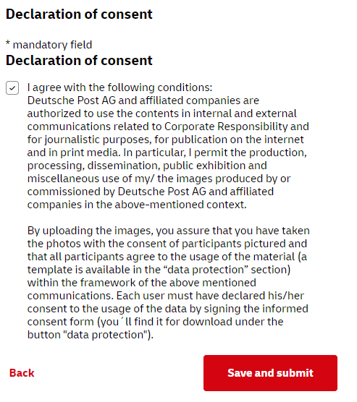
STEP 6: Tick the box

Slide 23
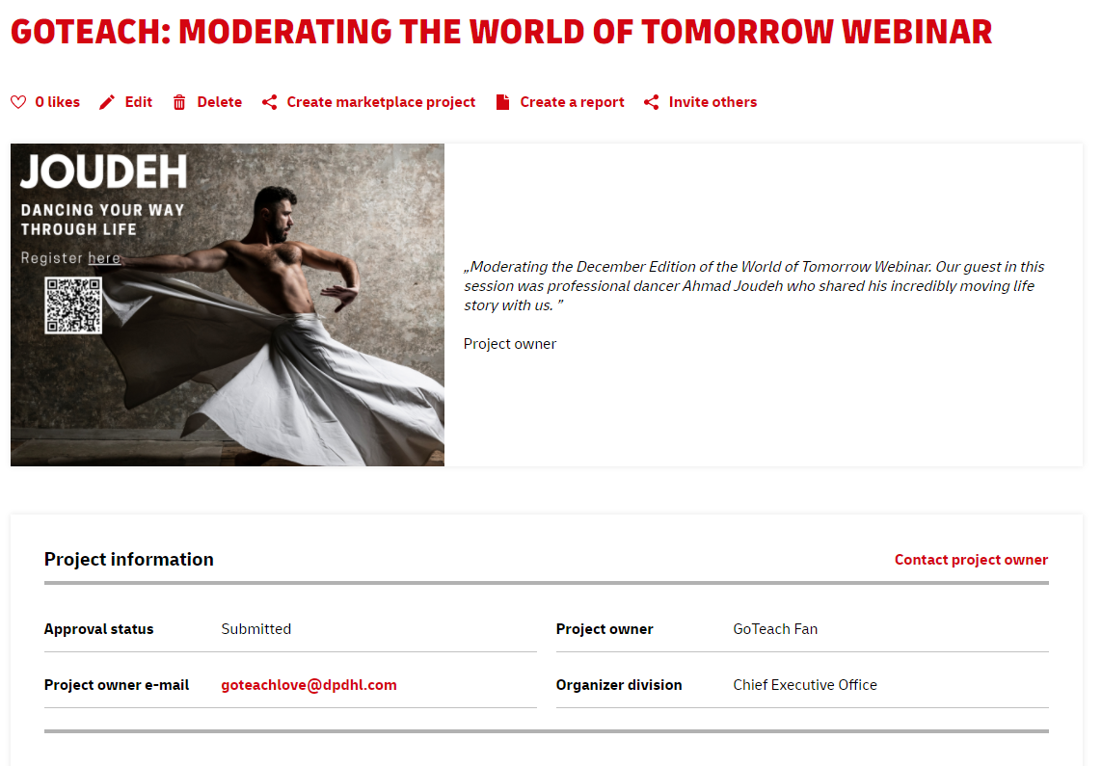
DONE
You and everyone else can now see all the details of the report. You can still edit your report by clicking on the icon „edit“ or share it with others.
Find a full Tutorial on the next page.

Slide 24


THANK YOU FOR VOLUNTEERING WITH US
AND HELPING US MAKE THIS WORLD A BETTER PLACE FOR EVERYONE

Slide 25
Any QUESTIONS?
For Any further questions, please contact your regional coordinator
Head of Sustainability Communications and Programs Ι Christoph Selig
Program Manager SOS Partnership Ι Banalata Sen
Program Manager Teach For All Partnership Ι Annette Wollmann
Program Manager Europe Ι Susanne Novotny
Program Manager MENA Ι Najwa Raslan
Program Manager Americas Ι Andrea Colchado Olivera
Program Manager Africa & Indian Ocean Ι Faneva Raharimanantsoa
Program Manager APAC Ι Thomas Ng
Raphael Orrego Flores
English Africa Ι Leigh Swartz
English Africa Ι Itumeleng Ralebitso
French, Portuguese Africa & Indian Ocean Ι Linda Rasamoelinianina

