Slide 1




GoTeach
For InTernal USE
Slides for Town Halls
October 2019
S

Slide 2

“I want to become an independent woman.” – Sonali, Mumbai

Slide 3

GoTeach – The Challenge
More than 64 million young people worldwide are unemployed. Many more do not earn enough to build a stable, independent life
Risk of marginalization and social exclusion:
Without education, work experience and income, especially disadvantaged young people are vulnerable to a lifetime of continued poverty
Source: International Labour Organization (ILO)

Slide 4








GoTeach – Main focus and target group
We support children and young people to fulfill their potential and increase their employment prospects
Improve employability
SDG 4 & 8: Enable children and youth to fulfill their potential by developing their mindsets, life skills, and capacity to reach their aspirations and connecting them to the world of work
SDG 17: Offer best practices and multi-stakeholder partnerships to scale solutions (collective impact approach)
Mission
Key objectives
Children (7+) and young people (15+) who are socio-economically disadvantaged due to poverty, loss of family and fleeing
Target group
Teach For All network
SOS Children‘s Villages
Lead partners
Main lever
Local employees interact with children and youth to bring the world of work to life by sharing their experience and expertise
+
supporting partners in the countries

Slide 5
GoTeach – Footprint
The global GoTeach program for employability was launched in 2009 and has by now established 66 national partnerships in 55 countries worldwide
LATIN AMERICA Argentina – Bolivia – Brazil –Chile – Colombia – Costa Rica – Dominican Republic – Ecuador – El Salvador – Guatemala –Haiti – Honduras – Jamaica – Mexico – Nicaragua – Panama – Paraguay – Peru – Uruguay
AFRICA Benin – Burundi – Cape Verde – Ghana – Ethiopia – Ivory Coast – Kenya – Mali – Mauritius – Madagascar – Nigeria – South Africa – Senegal – Swaziland – Tanzania – Uganda
ASIA PACIFIC India – Indonesia – Sri Lanka Thailand – Vietnam
EUROPE Lithuania – Serbia – Sweden
MENA Jordan – Lebanon – Morocco – Syria
LATIN AMERICA Argentina–Chile – Colombia – Ecuador – Paraguay – Peru – Uruguay – Mexico
AFRICA Uganda
ASIA PACIFIC Armenia – Bangladesh – Cambodia – India – Malaysia – Philippines
EUROPE Germany – Spain – UK*
MENA Lebanon
47
national SOS CV organizations
19
national Teach For All partners
*) in cooperation with the DHL UK Foundation

Slide 6
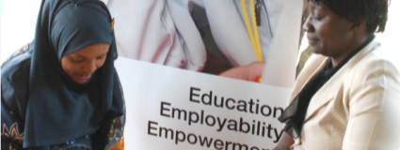
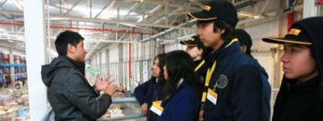

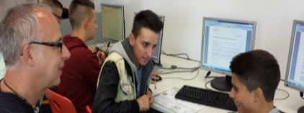
GoTeach – Partnership Activities
GoTeach offers a range of activities, including trainings, access to role models as well as mentors and hands-on experience in a real working environment
Kenya
Chile
1
2
Mentoring
Facility visits
Brazil
Germany
3
4
Work experience
Skills training

Slide 7
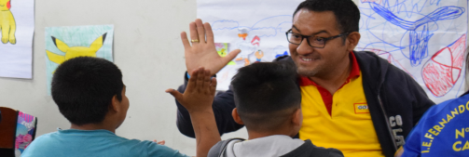

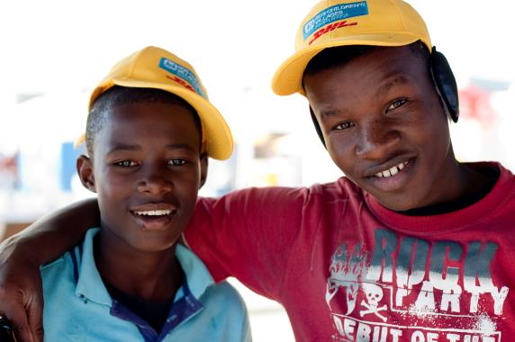

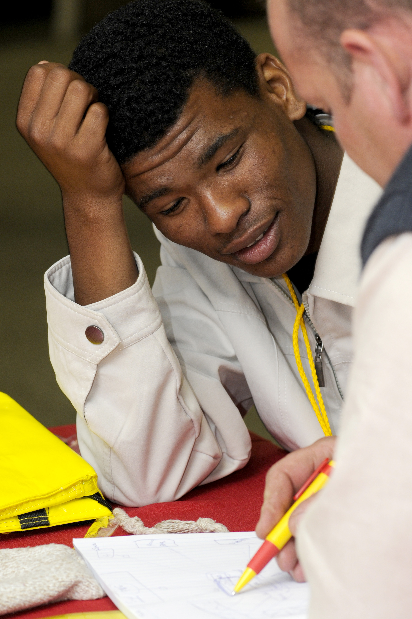
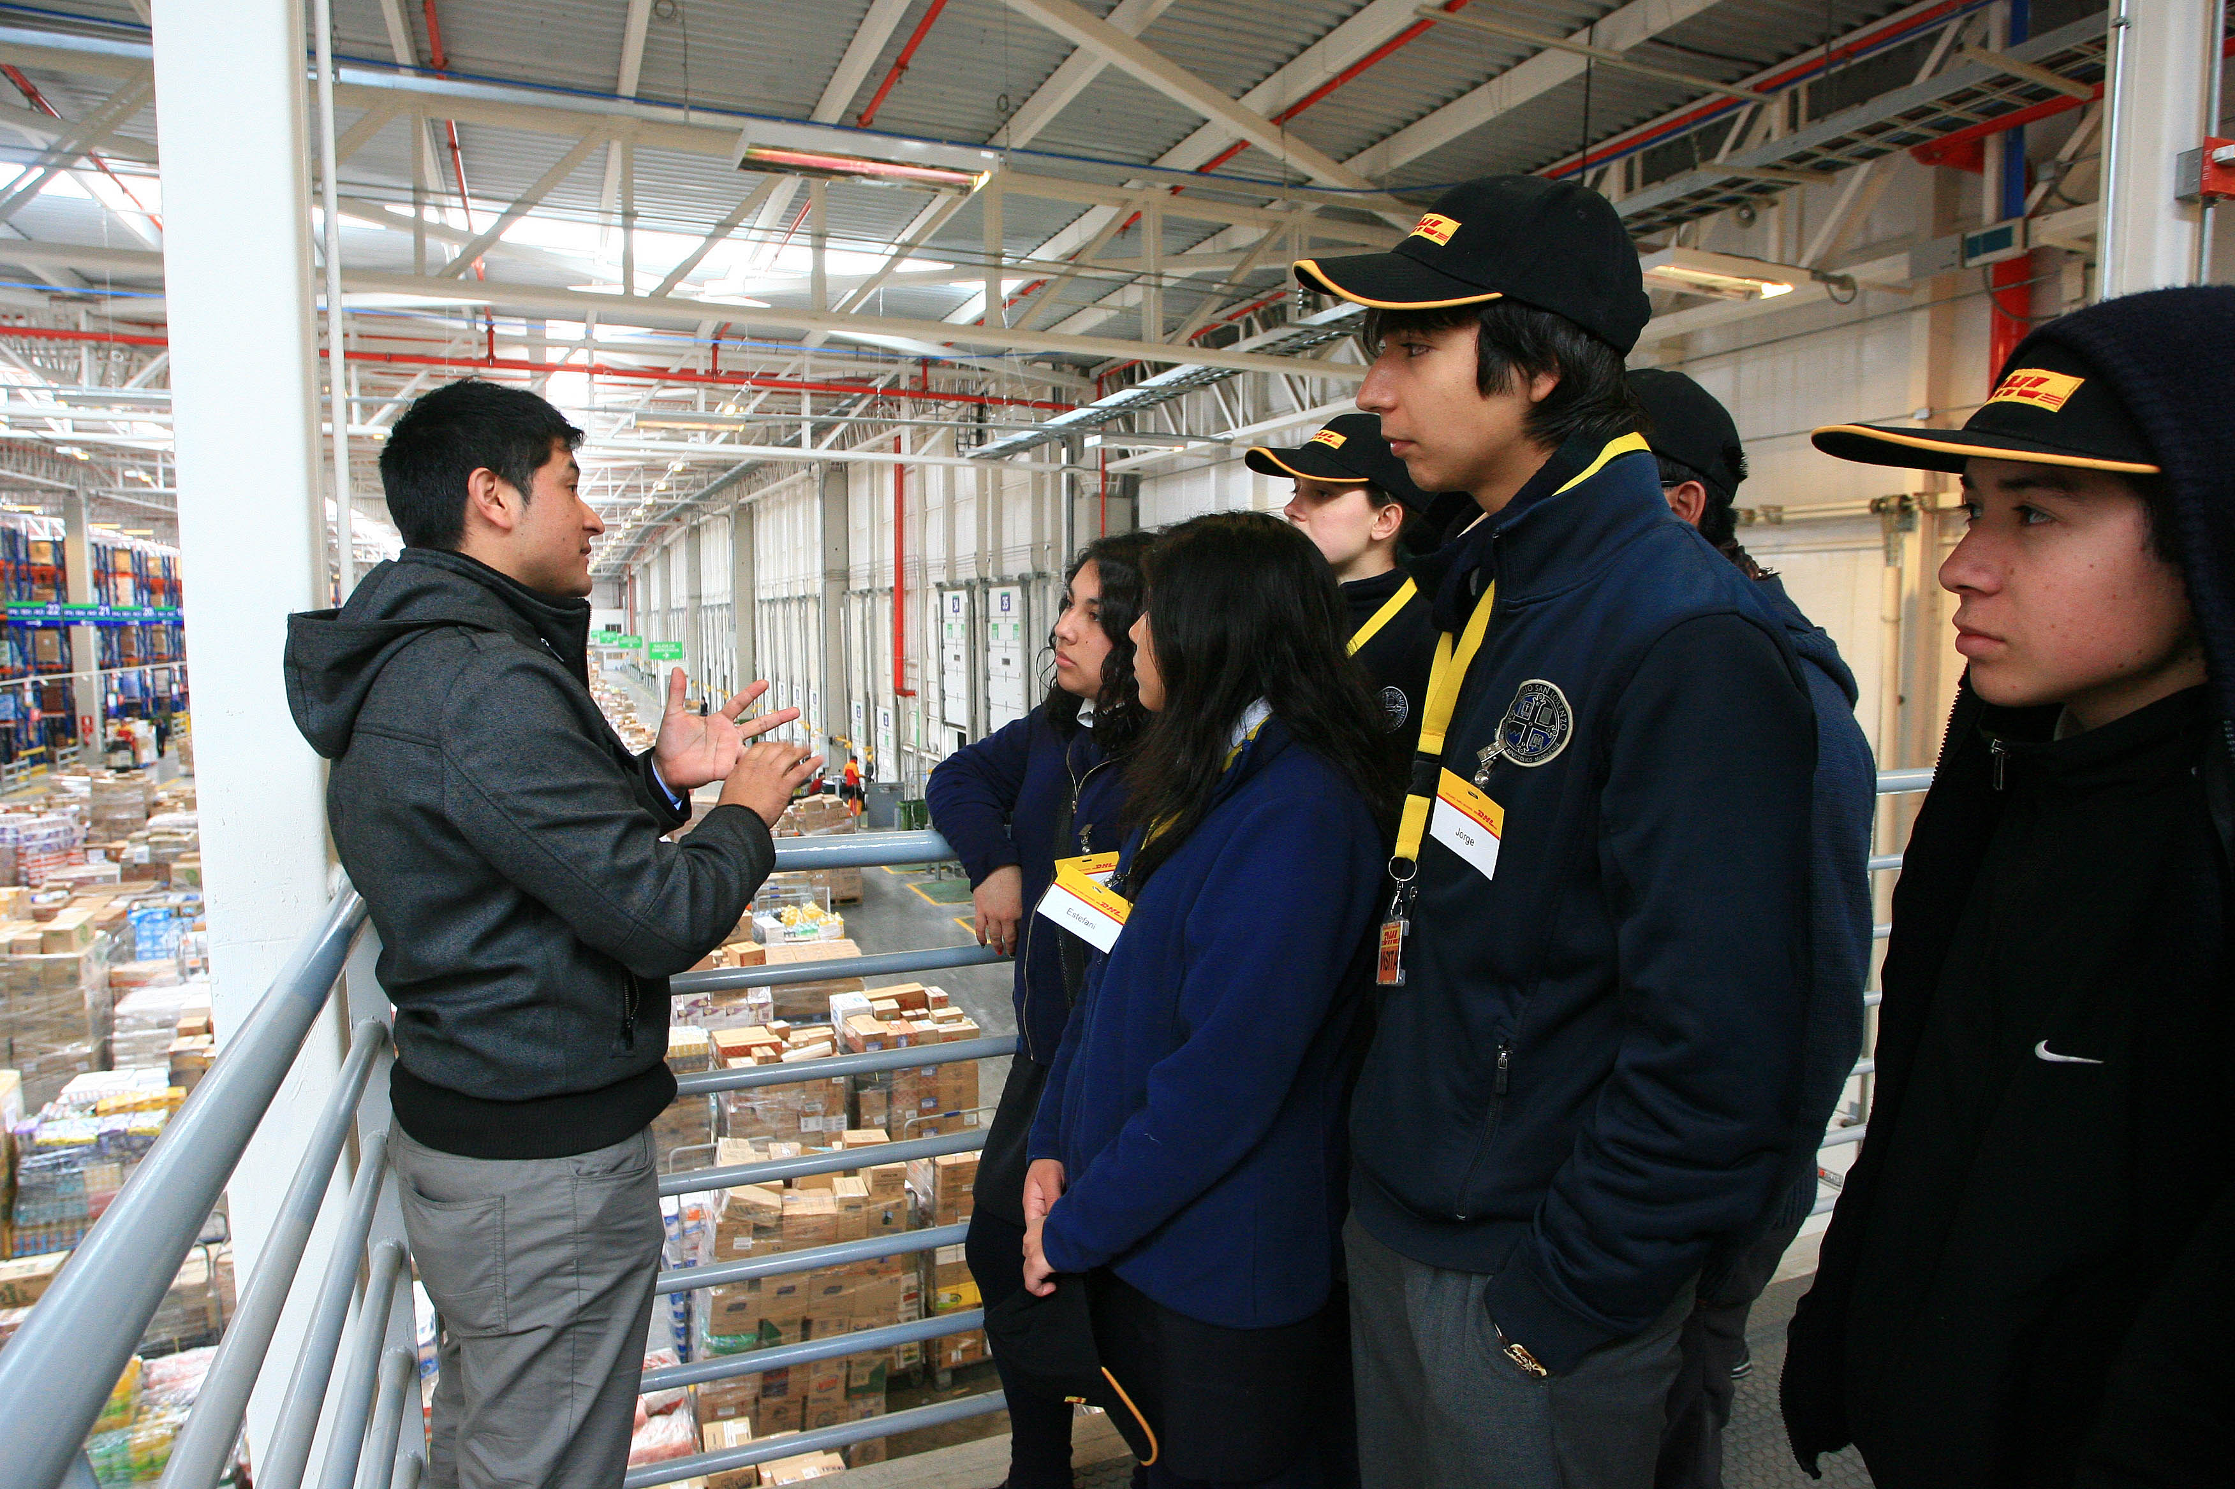
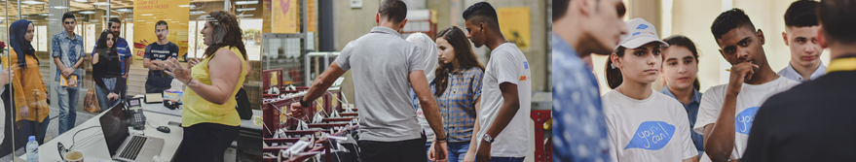
Encounters with the world of work are a powerful motivator
Research found that encounters with volunteers from the world of work make a real difference to young people
Students with four or more positive interactions with companies, such as site visits or career talks, are 78% less likely to be unemployed when they leave school and earn on average 18% more.
Source: Dr Anthony Mann Education and Employers Task Force

Slide 8




SOS and TFAll Partnerships in figures
During 2018 the program reached out to around 10,000 participants supported by 2,500 volunteers
SOS Children‘s Villages
1,500
Teach For All
1,000
Employee volunteers
Employee volunteers
15,400
4,300
Volunteer hours
Volunteer hours
3,000
118
7,900
Beneficiaries reached
Beneficiaries reached
Internships completed
305
Partnership activities
273
Global platform
Activity days

Slide 9
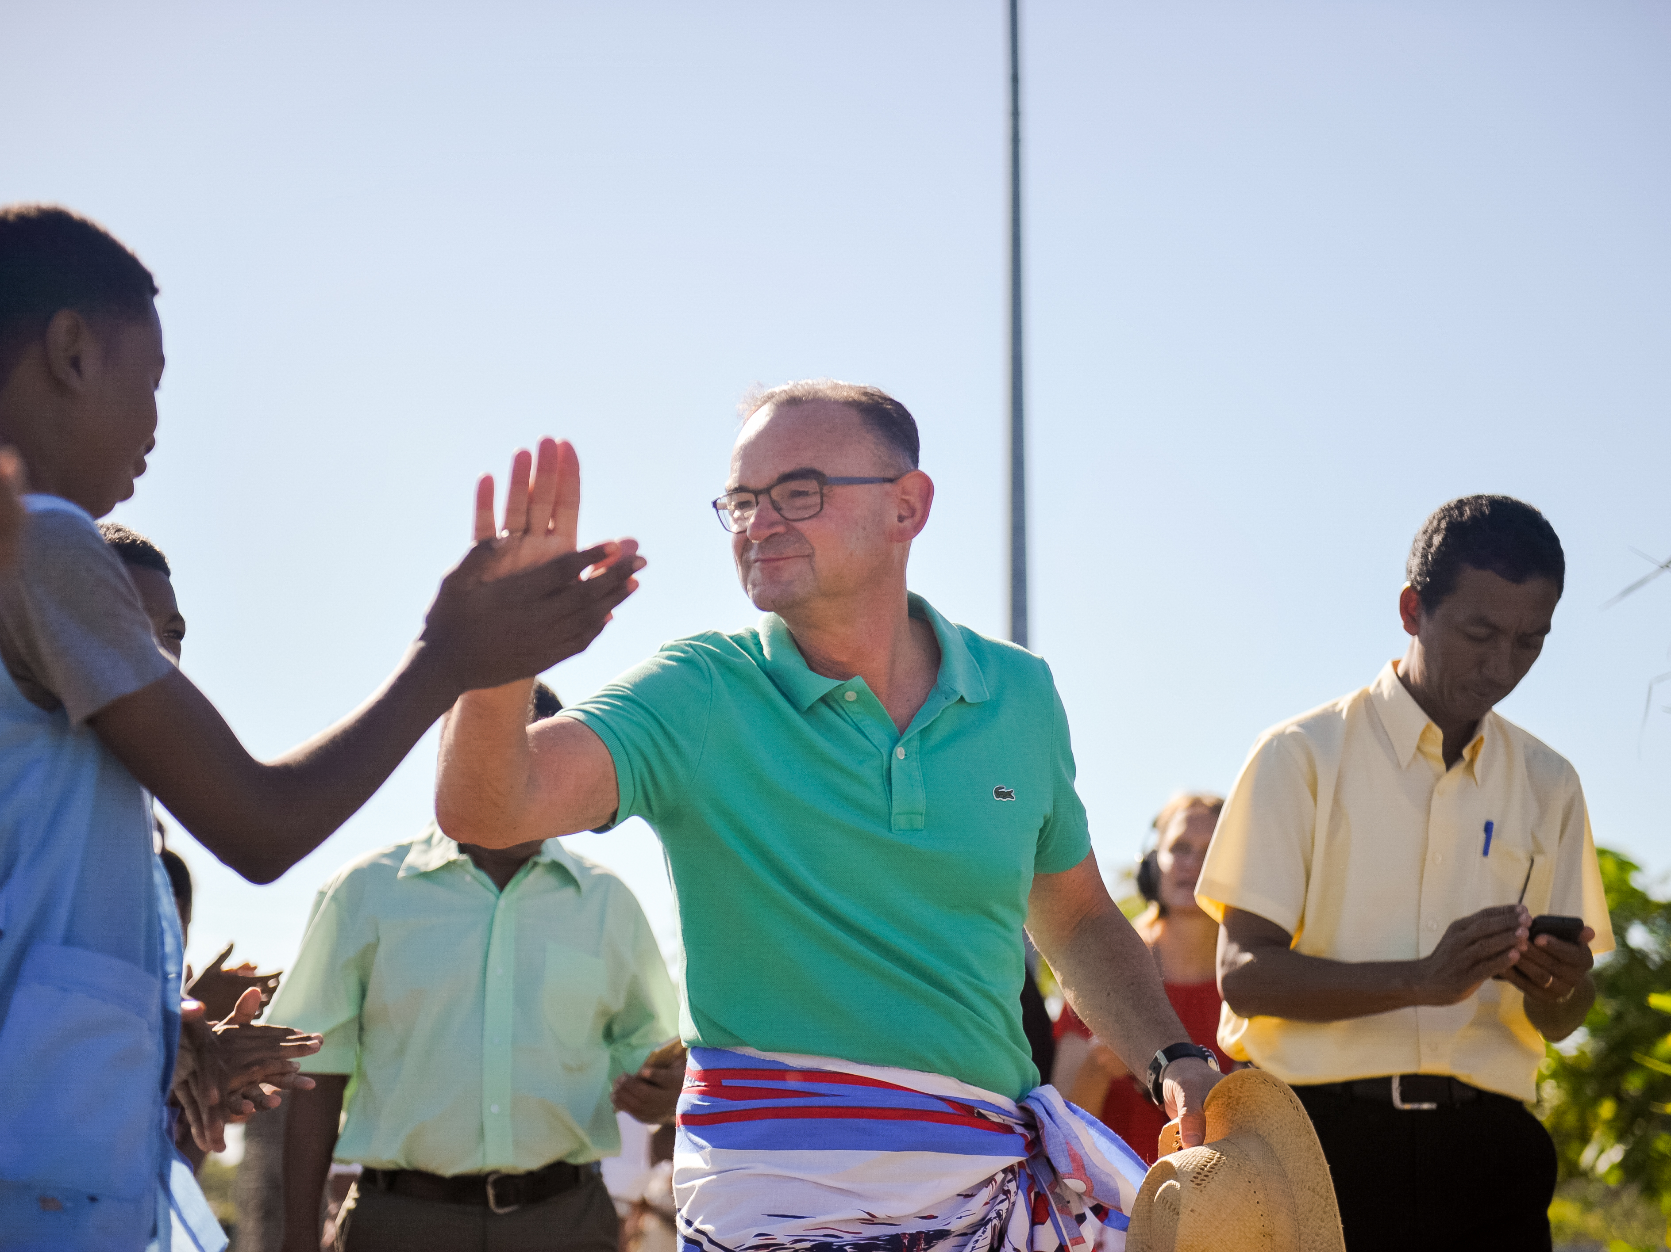
Thank you for your contribution
“Get involved. You can help us to reach more children and young people. You can start today, by joining existing activities or developing new ones.” – Ralf Dürrwang, Bonn

Slide 10
Appendix

Slide 11
Our partners
Teach For All (TFA) is a global network, currently comprising more than 50 independent, locally led and funded partners with a shared vision to develop collective leadership in classrooms and communities in order to ensure that all children can fulfill their potential.
Teach For All aims to ensure that students gain the skills, awareness, agency, and mindset they require to enter the world of work and pursue meaningful careers, to grow as civic leaders and to be in a position to shape a better future for themselves and all of us.
TFA network partners recruit and develop promising university graduates and young professionals with diverse backgrounds to commit to teach for at least two years in under-resourced schools and communities.
Through the network’s shared approach, Teach For All partners strive for both immediate and long-term impact: developing effective teachers to provide quality education and expanded opportunities for marginalized students today, and investing in their development as collaborative leaders who will continue to pursue lasting change for children, within and beyond the education sector, throughout their careers.
For more information visit: https://teachforall.org
SOS Children's Villages is the world’s largest non-governmental organization focused on supporting children and young people without parental care, or at risk of losing it. Founded in 1949 as a non-denominational organization, its presence grew to 136 countries and territories today.
The organization’s work is anchored in the UN Convention on the Rights of the Child and the UN Guidelines for the Alternative Care of Children. It operates more than 2,600 locally led programs, directly reaching more than a million children, young people and families.
Many SOS Children’s Villages are affiliated with kindergartens, schools, educational centers, medical centers or emergency relief programs, which are also available to needy children and families in the neighborhood. SOS Children’s Villages partners with donors, communities, governments and other organizations to reach the children and young people who need support, and advocates for governments to uphold their obligations with regard to children’s rights. By promoting social development, strengthening families, and ensuring education and healthcare, SOS Children’s Villages also makes a lasting contribution to positive change and growth in communities.
For more information visit: https://www.sos-childrensvillages.org

Slide 12
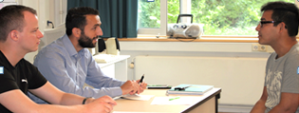


Menu of Activities (1/2)
Activity
Objective
1. Mentoring
Mentor a student, supporting them to develop the skills and attitudes needed to progress into employment, training or further education
2. CV & Interview
Session
Run a CV & Interview Skills workshop for young people – helping them to create an impactful CV and learn how to prepare for an interview
3. Site Visit
Provide an immersive and interactive site visit at a local site or office. This includes a site tour, career Q&A with DPDHL colleagues, and logistics-themed problem solving and teamwork activities.
4. Classroom
Session
Inspire students in the classroom by delivering a guest teacher lesson. As a role model, you will help the students think differently about the world of work and careers in the logistics industry.
5. Employability
Workshop
Run a workshop that supports young people to develop employability skills and helps attract more young people into Logistics.

Slide 13
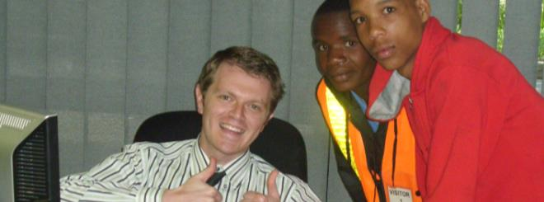
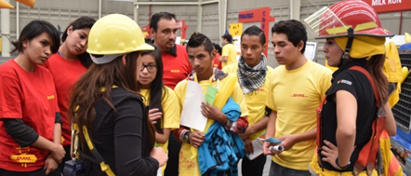

Menu of Activities (2/2)
Activity
Objective
6. Career Session
Help students develop their career plan and provide an insight into career opportunities and apprenticeships.
7. Internship
Provide a students with an opportunity to experience the working week in a real business environment, doing a job that benefits the employer and put into practice what employability skills they have already developed.
8. Job Shadowing
Young people accompany employees over a week or less to learn what it means to work in a certain area
9. Career Fair
Allow young people to obtain information about the professional work environment and provide an insight into career opportunities and apprenticeships. Stands are set up and each department the variety of professional opportunities, as well as their own work experience.
10. Entrepreneur-
ship Training
Train young people to start their own business covering areas like business plan writing, promoting their business, looking for funds etc.

Slide 14
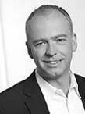
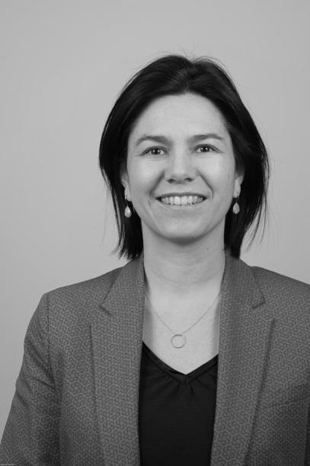

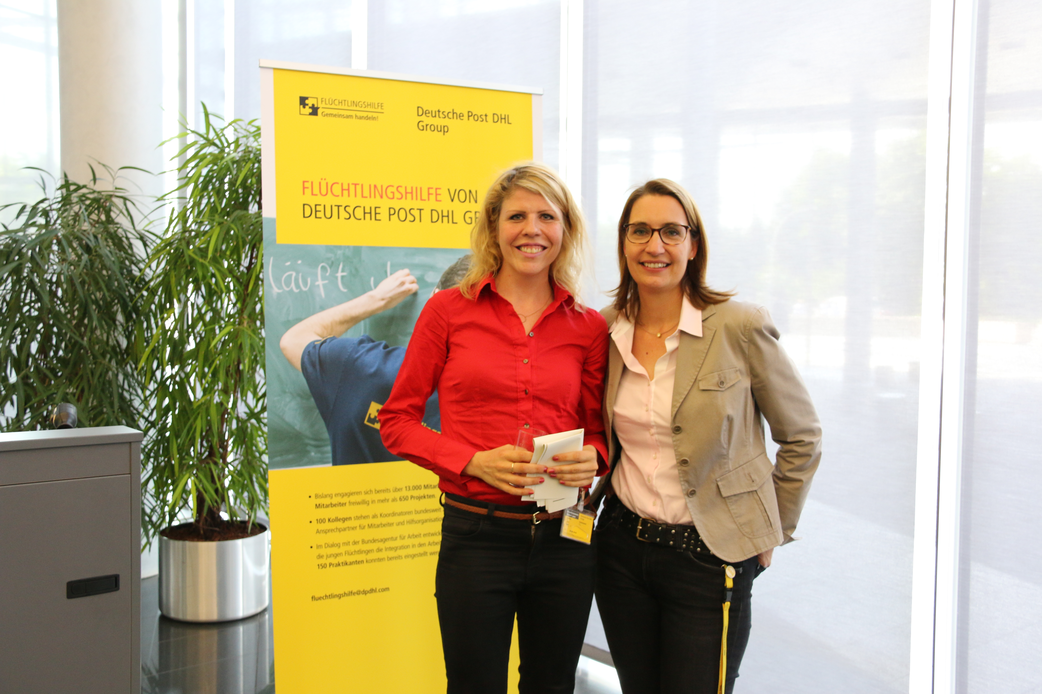



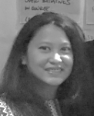



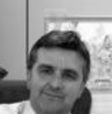


Global GoTeach Team
Christoph Selig Head of GoTeach Team/ SOS CV Program Manager
Susanne Novotny
DPDHL Group Partnership Manager
SOS CV International
GLOBAL
Annette Mock Refugee Aid programs Germany
Annette Wollmann
Teach For All Program Manager, Teach First Deutschland Coordinator
Chirlie Felix
DPDHL Group Partnership Manager
Teach For All
Andrea Colchado Olivera GoTeach Program Manager Americas
Leigh Swartz GoTeach Program Manager Sub Sahara Africa
Amanda De Silva GoTeach Program Manager Asia Pacific
REGIONAL
Faneva Raharimanantsoa GoTeach Program Manager Indian Ocean & French Africa
Najwa Raslan GoTeach Program Manager MENA
Andy Button-Stephens Senior Programme Manager Partnership with Teach First, DHL UK Foundation
César Liaño Alonso GoTeach Coordinator Spain
Alex Hislop GoTeach Coordinator Sweden / Nordics
NATIONAL

