Slide 1
THE LOGISTICS CHALLENGE
A VIEW ON THE LOGISTICS INDUSTRY - CLASSROOM

Slide 2
Explain in general terms what the logistics industry is about
Using DHL Group as an example, present the key specifics of the DHL Group divisions Express, Supply Chain and Global Forwarding as well as specifics of the DHL Group’s Environmental Focus
Prepare a pitch and present this in a professional setting

Slide 3


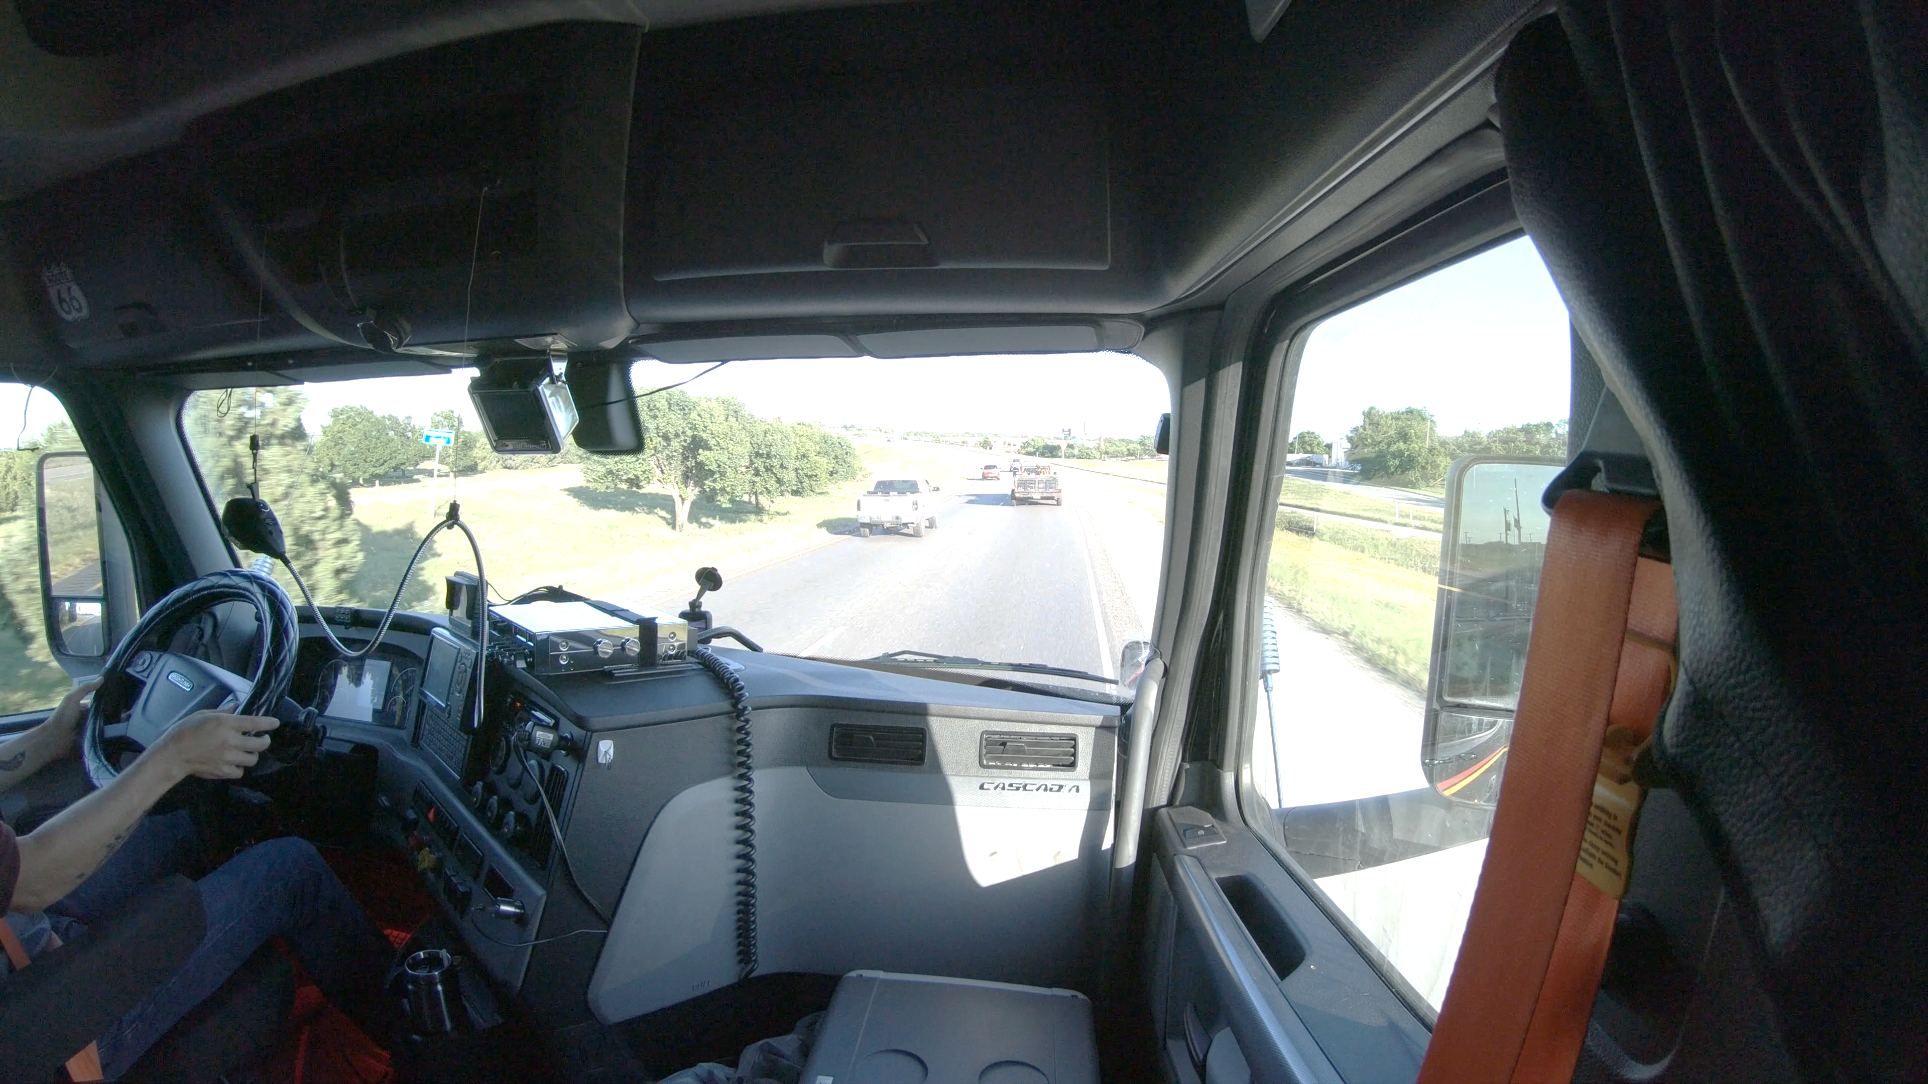
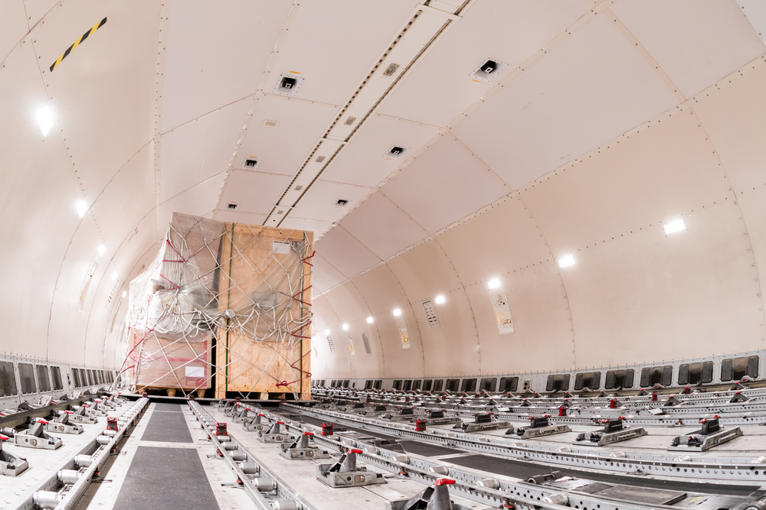
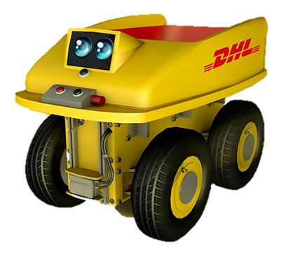
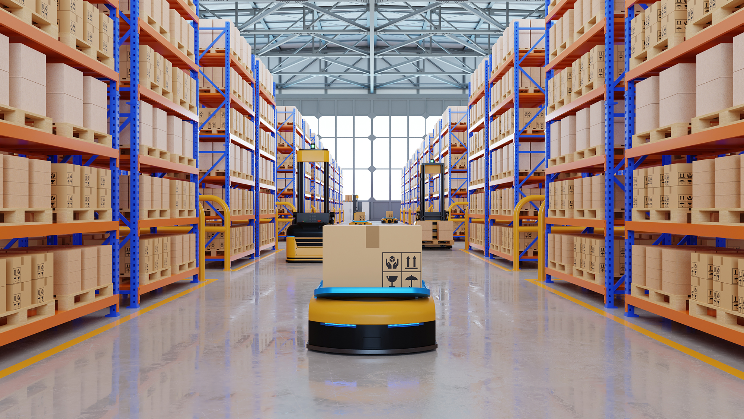

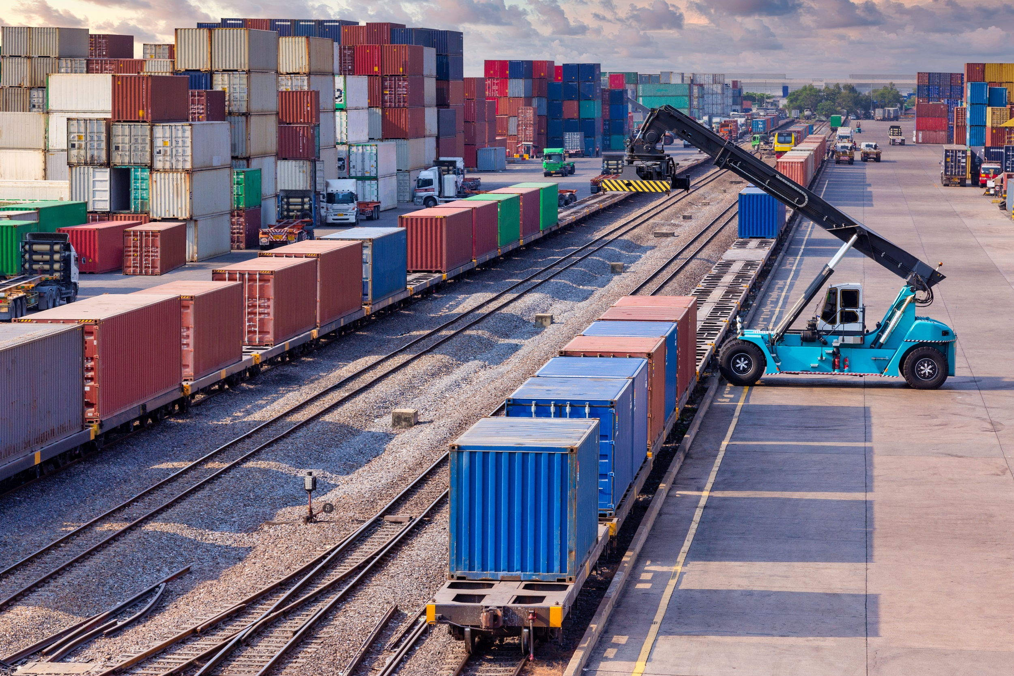

THIS IS ALL ABOUT LOGISTICS

Slide 4
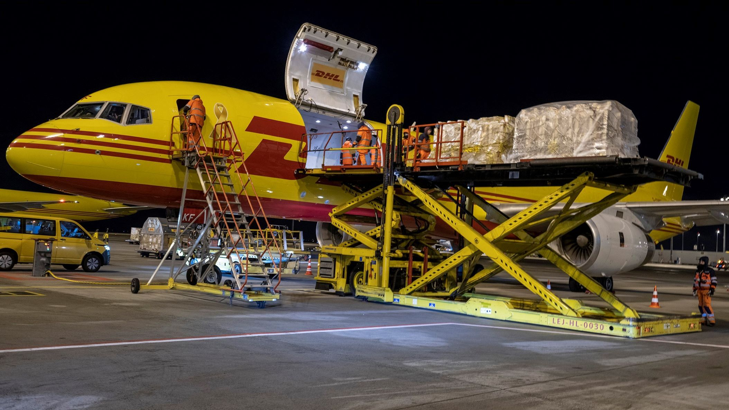

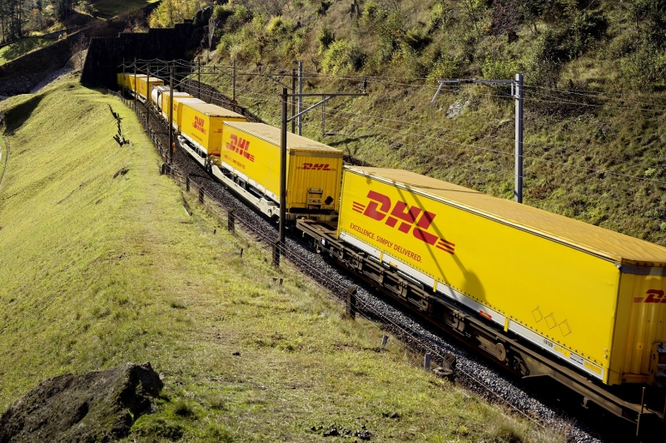
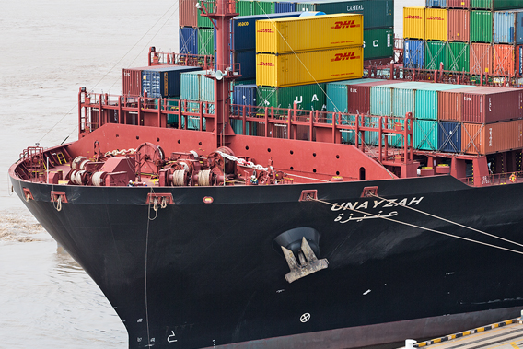
GOODS ARE MOVED BY ...
AIR
ROAD
RAIL
SEA

Slide 5



AIR TRANSPORT
Fast over long distances (short transit time)
Reliable when time is important
Frequent(daily) departures
Unsuitable for very large / heavy goods
Fairly expensive
Environmental impact

Slide 6
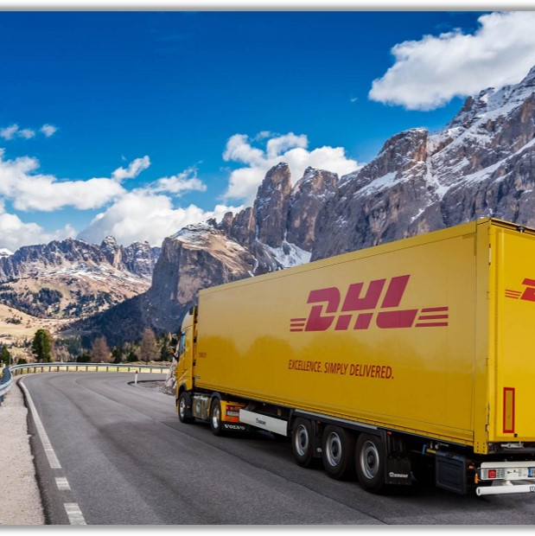
ROAD TRANSPORT
Flexible routes
Full access to the maze of road infrastructure
Door-to-door delivery is possible
Rather good price
Unsuitable for very long distances
Dependent on traffic conditions
Environmental impact and access restrictions

Slide 7

RAIL TRANSPORT
Covers long distances
Large capacity (great for high-load shipments)
Cost effective
Environmentally friendlier
Inflexible routes
No door-to-door delivery
Not ideal for small loads / shipments

Slide 8
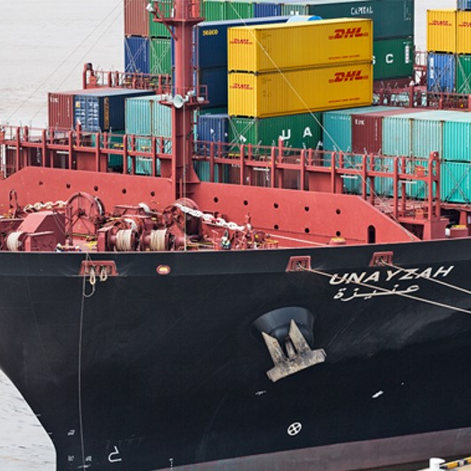
SEA TRANSPORT
Ideal for very large and heavy shipments
Rather cost effective for large amounts
Shipping containers fit on trucks
Slow delivery times
No door-to-door delivery option
Inflexible routes and timetables

Slide 9



LOGISITICS CHALLENGE - PART ONE
Working in 3 groups
Transport a product from Chongqing (China) to London (UK).
Each product has different transport requirements
Create a logistics plan
30 minutes

Slide 10
LOGISITICS CHALLENGE – MY TEAM
This handout contains everything you need to complete your logistics challenge.
Your team members are:

Slide 11
LOGISITICS CHALLENGE – GENERIC INFORMATION
First, find a name for your logistics company (who are you?).
To succeed, your group must create a logistics plan for the product you are transporting that stays within the allocated budget, timeframe and environmental impact criteria.
Your budget is 50,000 USD.
You have to transport the goods over four legs from China to the UK. On the next pages you will find information on these legs (from where to where, cost for each mode of transportation and the environmental impact)
Environmental impact:
A recent survey amongst DHL customers revealed that 94% feel the environmental impact of deliveries is extremely important to them. As a result of this, you must ensure that no more than 2 of your transport options have a high environmental impact.

Slide 12
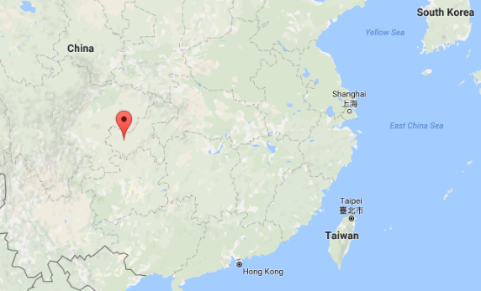
LEG 1 – CHONGQUING TO SHANGHAI
1800 kilometers
Transport options
Method | Cost | Speed | Environmental Impact
RAIL | £120 per 100 km | 2 days | Low
ROAD | £180 per 100 km | 2 days | Medium
AIR | £280 per 100 km | 5 hours | High

Slide 13
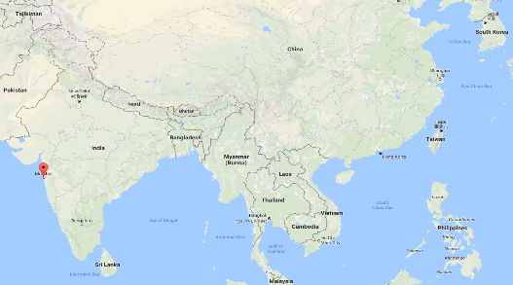
LEG 2 – SHANGHAI TO MUMBAI
5000 kilometers
Transport options
Method | Cost | Speed | Environmental Impact
RAIL | £310 per 100 km | 8 days | Medium
ROAD | £270 per 100 km | 15 days | Medium
AIR | £350 per 100 km | 12 hours | High
SEA | £140 per 100 km | 22 days | Low

Slide 14
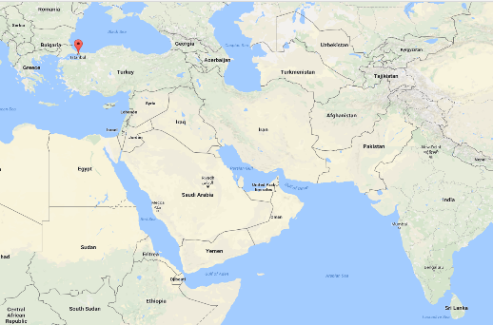
LEG 3 – MUMBAI TO INSTANBUL
4800 kilometers
Transport options
NOTE: There is political and military unrest in several countries covered in leg 3, and it is not possible to transport goods via road or rail. You must use only air or sea transport.
Method | Cost | Speed | Environmental Impact
AIR | £400 per 100 km | 8 hours | High
SEA | £170 per 100 km | 19 days | Medium

Slide 15
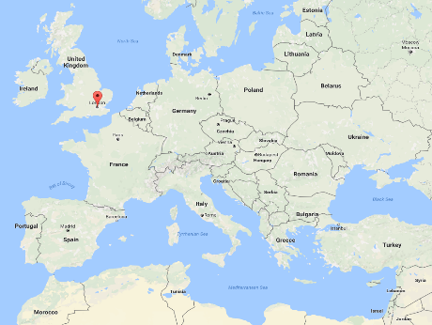
LEG 4 – ISTANBUL TO LONDON
3000 kilometers
Transport options
Method | Cost | Speed | Environmental Impact
RAIL | £300 per 100 km | 5 days | Low
ROAD | £270 per 100 km | 4 days | Medium
AIR | £340 per 100 km | 5 hours | High
SEA | £150 per 100 km | 15 days | Medium

Slide 16


LOGISITICS CHALLENGE – SPECIFIC INFORMATION
Product to transport: 600 boxes of cookies
Transport details: Can only be transported by road or rail once, otherwise they will be damaged in transit
Timeframe: Must arrive at destination within 2 weeks
CHEWY COOKIES CO
A delight with every bite
CHEWY COOKIES CO

Slide 17
LOGISTICS PLAN
LOGISTICS PLAN FOR: CHEWY COOKIES CO
 | Transport Method | Cost | Time | Environmental Impact
Leg 1
Leg 2
Leg 3
Leg 4
Total

Slide 18
YOUR NOTES ...

Slide 19

LOGISITICS CHALLENGE – SPECIFIC INFORMATION
SUPER PHARMA
In love with life
Product to transport: 200 boxes of medicine
Transport details: Can only transport by road or air, as products must be kept cool at all times
Timeframe: Must arrive at destination within 1 week

Slide 20
YOUR NOTES ...

Slide 21
LOGISTICS PLAN
LOGISTICS PLAN FOR: SUPER PHARMA
 | Transport Method | Cost | Time | Environmental Impact
Leg 1
Leg 2
Leg 3
Leg 4
Total

Slide 22

LOGISITICS CHALLENGE – SPECIFIC INFORMATION
TOP ENGINES LTD
YOUR ENGINE, OUR DRIVER
Product to transport: 5 airplane jet engines
Transport details: Extremely large and heavy, can only be transported easily by sea or rail. Add an extra £100 per 100km to any road or air transport to account for additional costs
Timeframe: Must arrive at destination within
1 months (31 days)

Slide 23
YOUR NOTES ...

Slide 24
YOUR LOGISTICS PLAN
LOGISTICS PLAN FOR: TOP ENGINES LTD
 | Transport Method | Cost | Time | Environmental Impact
Leg 1
Leg 2
Leg 3
Leg 4
Total

Slide 25
LOGISTICS CHALLENGE – PART TWO
Working in 3 groups
Your group represents a logistics company.
Find a nice (or cool) name for your logistics company
Create a sales pitch, using the guiding questions on the next page and consider: BUDGET, TIMEFRAME, ENVIRONMENT
Convince the owners that your logistics company should be considered and present your logistics plan
At least two, preferably three, people to present
25 minutes to create your pitch, 5 minutes presentation per group, 5 minutes feedback

Slide 26
GUIDING QUESTIONS
Introduce your company. What is your logistics company name?
What is your company all about ... briefly?
Why are you the best in the logistics business? What are your unique selling points?
What does your logistics plan look like considering: budget, timeframe, environment?
Who will present your pitch (2 or 3 people)?

Slide 27
YOUR NOTES ...
Our logistics company is called:

Slide 28
YOUR NOTES ...

Slide 29
Top tips for a great pitch
Know your objective: what do you want to achieve?
A proper introduction with your company’s summary
What are your company’s unique selling points?
Build a logical story
Watch the clock and stick to your core messages:
less is more!

Slide 30
YOUR ADDITIONAL NOTES

Slide 31
YOUR ADDITIONAL NOTES

Slide 32
MY KEY TAKEAWAYS ...
1
2
3

Slide 33
Disclaimer:
The material contains images from Shutterstock. These images cannot be used in any other materials by anyone without applicable Shutterstock licensing.
Some of the icons used in this material originate from Flaticon.

