Slide 1
CAREER TALKS
YOUR TRAITS AND SKILLS FOR CAREER
DEVELOPMENT - CLASSROOM

Slide 2
Explain in a broader context, the key requirements and elements for successful career development
Explain the difference between Personality Traits and Transferable Skills and how these are important for specific job roles and career development
Reflect on future career opportunities and the areas that require focus for building a career in a specific direction

Slide 3
Session introduction:
Teaser and Guest Speaker
Your career:
Logistics activity
Duration
03:00 hours
1
3
2
Wrap up
4
Your career: personality traits & transferable skills

Slide 4




GROUNDRULES
?!

Slide 6
INTRODUCING YOURSELVES

Slide 7

INTRODUCING YOURSELVES
Everybody to form a circle and work in pairs
In pairs, interview the person next to you and find out:
The name
Where do you come from?
Likes and dislikes
What do you strive for in life … and why?
You have 5 minutes and then ... 30 seconds to introduce your fellow student (so manage your time well ☺)

Slide 8
INTRODUCING YOURSELVES
Work in teams of 5 or 6
In pairs, interview the person next to you and find out:
Get to know each other (who are you?)
Find a cool name for your team
The people in this team strive for …………. and why(?!)
You have 10 minutes and then ... 2 minutes to introduce your team (so manage your time well ☺)

Slide 10
My future career should bring me ...

Slide 11

My future career should bring me ...
Individual activity
According to you, what would a successful career look like?
Indicate in the spiderweb diagram
NOTE: Not all items should be rated equally important
3 minutes

Slide 12

My future career should bring me ...
Other...
10
8
6
4
Growth opportunities
2
Happiness
Great
job content
Good money

Slide 13
YOUR CAREER

Slide 14
COMFORT BREAK
Let’s take a short comfort break 15 minutes and then we will resume

Slide 15
CAREER & CAREER DEVELOPMENT
What would be some of the requirements that can help your career and your career development?

Slide 16
CAREER DEVELOPMENT: TOP TIPS
Identify your talents
Embrace your strengths and weaknesses
Turn around- your ‘Yeah ... but’ thoughts
Identify development needs for skills and personality
Map out your career development plan
Own your career development
Remain open to change

Slide 17



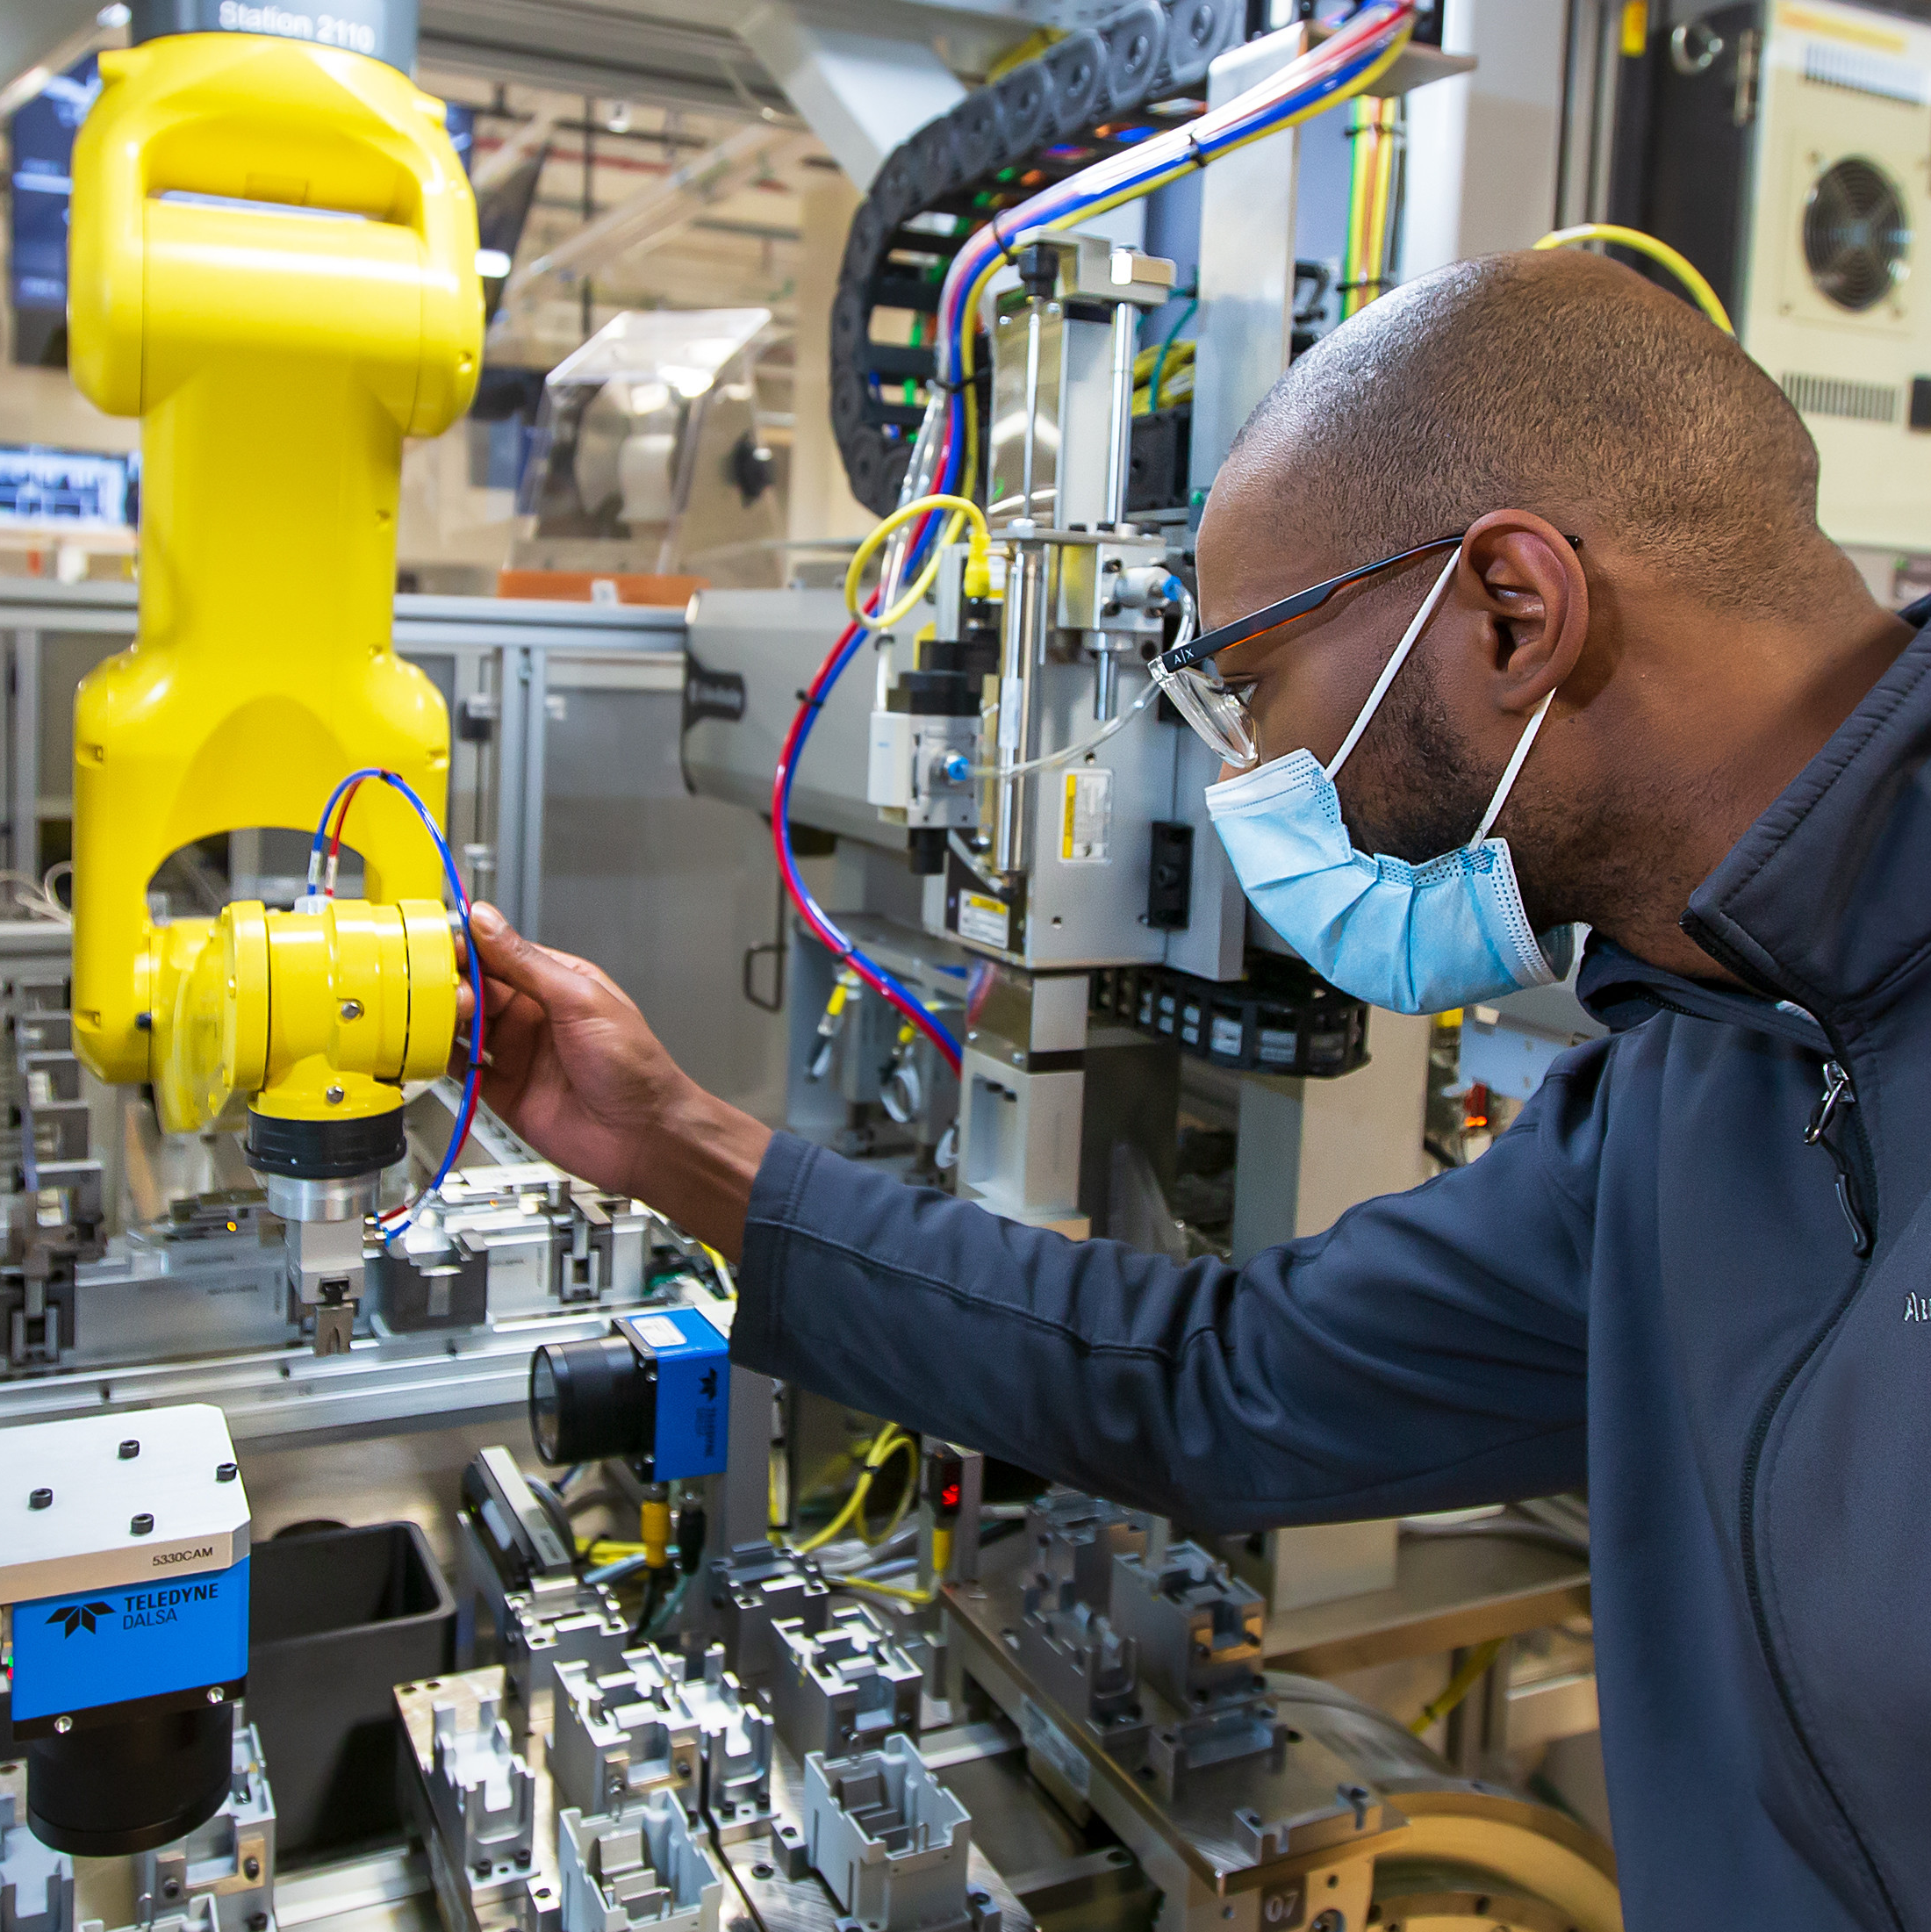





FOR YOUR INSPIRATION - INDUSTRIES TO PURSUE A CAREER
Logistics
Pharmaceutical
Agriculture
Manufacturing
Hospitality
Technology & IT
Education
Finance
Healthcare

Slide 18


PERSONALITY TRAITS & TRANSFERABLE SKILLS
Who knows what these are? Any ideas are welcome.
Personality traits relate to your character as a person: how you are, and the attitude related to it.
Transferable skills are learnt abilities that can help you at work or in life, so in a variety of situations.

Slide 19


PERSONALITY TRAITS - EXAMPLES
Positive
Negative
Helpful
Optimistic
Arrogant
Honest
Friendly
Lazy
Disrespectful
Responsible
Impatient
Reckless

Slide 20


TRANSFERABLE SKILLS - EXAMPLES
Flexibility
Teamwork
Problem
solving
Critical thinking
Communi-cation
Adaptability
Attention to detail

Slide 21
AN EXAMPLE
Finding a job role that matches your personality is only part of the equation. You also need to find a role that matches your skillset.

Slide 22
THE RELEVANCE
So ... Why is it important to know about your Personality Traits and Transferable Skills?

Slide 24
YOUR CAREER – LOGISTICS ACTIVITY

Slide 25
LOGISTICS INDUSTRY AS AN EXAMPLE
When you think of the word 'Logistics', what thoughts or words come to mind?

Slide 26

LOGISTICS ... BUZZ WORDS
PLAINS, TRAINS AND AUTOMOBILES
SEA TRANSPORT
AIR TRANSPORT
DPDHL
CARGO
FROM HERE TO THERE (A TO B)
TRANSPORT
ROAD TRANSPORT
DRIVERS

Slide 27
Logistics fun facts

Slide 28


LOGISTICS FUN FACT - 1
If you joined together all the sausages that the logistics industry delivers in one year, they’d reach beyond the moon.
TRUE
FALSE

Slide 29

LOGISTICS FUN FACT - 2
If you laid all of the railway tracks in the USA end to end, they would reach the whole way around the Earth.
TRUE
FALSE

Slide 30

LOGISTICS FUN FACT - 3
The World’s largest cargo ship could carry the Eiffel Tower.
TRUE
FALSE

Slide 31

LOGISTICS FUN FACT - 4
In 2014 Logistics company DHL Express transported two VIPs from China to Brussels: Hao Hao and Xing Hui..
TRUE
FALSE

Slide 32
A QUICK QUESTION ...
Who has ever heard of DHL and if you heard of it, is there anything you can tell us about it?

Slide 33









ANY COMMONALITIES?
Sports
Logistics
Fashion
Movies
Music
Disaster
Logistics
Sports

Slide 34







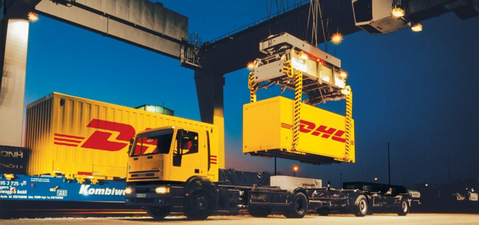

WE ARE EVERYWERE!
Sports
Logistics
Fashion
Movies
Music
Disaster Response Team
Logistics
Sports

Slide 35
A career in logistics

Slide 36
A CAREER IN LOGISTICS
Working in groups of 4
In your group, for your assigned job role, define:
What transferable skills and personality traits would be required? (TOP 3 of each)
How do you think these add to success?
10 to 15 minutes

Slide 38
WRAP UP

Slide 39
Explain in a broader context, the key requirements and elements for successful career development
Reflect on future career opportunities and the areas that require focus for building a career in a specific direction
Explain the difference between Personality Traits and Transferable Skills and how these are important for specific job roles and career development

Slide 41
QUESTION 1
What would be a good way to learn about and close any existing gaps in your traits and skills?
A
Keep doing what you always did as so far this seemed to work effectively
B
Observe other people critically and do as they do, copying their behavior
C
Remain open to feedback and make changes where necessary

Slide 42
QUESTION 2
Which of the following would be considered good for career development?
A
Remain open to change, identify your talents and embrace your strengths but also your weaknesses
B
Avoid taking risk, think short term and wait for opportunities to present themselves
C
Be critical using ‘yeah … but’ thoughts and ensure you only develop in the areas you know you’re good at

Slide 43
QUESTION 3
How would you define a personality trait?
A personality trait ...
A
… relates to learnt abilities that can help you at work or in life in various situations
B
… relates to how you deal with other people in different circumstances
C
… relates to your character: how you are, and the behavior related to it

Slide 44
QUESTION 4
What are some good examples of transferable skills?
A
Arrogance, Impatience, Laziness, Disrespect
B
Teamwork, Flexibility, Critical Thinking, Adaptability
C
Optimism, Honesty, Responsibility, Helpfulness

Slide 45
QUESTION 5
In relation to career development, why would it be important to know about your personality traits and transferable skills?
A
When applying for a job, that is what potential employers want to know about: what do you bring to their business!
B
Knowing about this, you will also know that you are on the right track and no change is needed
C
If you know about these, you can use that against other people, which is in your advantage

Slide 46
ONE WORD ... ONE SENTENCE
What is the one word that summarizes today's workshop for you and how would you explain that word in one sentence?

Slide 47
Get your career going

Slide 48
Disclaimer:
The material contains images from Shutterstock. These images cannot be used in any other materials by anyone without applicable Shutterstock licensing.
Some of the icons used in this material originate from Flaticon.

